Slide 1



CLASS : NURSERY
DATE 03/08/21
SUBJECT : ENGLISH
SUBJECT : ENGLISH
TOPIC BK PG NO-89(LETTER-Z)
SUB-TOPIC- -ACTIVITY IN NOTE BK

Slide 2







Identify the given letter and tell one word related to the letter

Slide 3
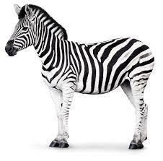




Identify the given picture

Slide 4


Identification of letter Z

Slide 5
PICTURE RELATED TO LETTER -Z

Slide 6
ACTIVITY IN NOTE BK
CW
03/08/21
Paste the picture related to the given letter
C
E
A
D
Notes:
03/08/21

Slide 7

03/08/21
ASSIGNMENT
1 .Practice phonic song sound of letter -Z
2. Complete the work given in note bk
Notes:
.3’

Slide 8
THANKING YOU
ODM EDUCATIONAL GROUP

