Slide 1



CLASS : NURSERY
DATE -03/01/22
SUBJECT : ENGLISH
SUBJECT : ENGLISH
TOPIC - BK PG NO-12,13
SUB-TOPIC- LETTER-B – IN BK

Slide 2

Identification of letter Q

Slide 3

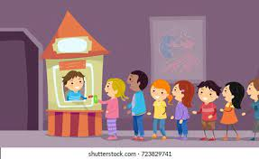

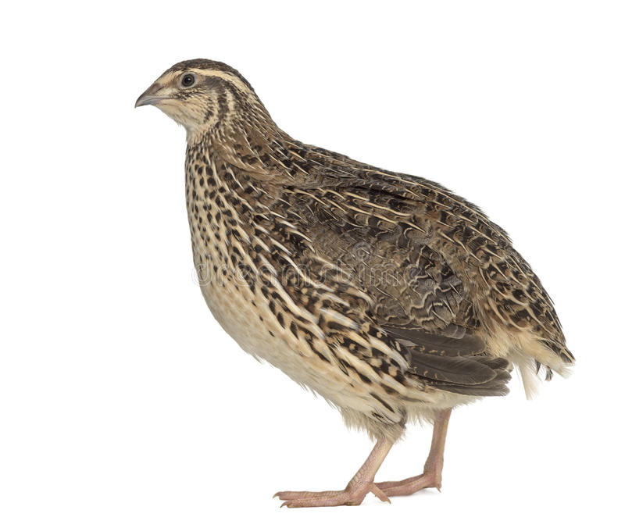

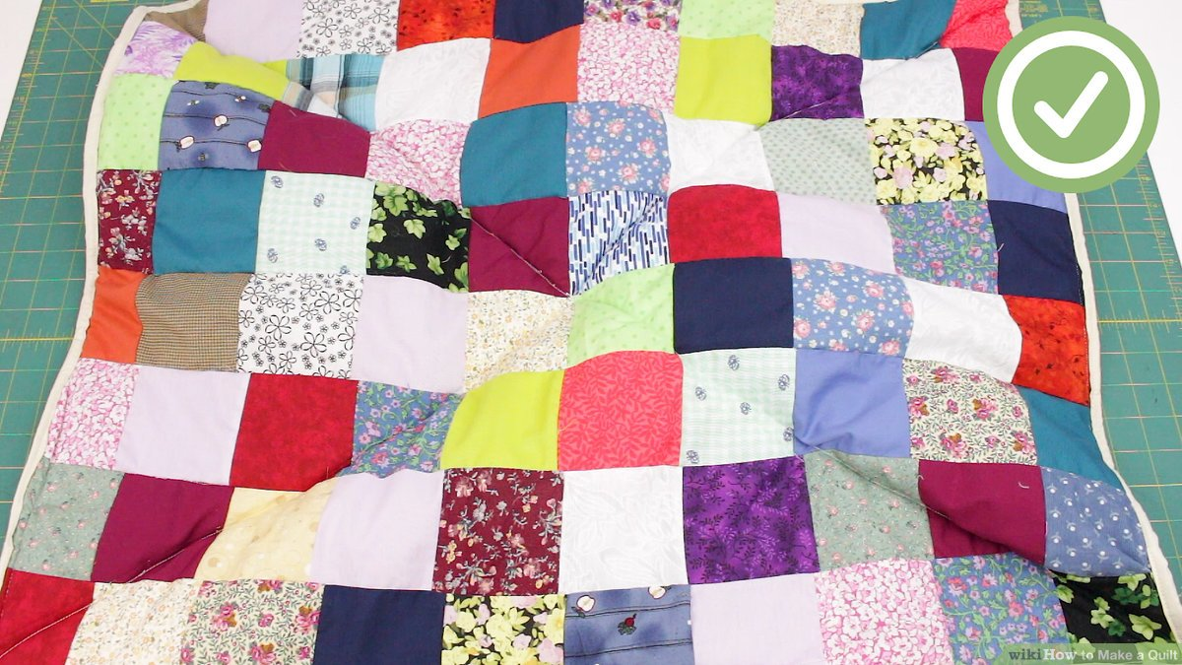
Picture related to letter Q
CW
03/01/22
QUEUE
QUEEN
QUILL
QUILT
QUAIL
QUIET

Slide 4



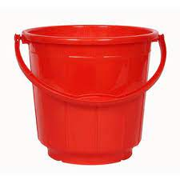
Identify and tell the name of the given object

Slide 5


Identification of letter B

Slide 6


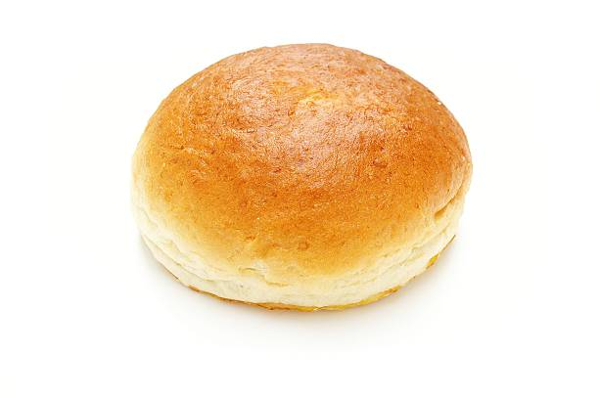
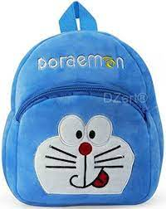


Picture related to letter B
BEE
BANANA
BUN
BALL
BAG
BAT

Slide 7
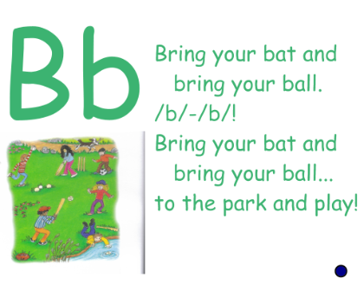
Phonic song on letter B

Slide 8

HI children

Slide 9
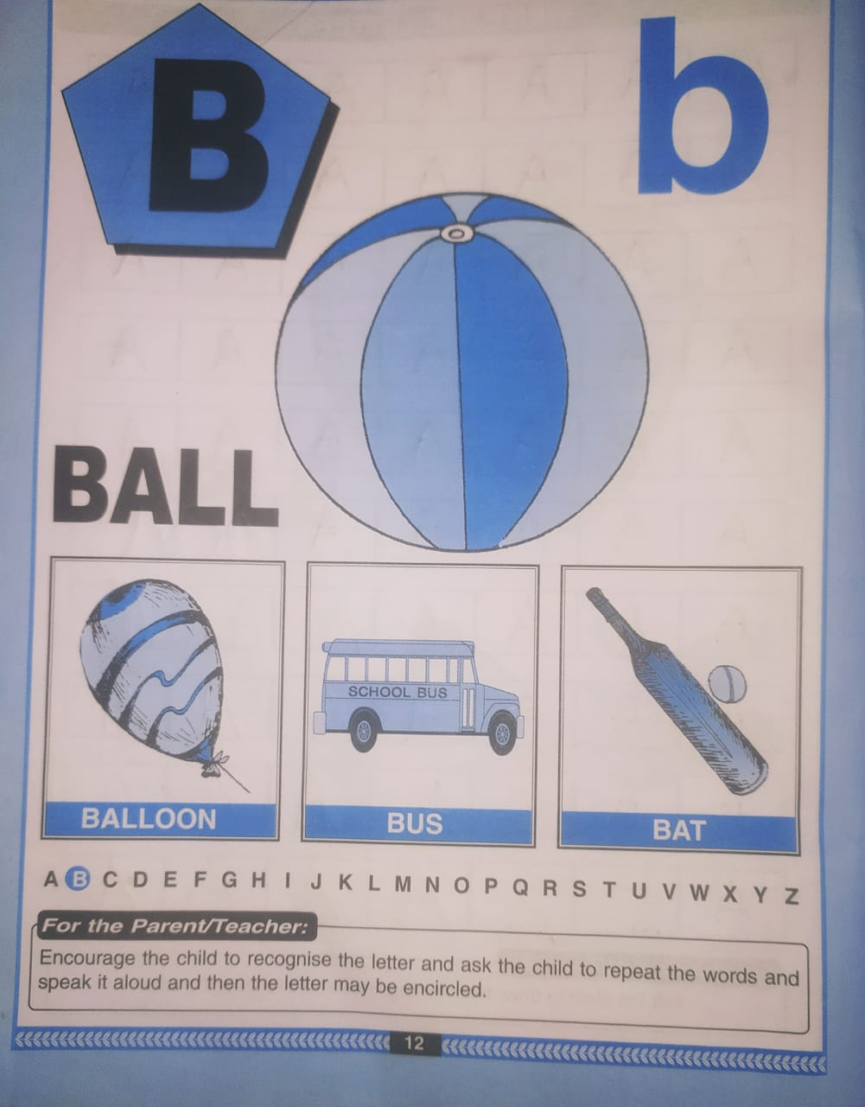
CW
03/01/22

Slide 10
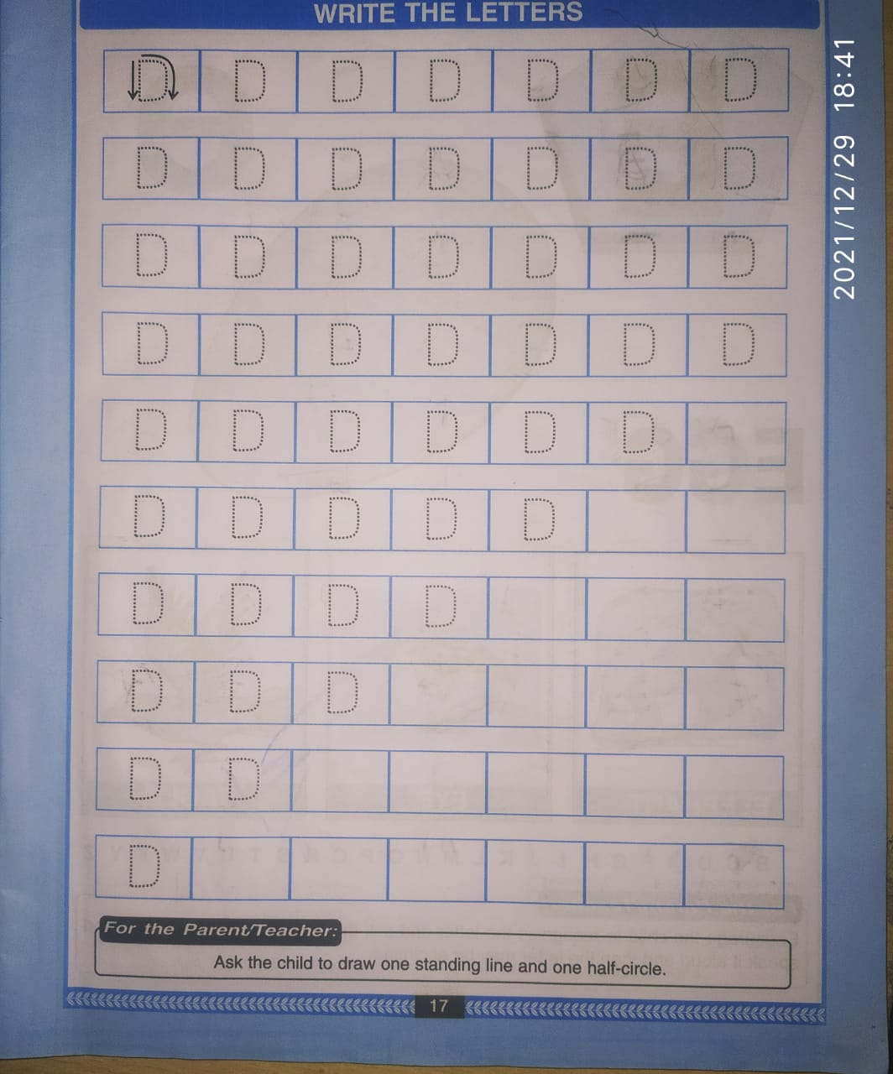
Say Trace And Write Letter B(BK PG NO-17
CW
03/01/22

Slide 11
ACTIVITY
HW
03/01/22
Identify and encircle letter B from the given words.
BAT CUB BUTTER TUB
JOB BARBER CRAB BOY
VERB SOB BALL TABLE

Slide 12


03/01/22
ASSIGNMENT
1 .Practice phonic song of letter -B
.2.Complete the work given in nt bk
Notes:
.COMPLETE BK PG NO-38

Slide 13
THANKING YOU
ODM EDUCATIONAL GROUP

