Slide 1



CLASS : NURSERY
DATE -2/12/21
SUBJECT : ENGLISH
SUBJECT : ENGLISH
TOPIC - BK PG NO-29,30
SUB-TOPIC- LETTER-G IN NTBK

Slide 2


letter G

Slide 3
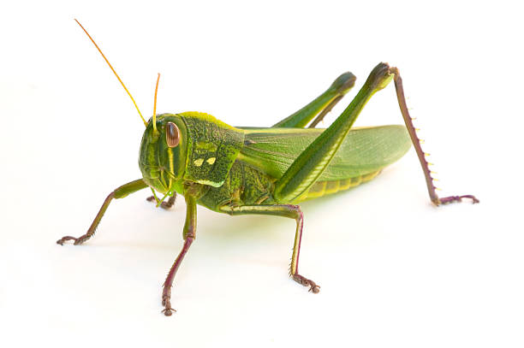
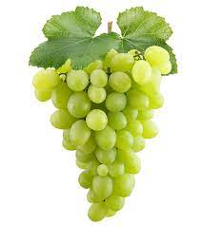
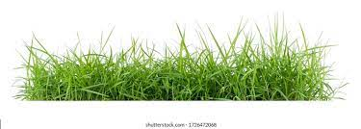

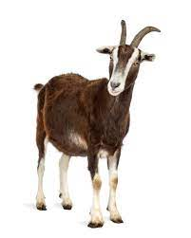
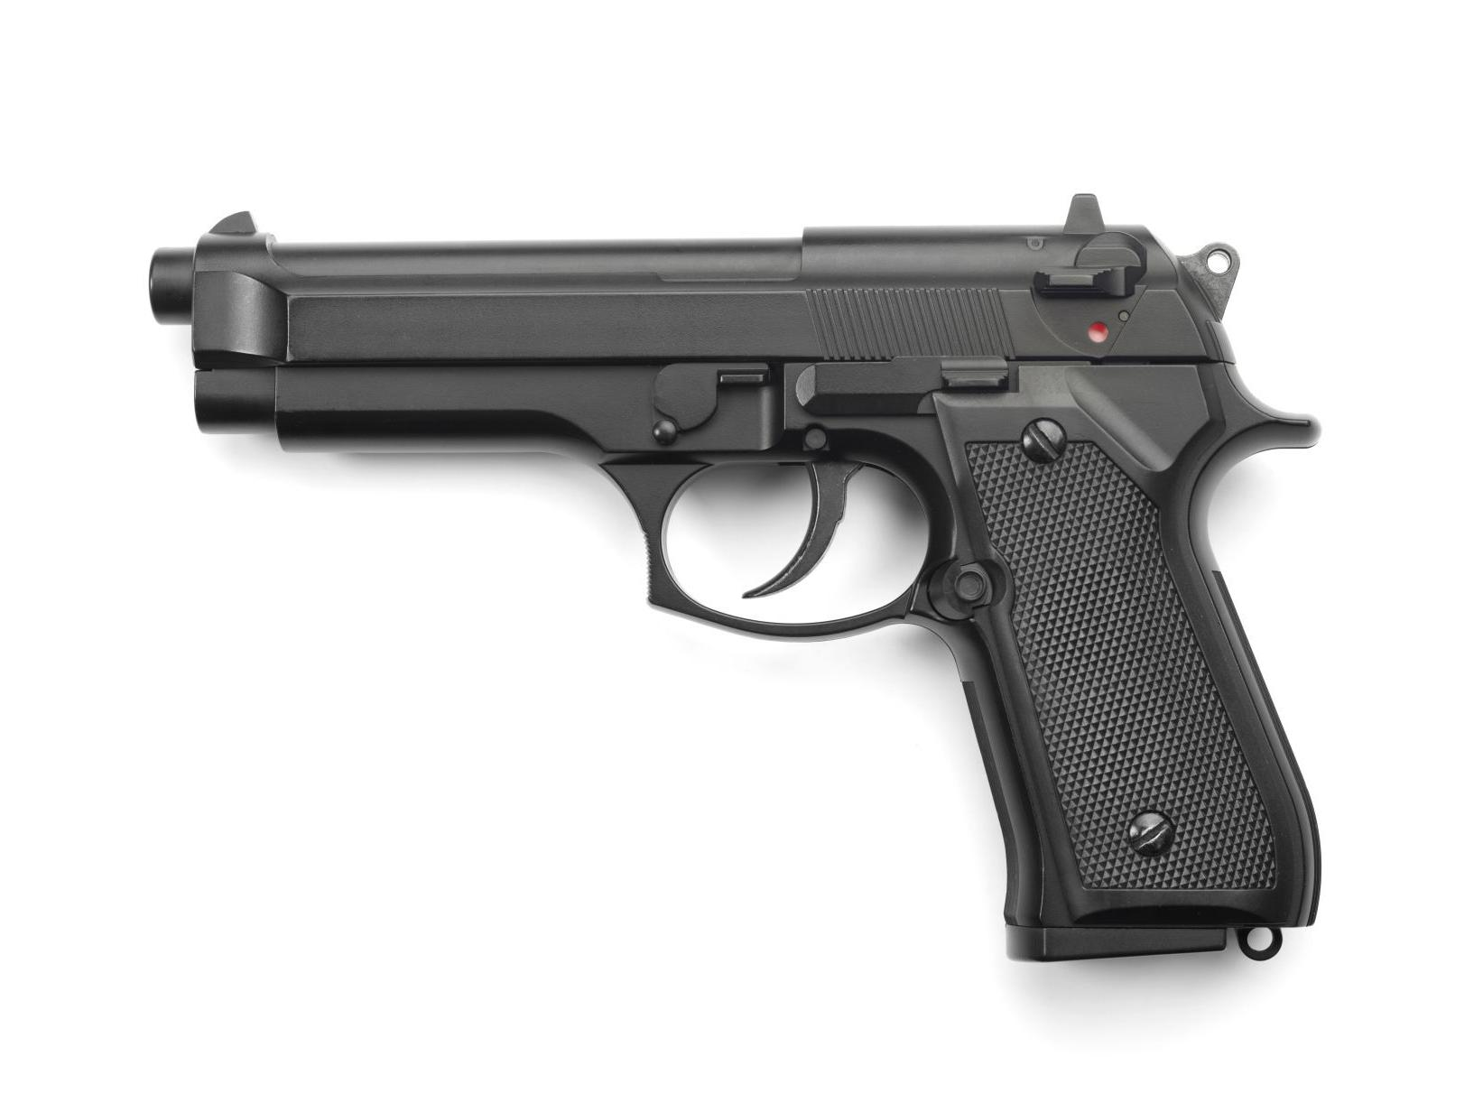
Picture related to letter G
GRASS
GRASS HOPPER
GRAPES
GOAT
GIRL
GUN

Slide 4
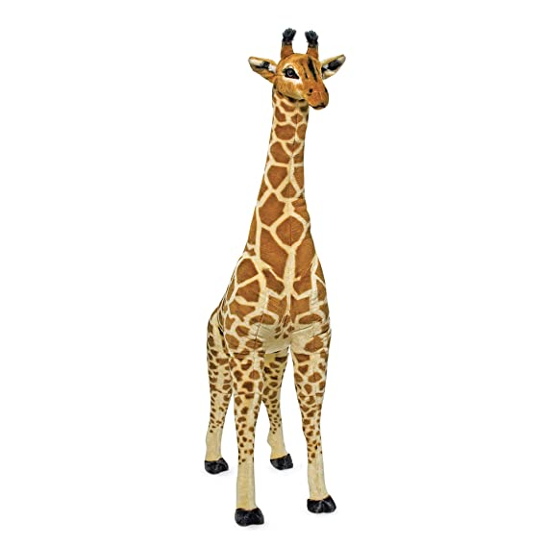
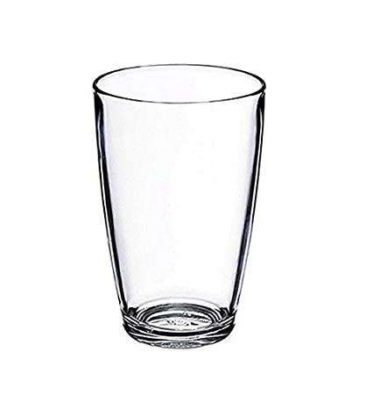
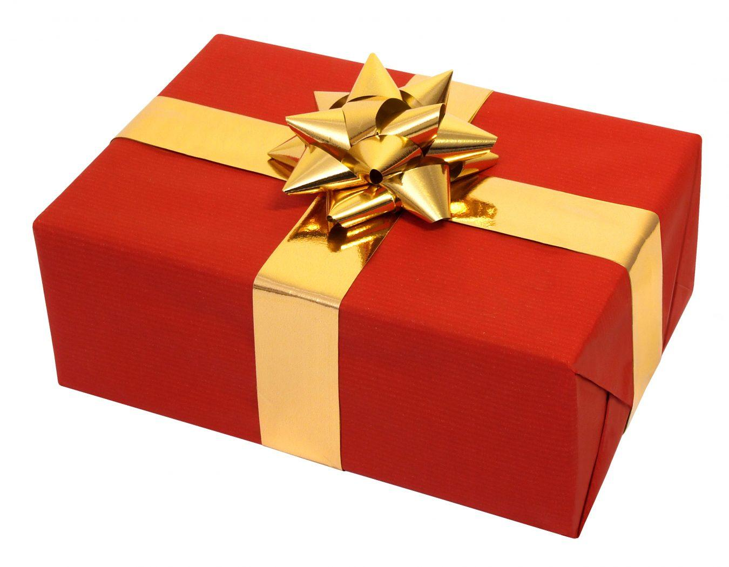
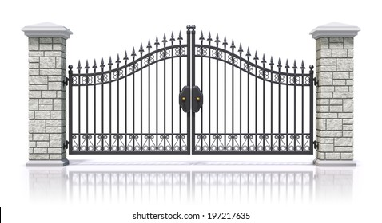
GIFT
GLASS
GIRAFFE
GATE

Slide 5

HI children

Slide 6

Hi children let‘s write in bk
IN NT BK LETTER G
Notes:
Hi children let‘s write in a book

Slide 7
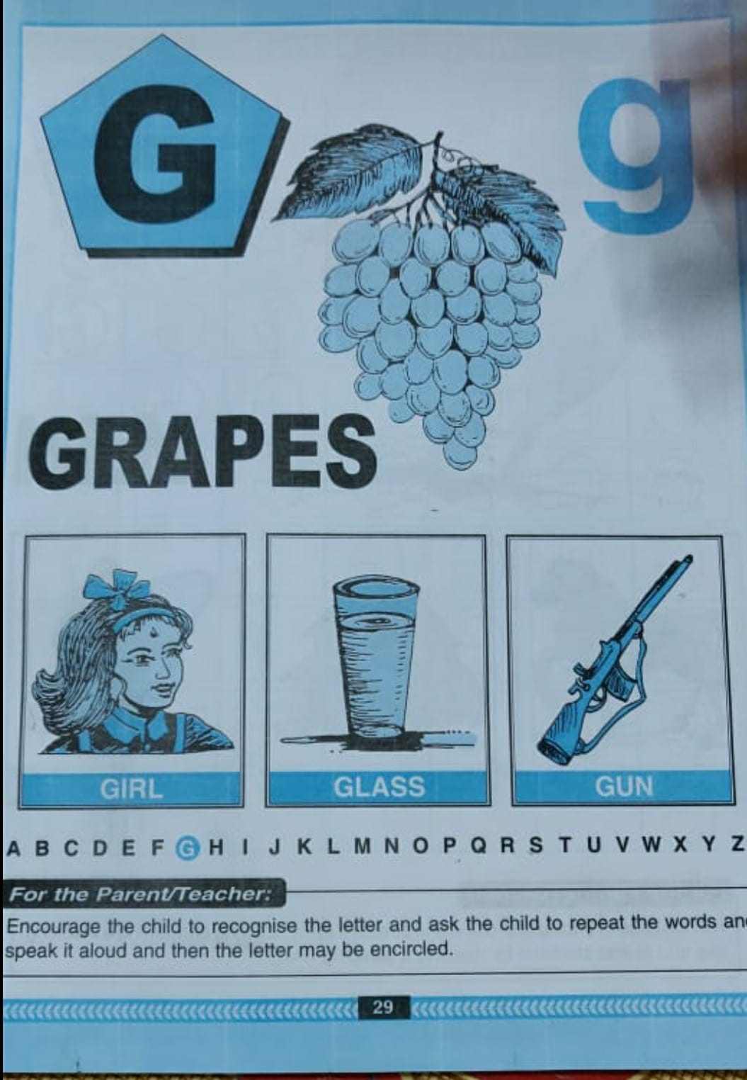
BK PG NO-29(Reading)
CW
2/12/21

Slide 8


G STANDS FOR GRAPES
CW
2/12/21

Slide 9

SAY AND WRITE
CW
2/12/21

Slide 10
SAY AND WRITE LETTER -G
HW

Slide 11


2/12/21
ASSIGNMENT
1 .Practice phonic song of letter -G
.2.Complete the work given in nt bk
Notes:
.COMPLETE BK PG NO-38

Slide 12
THANKING YOU
ODM EDUCATIONAL GROUP

