Slide 1



CLASS : NURSERY
DATE : 02.09.2021
SUBJECT : ENGLISH
TOPIC- : ACTIVITY
SUB-TOPIC:ACTIVITY (In nt bk)

Slide 2
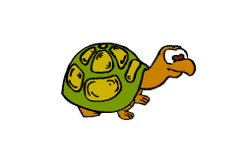
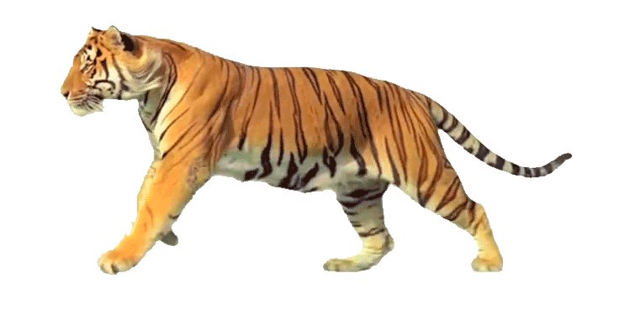

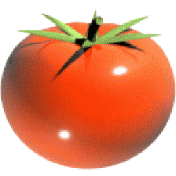
Identify the given pictures

Slide 3


Identification of letter T

Slide 4
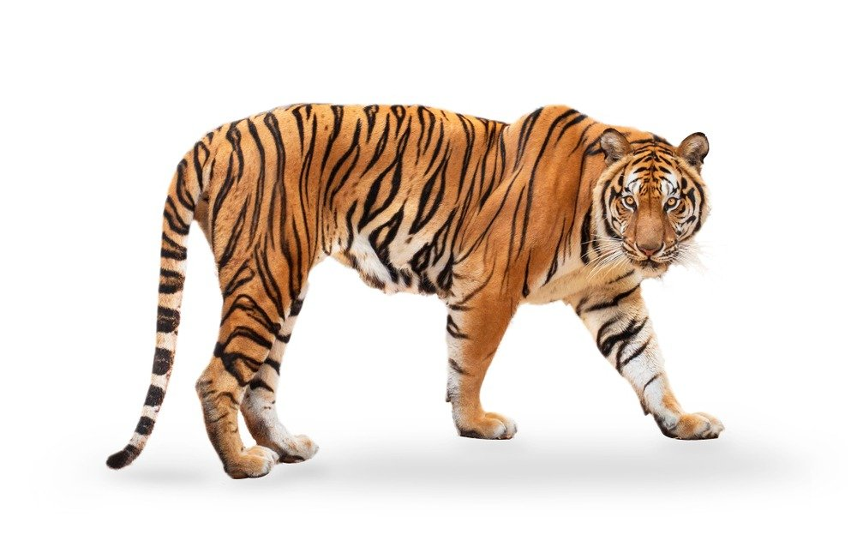

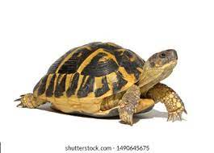
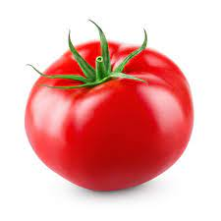
Pictures related to letter T
TIGER
TREE
TORTOISE
TOMAT0
Notes:
CW

Slide 5

ACTIVITY IN NOTE BK
Notes:
IN BK PG NO-9

Slide 6
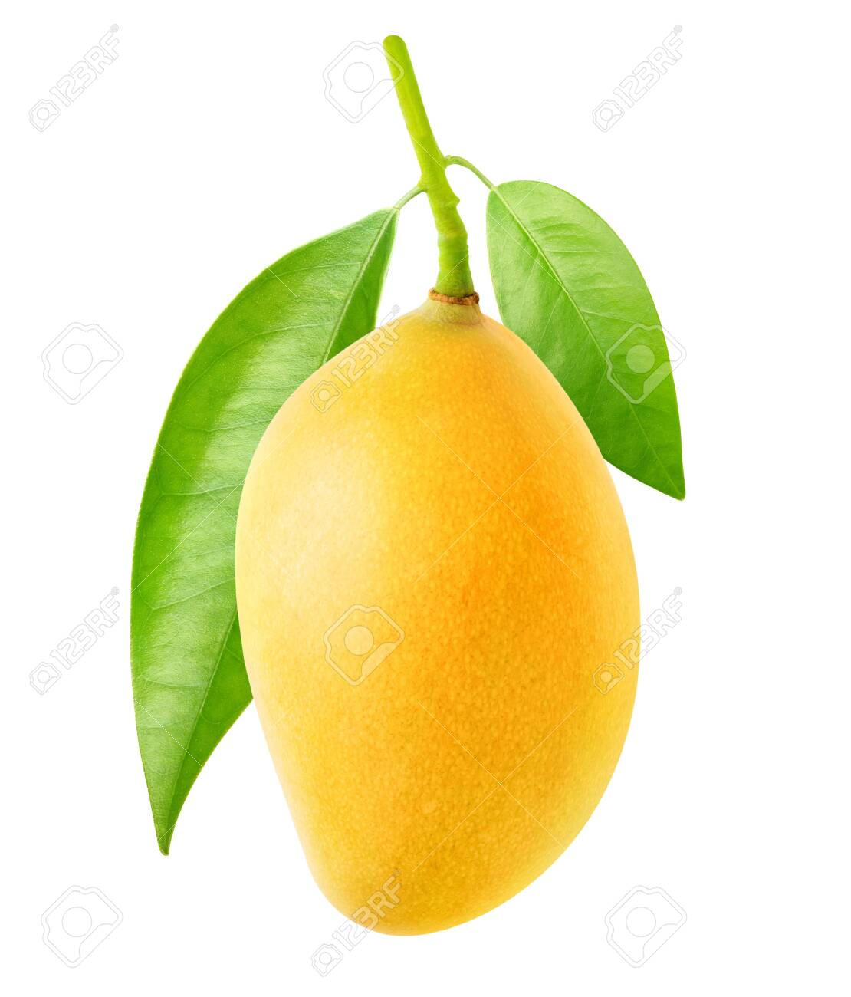
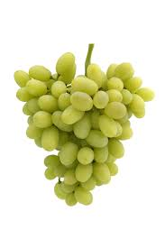
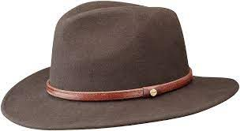
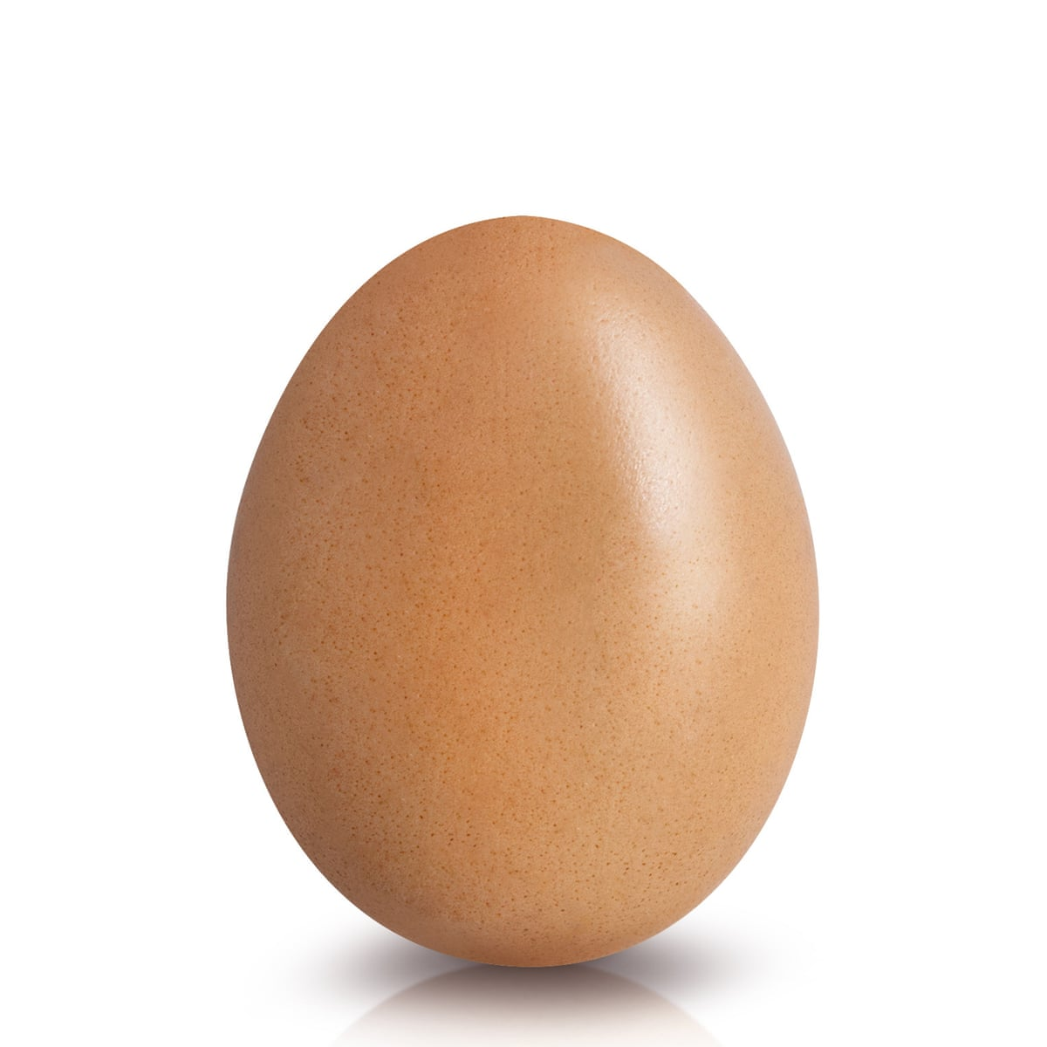
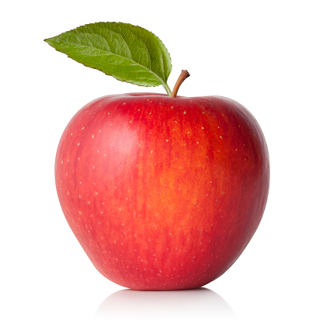

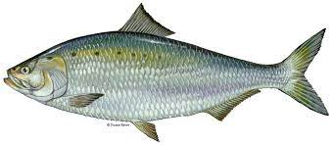
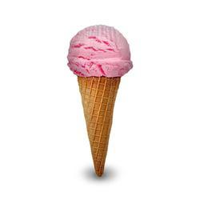
Match the letter with related picture
CW
02/09/21
F
H
I
T
E
Notes:
02/09/21

Slide 7




Paste or draw the pictures related to the given letter
HW
Notes:
HW

Slide 8

ASSIGNMENT
02/09/21
1 .Practice phonic sound of letter T
2.
Complete the work given in nt bk
3. Do the HW given in nt bk

Slide 9
THANKING YOU
ODM EDUCATIONAL GROUP

