Slide 1



CLASS : NURSERY
DATE 02/08/21
SUBJECT : ENGLISH
SUBJECT : ENGLISH
TOPIC BK PG NO-89
SUB-TOPIC-LETTER -Z

Slide 2







Identify the given letter and tell one word related to the letter

Slide 3
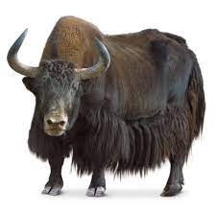


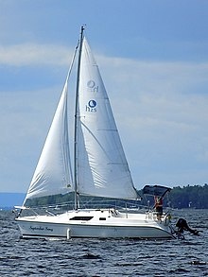

RECAPITULATION OF LETTER- Y

Slide 4
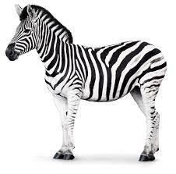
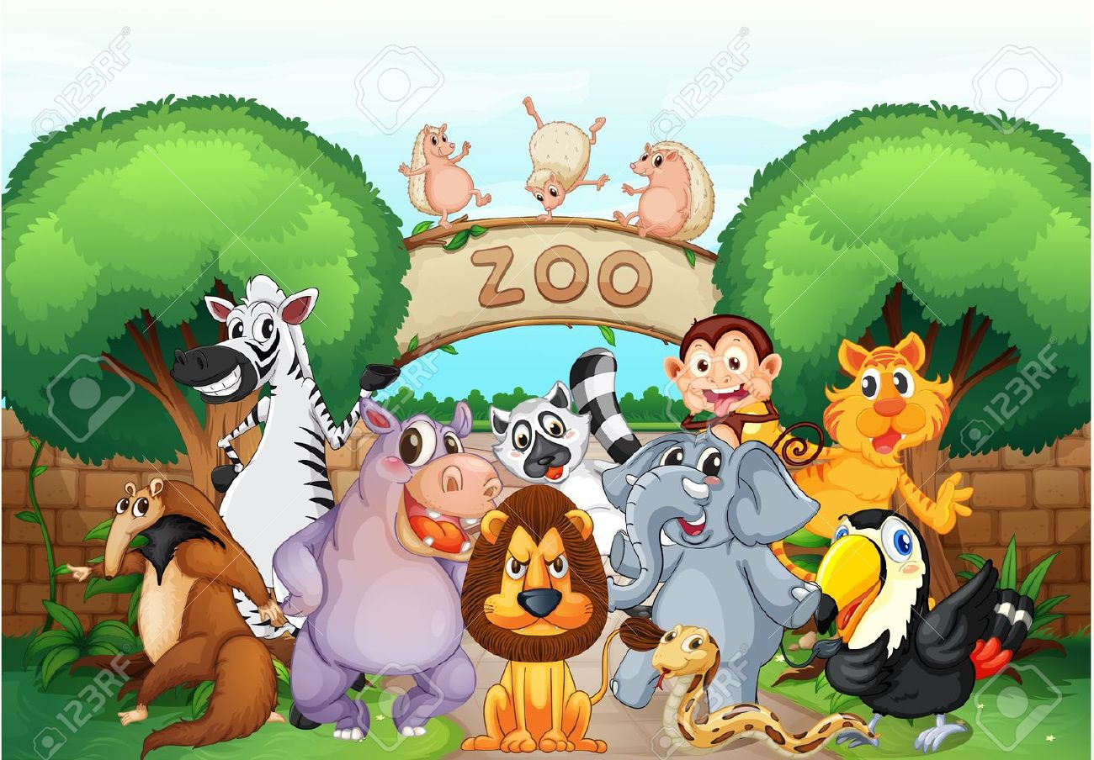



Identify the given picture

Slide 5


Identification of letter Z

Slide 6
PICTURE RELATED TO LETTER -Z

Slide 7


Slide 8
ACTIVITY ON LETTER-Z
CW
2/08/21
Encircle letter Z in a given circle
Z
W
Z
E
F
Z
G
Z
Z
A
M
Z
U
Z
Notes:
2/08/21

Slide 9

02/08/21
ASSIGNMENT
1 .Practice phonic song sound of letter -Z
2. Complete the work given in note bk
Notes:
.3’

Slide 10
THANKING YOU
ODM EDUCATIONAL GROUP

