Slide 1



CLASS : NURSERY
DATE -1/12/21
SUBJECT : ENGLISH
SUBJECT : ENGLISH
TOPIC - BK PG NO-29,30
SUB-TOPIC- LETTER-G – IN BK

Slide 2


Identification of letter C

Slide 3
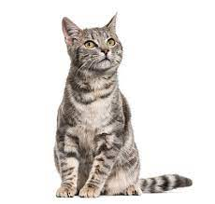
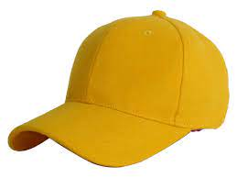
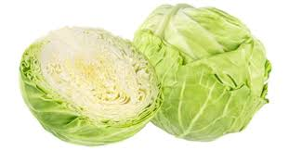
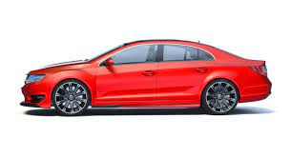
Picture releted to letter -C

Slide 4
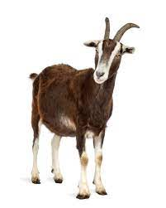
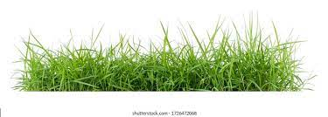

Identify and say the name of the given picture

Slide 5


Identification of letter G

Slide 6
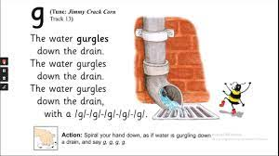
PHONIC SONG ON LETTER -G

Slide 7
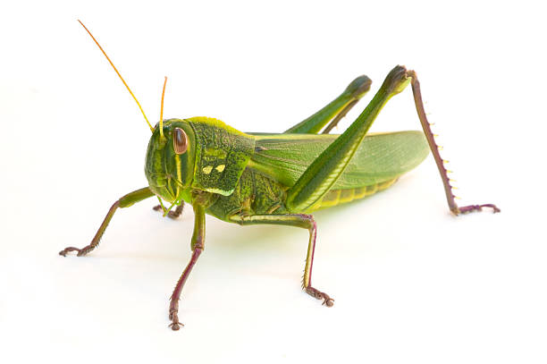
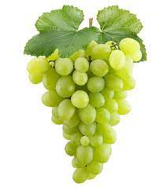
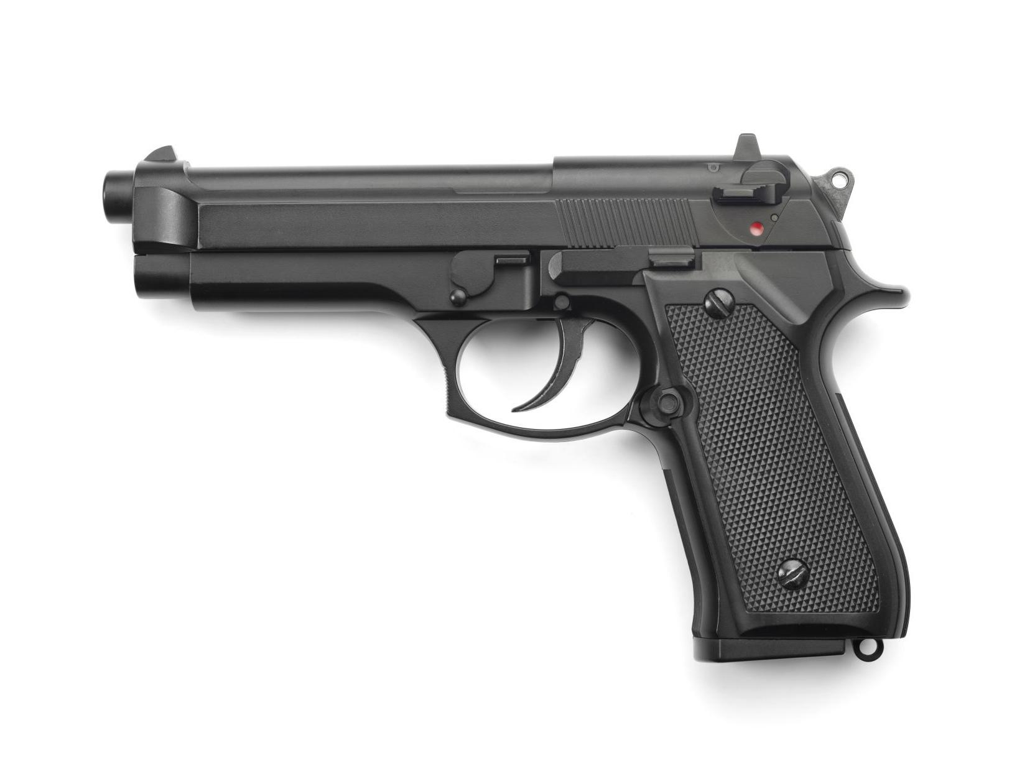
Picture related to letter G
GRASS
GRASS HOPPER
GRAPES
GOAT
GIRL
GUN

Slide 8

HI children

Slide 9

Hi children let‘s write in bk
G IN BK PG NO -29,30
Notes:
Hi children let‘s write in a book

Slide 10
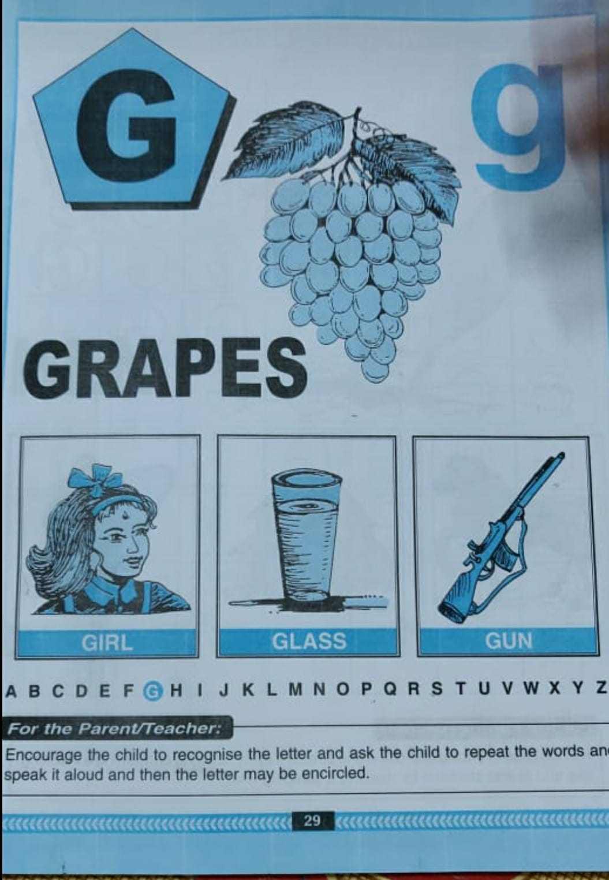
BK PG NO-29(Reading)
CW
1/12/21

Slide 11
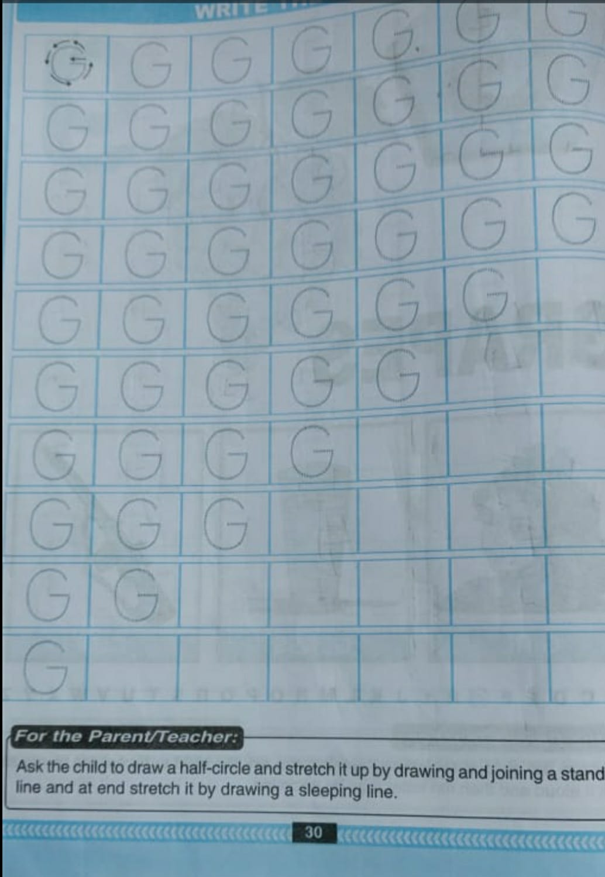
TRACE AND WRITE
CW
1/12/21
CW

Slide 12
Circle and color letter G
(In nt bk)
HW
T
K
G
M
G
G
L
G
L
N
A
G
G
G
Notes:
(In nt bk)

Slide 13


1/12/21
ASSIGNMENT
1 .Practice phonic song of letter -G
.2.Complete the work given in bk pg no-30
Notes:
.COMPLETE BK PG NO-38

Slide 14
THANKING YOU
ODM EDUCATIONAL GROUP

