Slide 1



CLASS : NURSERY
DATE : 01.09.2021
SUBJECT : ENGLISH
TOPIC- : BK PG NO-70,71
SUB-TOPIC:LETTER T (In nt bk)

Slide 2





Recapitulation
Notes:
CW

Slide 3
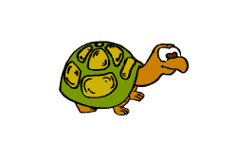
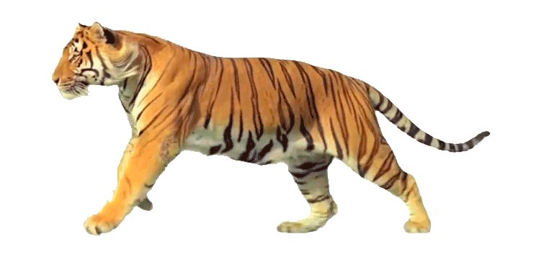

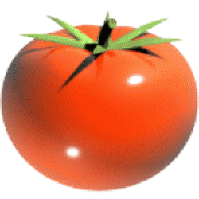
Identify the given pictures

Slide 4


Identification of letter T

Slide 5
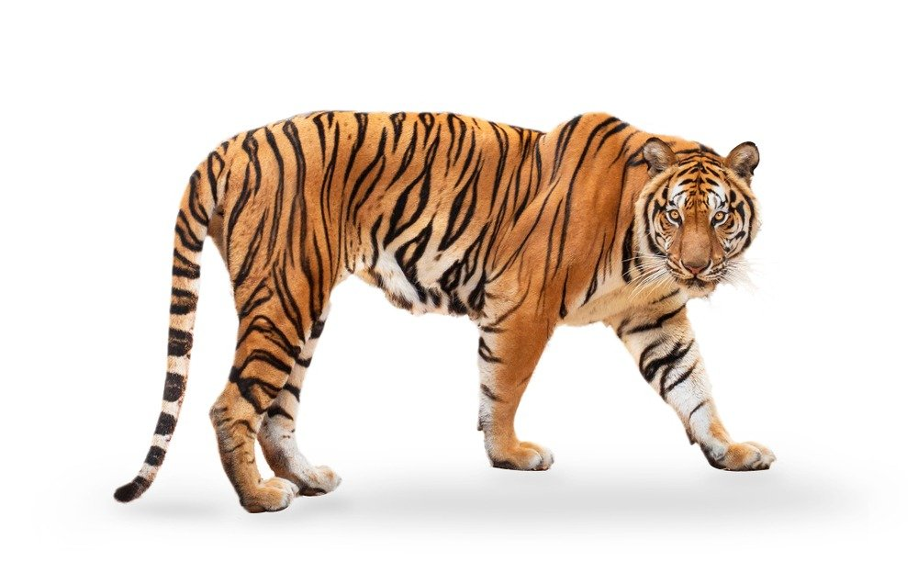

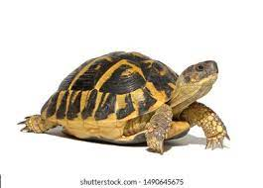
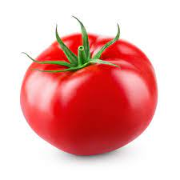
Pictures related to letter T
TIGER
TREE
TORTOISE
TOMAT0
Notes:
CW

Slide 6
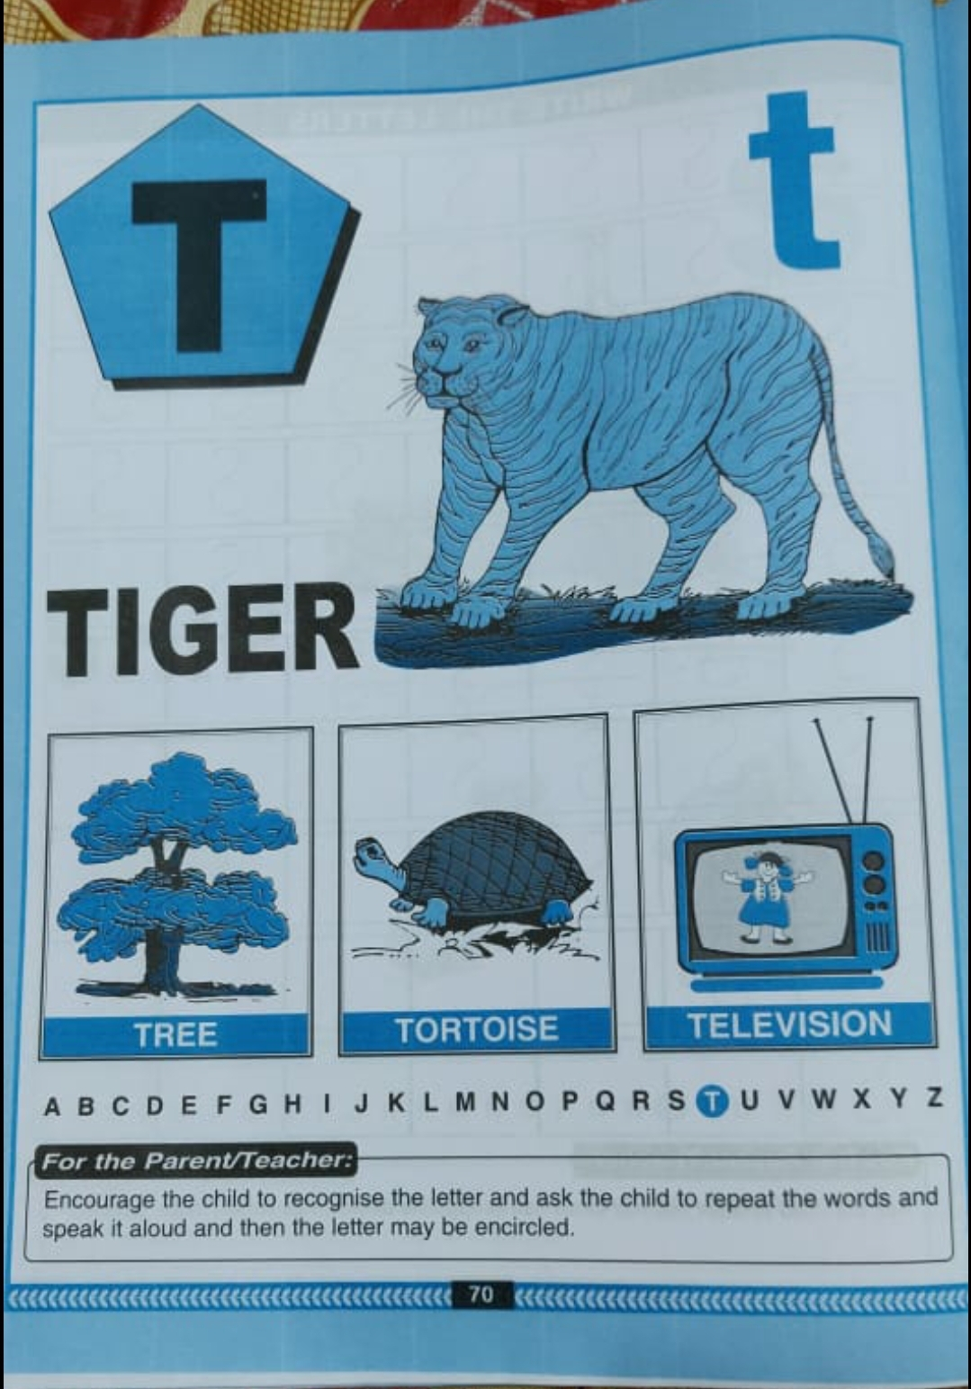
Read it five timesBk Pg-no-70
CW
31/08/21

Slide 7

ACTIVITY IN NOTE BK
Notes:
IN BK PG NO-9

Slide 8
T STANDS FOR TOMATO(IN NT BK)
CW
01/09/21

Slide 9


Trace and write letter T
CW
01/09/21

Slide 10
Say and write
HW
01/09/21
Notes:
01/09/21

Slide 11

ASSIGNMENT
01/09/21
1 .Practice phonic sound of letter T
2.
Complete the work given in nt bk
3.PRACTICE TO READ BK PG NO-70 -LETTER T

Slide 12
THANKING YOU
ODM EDUCATIONAL GROUP

