Slide 1

WELCOME TO ONLINE CLASS
CLASS : UKG
SUBJECT : ENGLISH
CHAPTER : 7
TOPIC : P SOUND WORDS

Slide 2
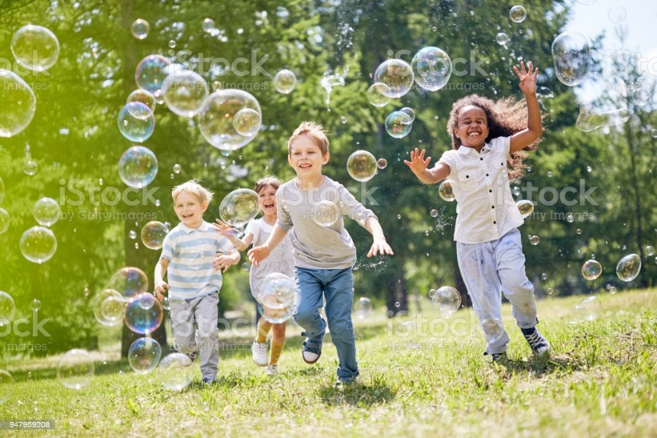
LETS READ THE PASSAGE
Children Play in the park. Punit and Priya play with a pup. The pup is their pet. Pam looks at the picture in the book. She draws the pictures. She draws parrots.

Slide 3
Rearrange the jumbled words Class Assignment
rrotpa -
etp –
upp –
enp –
cilenp -
parrot
pet
pup
pen
pencil

Slide 4
Home Assignment
Make sentences using the given words
EXAMPLE – I love to play cricket
Pencil -
Pen -
Park –
Pet -
Picture -

Slide 5

THANKING YOU
ODM EDUCATIONAL GROUP

