Slide 1

WELCOME TO ONLINE CLASS
CLASS : UKG
SUBJECT : ENGLISH
TOPIC : Unit-VI – “Ch” sound words

Slide 2

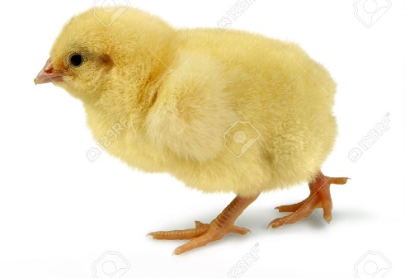




CLASS ASSIGNMENT
Activity : 1 - Identify the pictures ending with “ch” sound words and write their spellings in notebook.

Slide 3



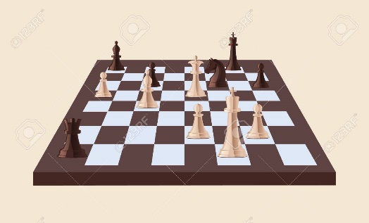

Activity : 2- Circle the “ch” sound words .
1. Chop the wood .
2. Sit on the bench .
3. Do you play chess ?
4. Lunch is in the box .

Slide 4

HOME ASSIGNMENT : WRITE THE CORRECT SPELLINGS .
1. IHCN
2. TACWH
3. ICHKC
4. RREHCY

Slide 5

THANKING YOU
ODM EDUCATIONAL GROUP

