Slide 1


CLASS : UKG
SUBJECT : ENGLISH
CHAPTER : 8
TOPIC : ‘OW’SOUND WORDS (PASSAGE READING)

Slide 2

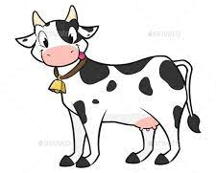
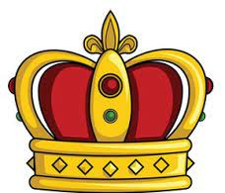
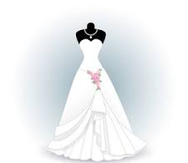
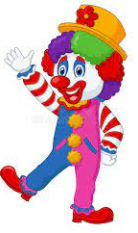

PASSAGE READING
An owl and a cow go to see the queen.
She wears a crown. She wears a gown.
There is a clown with the queen.
He makes everyone laugh.
The owl and the cow laugh and laugh and fall down.
An owl and a cow go to see the queen.
She wears a crown. She wears a gown.
There is a clown with the queen.
He makes everyone laugh.
The owl and the cow laugh and laugh and fall down

Slide 3
‘ow’ sound words from the seen passage(ORAL)
cow
owl
crown
gown
clown
down

Slide 4
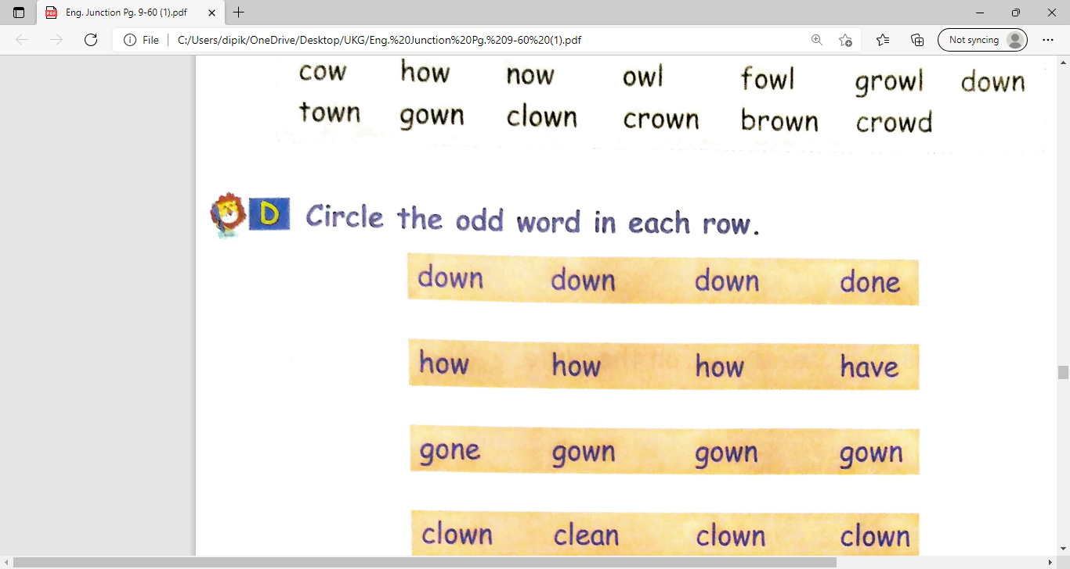
CLASS ASSIGNMENT
Circle the odd word in each row( Page no- 43D)

Slide 5
HOME ASSIGNMENT:
Write the ‘ow’ sound words from the seen passage(2 times)
owl
cow
crown
gown
clown
down

Slide 6
THANKING YOU
ODM EDUCATIONAL GROUP

