Slide 1


CLASS : UKG
SUBJECT : ENGLISH
CHAPTER : 8
TOPIC : “ OW” SOUND WORDS

Slide 2
UNIT - 8
Let’s blend “ow” sound words.

Slide 3
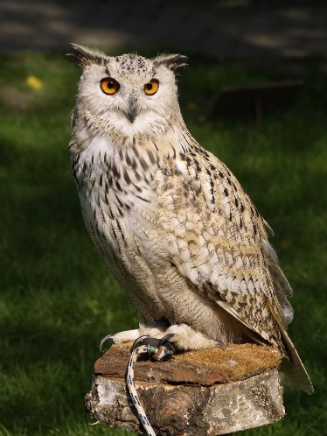
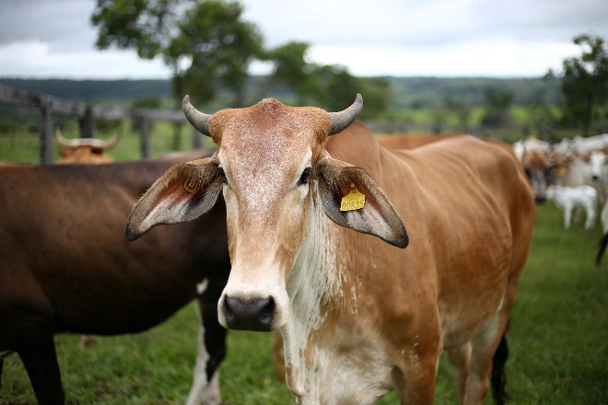
‘ow’ SOUND WORDS
OWL
cow

Slide 4
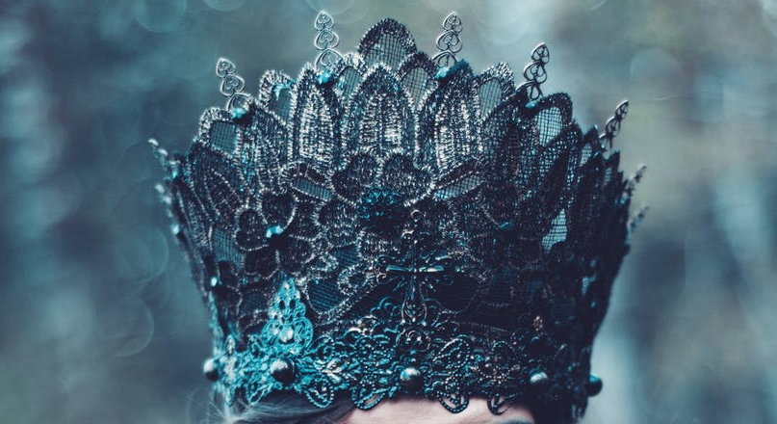
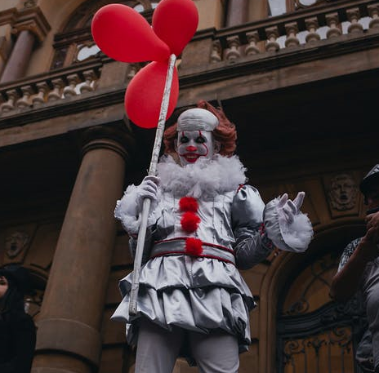
crown
clown

Slide 5


brown
down

Slide 6
CLASS ASSIGNMENT ( Let’s write the following words twice in note book )
fowl
growl
town
crowd
gown
clown
brown
down
cow
owl
crown
how
✓

Slide 7
REARRANGE THE LETTERS TO FORM THE CORRECT WORDS
HOME ASSIGNMENT
ROWNC
CROWN
WNGO
GOWN
CLWNO
CLOWN
OWNBR
BROWN
CWO
COW

Slide 8
THANKING YOU
ODM EDUCATIONAL GROUP

