Slide 1


ELECTRICITY
SUBJECT-PHYSICS CHAPTER NUMBER-8

Slide 2

ELECTRICITY: connection from pole to distribution board
https://youtu.be/HYcP4E4oxXI
To connect cable from pole to meter:
Fuse of high rating 50A is connected in the live wire in series.
The fuse is called company fuse or pole fuse.
The cable is connected to electric meter.
From electric meter, connections are made to distribution board through a main fuse and a main switch.

Slide 3
Commercial unit of electrical energy
1. BOT: Board Of Trade Unit
2. kWh: kilowatthour
1 kilowatthour is defined as the amount of energy consumed when an electrical appliance of powar 1 kilowatt is used for 1 hour.
1 kWh = 1kW x 1 h
= 1000 w x 3600 s
= 3600000ws
= 3600000joule

Slide 4
Electric Fuse
https://youtu.be/BLIYsRwKrkE
Fuse is an electrical safety device that protects the circuit from short-circuiting, the fuse wire is made of tin alloys that have high resistance and low melting points. A switch is used before the equipment in the circuit in a series combination.

Slide 5
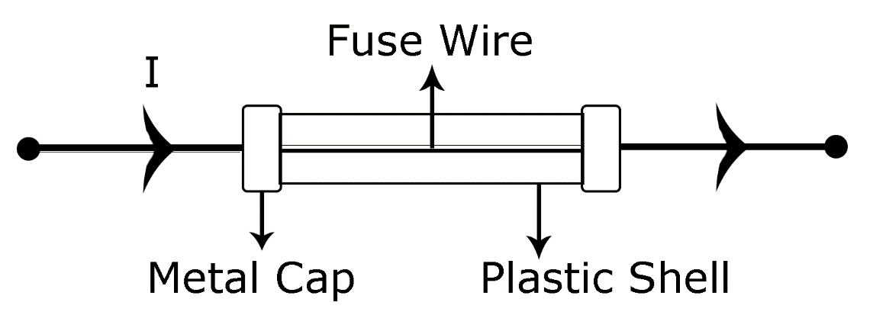
Fuse

Slide 6
Faulty/Defective Wiring Loose connections, pierced/cracked/pinched insulation, damaged appliances, or wire damage by rodents can lead to power surges, arc faults, electrical shocks, and fires. Any damaged, corroded, or worn electrical wire should be immediately replaced and upgraded.
Outdated Wiring Wiring that hasn’t been replaced in over 30 years isn’t only more likely to have poor or degraded insulation, cracking, and heat damage. It is also not designed to current standards. To avoid electrical shocks and fires, have our Los Angeles electrician replace it with new wiring that supports the electrical demand of modern devices and appliances.
Extension Cords Plugging too many devices into an extension cord box can cause an overload. You should not rely on one to power appliances. An extension cord may seem convenient, but it is also a trip hazard; a serious accident and/or injury can occur just by falling over one.
Contact with Water Water and electricity do not mix. Always install outlets away from water sources, and never use electrical devices near a wet floor or with wet hands (electrocution is a strong possibility). If a socket must be installed near water, make sure it is a GFCI. Also, ever pour water on an electrical fire; this is what fire extinguishers are for.

Slide 7
Children Youngsters, especially babies and toddlers, have a curiosity that seems to draw them to electrical outlets. One finger or object in an outlet hole can have fatal consequences. Always supervise young children and use specialized covers and other outlet protectors.
Overheating Even newer heavily coated wires are at risk of overheating. To avoid problems, make sure there’s sufficient air and ventilation near wires and equipment, especially televisions and computers. Covered wires and cords can easily overheat if overloaded.
Lightbulbs They’re all over your house, but can be dangerous if removed before turning off the switch (a shock hazard) and if sitting near flammable plastics, drapes, upholstery, and bedding materials. Make sure all bulbs are the correct wattage and dry your hands before touching a switch or replacing a lightbulb.
Attempting Electrical Repairs Yourself Professional electricians are trained, certified, and equipped to safely fix common electrical problems. All home electrical hazards can become deadly if your body comes in contact with high voltages. You also run the risk of shorting out wires and appliances, causing more damage than there was before, and requiring more expensive repairs.

Slide 8
THANKING YOU
ODM EDUCATIONAL GROUP

