Slide 1


ELECTRICITY AND MAGNETISM
STD-VII
SUBJECT-PHYSICS
CHAPTER NO- 07

Slide 2


LEARNING OBJECTIVE
Students will be able to
Define circuit
Differentiate series and parallel circuit

Slide 3
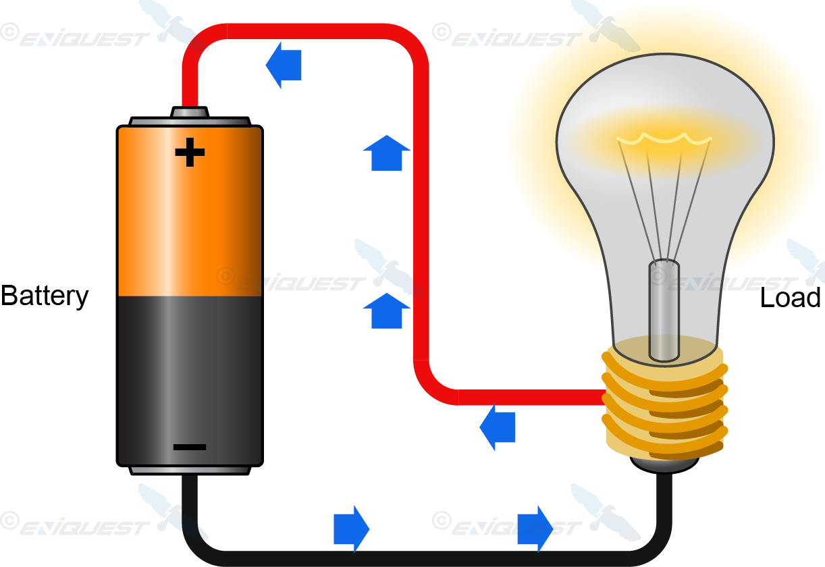
CURRENT ELECTRICITY
Current is defined as the rate of flow of charge i.e., the amount of charge flowing in one second.
It is measured in the unit ampere (symbol A) named after the name of the scientist Ampere.

Slide 4
Electric Circuit
The electric circuits are closed-loop or paths, forming a network of electrical components where electrons can flow.
This path is made using electrical wires and is powered by a source, like a battery.
The start of the point from where the electrons start flowing is called the source, whereas the point where electrons leave the electrical circuit is called the return.
Various electric components are
Electric bulb
Wire
Key
A battery

Slide 5
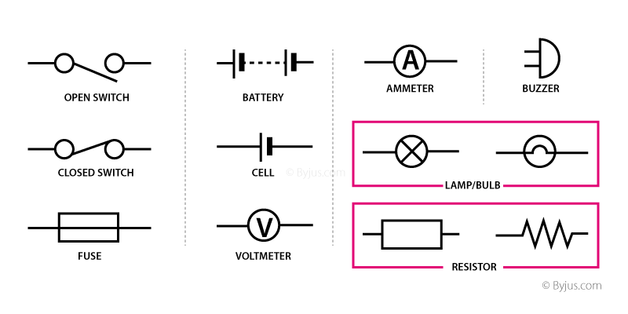

Slide 6
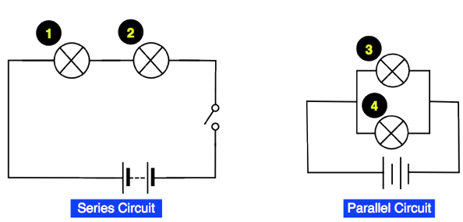
What is a Series Circuit?
A circuit is said to be connected in series when the same current flows through all the components in the circuit.
In such circuits, the current has only one path.
What is a Parallel Circuit?
A circuit is said to be parallel when the electric current has multiple paths to flow through.
The components that are a part of the parallel circuits will have a constant voltage across all ends.

Slide 7
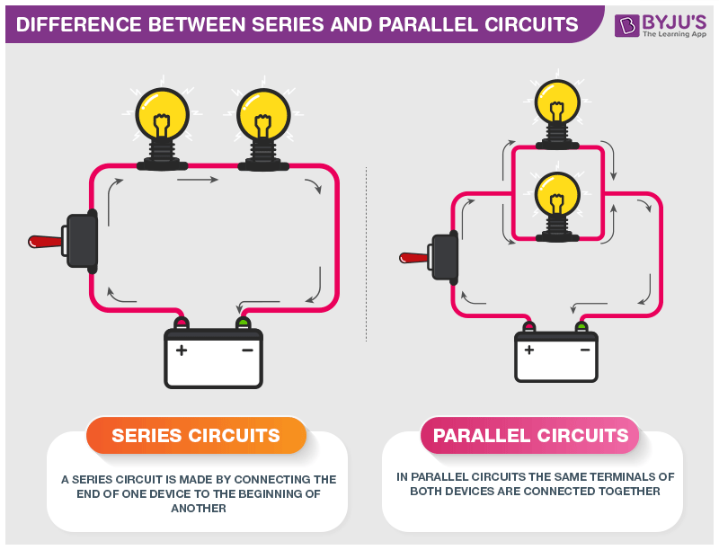

Slide 8

HOME ASSIGNMENT
Define series and parallel circuits.
Define circuit .
Define current.

Slide 9

THANKING YOU
ODM EDUCATIONAL GROUP

