Slide 1


ELECTRICITY AND MAGNETISM STD-VII
SUBJECT-PHYSICS
CHAPTER NO- 07

Slide 2


LEARNING OBJECTIVE
Students will be able to
Define sources of electricity
State advantages of dry cell

Slide 3

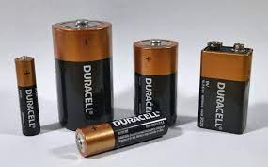
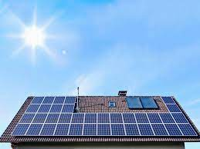
SOURCES OF ELECTRICITY
The main sources from where we obtain electricity for our use are:
The electric cell and battery,
The mains,
The generator, and
The solar cells.

Slide 4
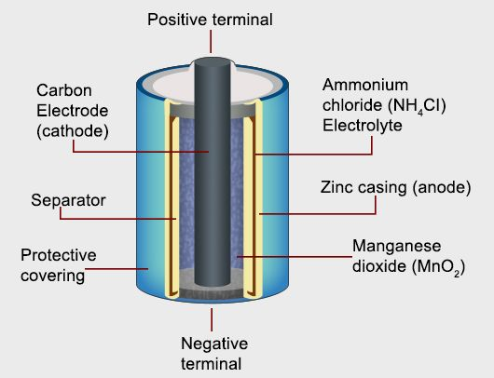
DRY CELL
A dry cell is one type of electric battery, which is generally used for the home and portable electronic devices.
A battery is a device that consists of one or more electrochemical cells, which converts chemical energy into electrical energy.

Slide 5
Advantages of a dry cell are: 1. The compact size of a dry cell makes it suitable for powering small electronic devices. (toys, flashlights, portable radios, cameras, hearing aids) 2. The electrolyte used in dry cells is relatively not so harmful to the environment. 3. Dry cells are inexpensive. Disadvantages of a dry cell are: 1. The main disadvantage of a dry cell is that it cannot be recharged once it loses its electrical power.

Slide 6
What are Conductors?
An electrical conductor is defined as materials that allow electricity to flow through them easily.
This property of conductors that allow them to conduct electricity is known as conductivity.
What are Insulators?
Insulators are materials that hinder the free flow of electrons from one particle of the element to another.
If we transfer some amount of charge to such an element at any point, the charge remains at the initial location and does not get distributed across the surface.

Slide 7
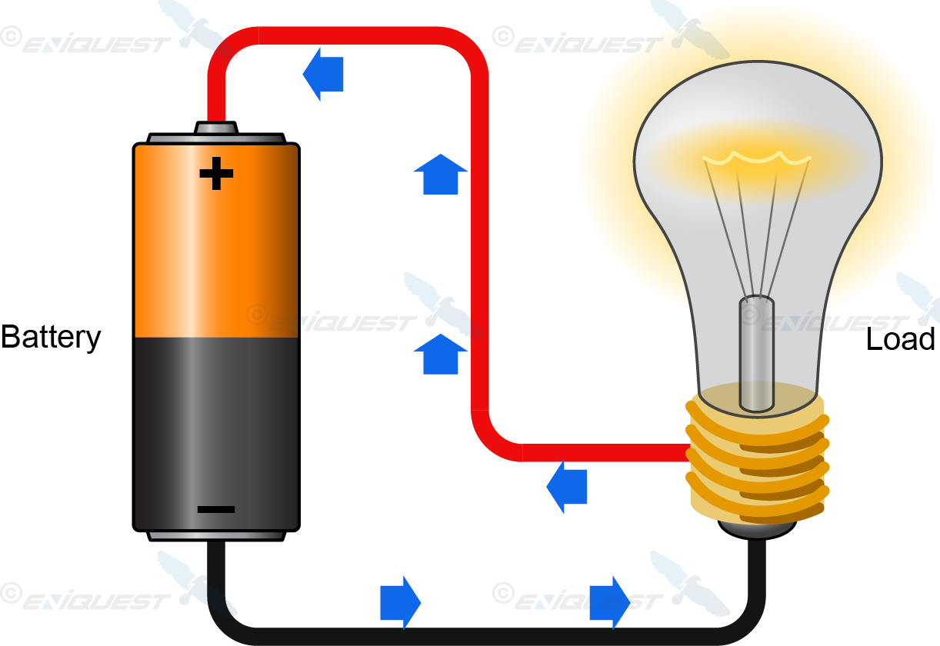
CURRENT ELECTRICITY
Current is defined as the rate of flow of charge i.e., the amount of charge flowing in one second.
It is measured in the unit ampere (symbol A) named after the name of the scientist Ampere.

Slide 8

HOME ASSIGNMENT
1. Define dry cell
2. What are the advantages of dry cell?
3. What are the uses of dry cell

Slide 9

THANKING YOU
ODM EDUCATIONAL GROUP

