Slide 1


ELECTRICITY AND MAGNETISM STD-VII
SUBJECT-PHYSICS
CHAPTER NO- 07

Slide 2

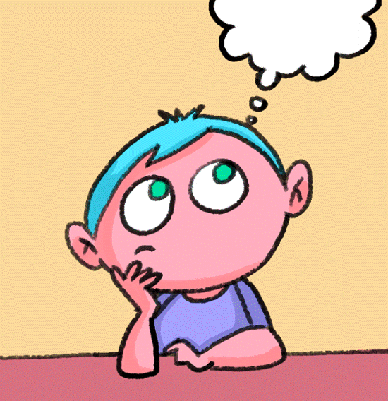
LEARNING OBJECTIVE
Students will be able to
Define electromagnet
State the uses of electromagnet

Slide 3
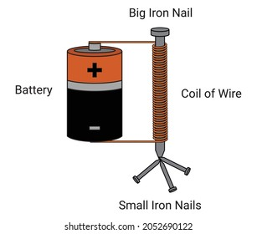
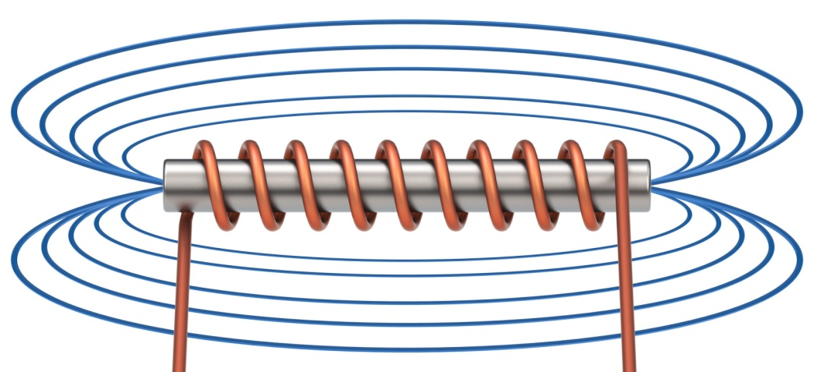
ELECTROMAGNET
An electromagnet is a type of magnet in which the magnetic field is produced by an electric current. Electromagnets usually consist of wire wound into a coil

Slide 4
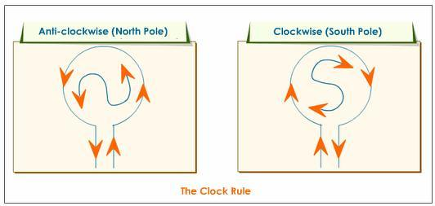
PRINCIPLE OF AN ELECTROMAGNET:
If an insulated copper wire is wound around a cylindrical card board of length much more than its diameter, we get a cylindrical coil (called solenoid)
Clock rule:
The end of the electromagnet where the direction of current is anticlockwise, becomes the north pole N and the end where the direction of current is clockwise, becomes the south pole S .

Slide 5
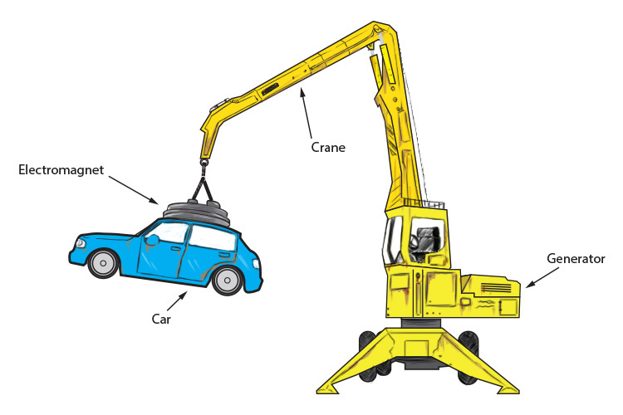
USES OF ELECTROMAGNETS
The electromagnets are mainly used for the following purposes:
For loading furnaces with iron.
For removing iron dust from wounds.
For separating magnetic substances such as iron from other non-magnetic substances.
For lifting and transporting big pieces of iron scrap, girders, plates etc., from one place to another, particularly where it is inconvenient to take the help of human labour .

Slide 6
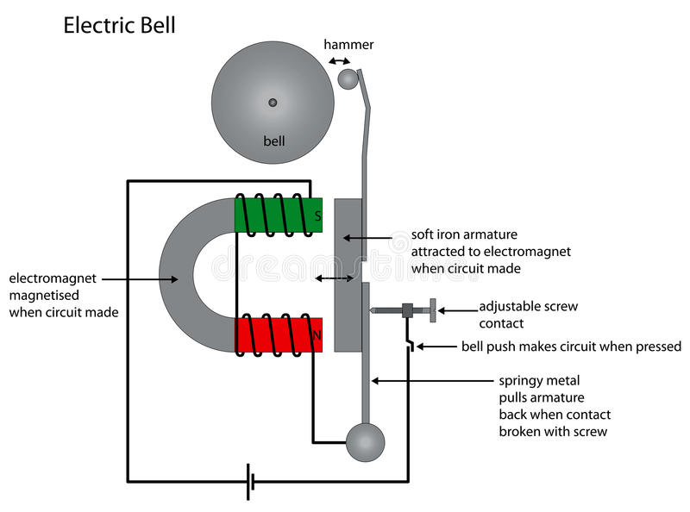
ELECTRIC BELL

Slide 7
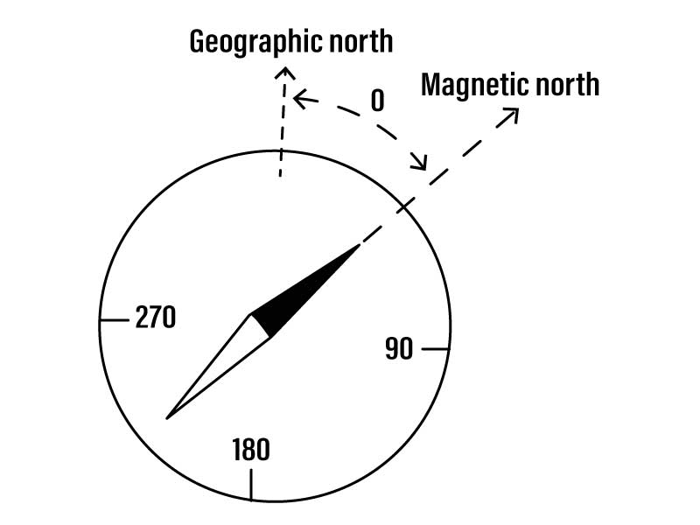
EARTH’S MAGNETIC DECLINATION
Magnetic declination is the angle of the horizontal plane between the magnetic north and the geographic north (or true north).

Slide 8

HOME ASSIGNMENT
Define electromagnet.
State the principle of an electromagnet .
What are the uses of electromagnet?

Slide 9

THANKING YOU
ODM EDUCATIONAL GROUP

