Slide 1


GRAMMAR
STD-VI
SUBJECT : ENGLISH
CHAPTER NUMBER: 8
PERIOD NUMBER : 1
CHAPTER NAME : DIRECT AND INDIRECT OBJECT

Slide 2

EXPECTED LEARNING OUTCOMES
GENERAL OBJECTIVES Understanding the concept Being acquainted with tenets of grammar Understanding the idea Appreciate the usage Developing LSRW Skills
SPECIFIC OBJECTIVES/ EXTENDED OBJECTIVES Understanding the concept Being acquainted with tenets of grammar Understanding the idea Appreciate the usage Developing LSRW Skills

Slide 3
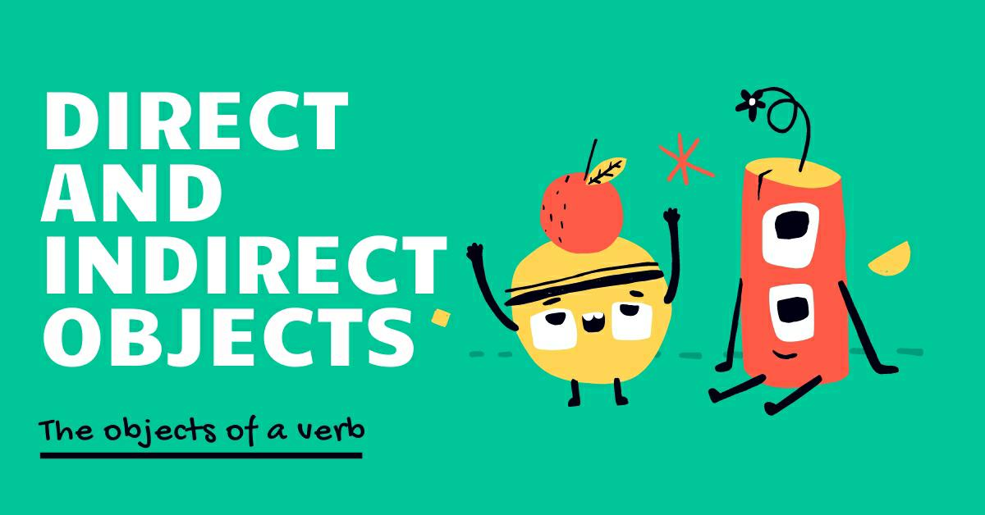
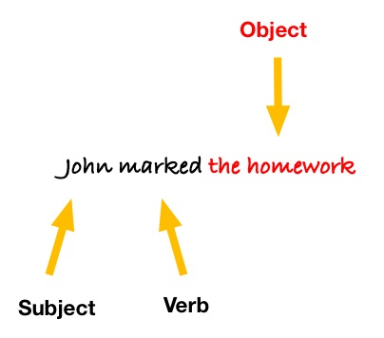
DEFINITION OF THE CONCEPT
A verb is an action word such as throw, give, read, explain etc.
An object is the part of a sentence that gives meaning to the subject’s action of the verb.
For example: John marked the homework.
Subject= John Verb= Marked Object= thehomework
An action verb can have direct and indirect objects.
Direct and indirect objects play an important role in many sentences by expanding the meaning of the verb.

Slide 4
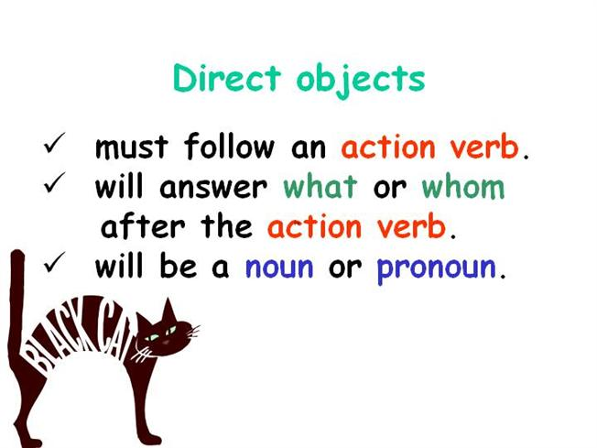
DIRECT OBJECT
A direct object receives the action of a verb.
A direct object answers the questions ''who'' or ''what.‘’
For example,
The player throws the ball.
The verb ‘’throw’’ often has a direct object stating what was thrown.
''Ball'' is the direct object of the verb throws.

Slide 5
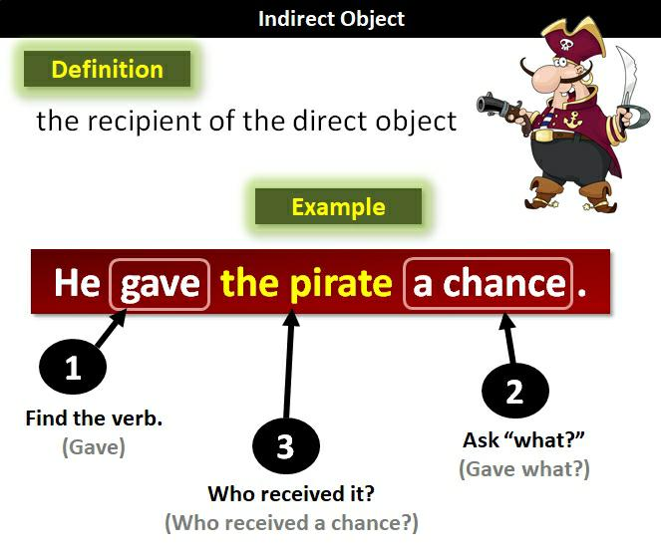
INDIRECT OBJECT
An indirect object receives the action of the direct object, answering the questions ''to or for whom or what.‘’
Revisiting the previous example:
The player throws Keith the ball
To whom did the ball player throw the ball? To Keith.
''Keith'' is the indirect object of the verb throws.

Slide 6
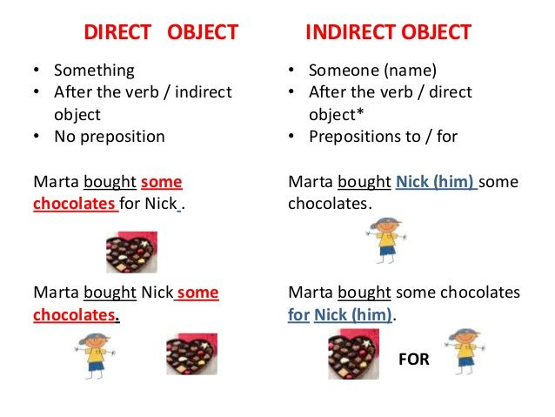

Slide 7
THANK YOU
ODM EDUCATIONAL GROUP

