Slide 1


LITERATURE
STD-VII
SUBJECT : ENGLISH
CHAPTER NUMBER:
PERIOD NUMBER : 1
CHAPTER NAME : Daybreak
BY Henry Wadsworth Longfellow

Slide 2
EXPECTED LEARNING OUTCOMES
GENERAL OBJECTIVES
Reading Comprehension followed by questions
Be acquainted with short story/Fiction
Understanding the plot
Understanding characters
Developing LSRW Skills
Know how to write a poem - Beginning, middle and end
SPECIFIC OBJECTIVES/ EXTENDED OBJECTIVES
Engage with the poet’s imagination- the idea of a wind journeying across land and sea at daybreak.
Respond to the mood of the poem and relate it to my experience.
Appreciate that the wind is imagined to be a person.
Appreciate that the poem is set in rhyming stanzas that make it musical.

Slide 3
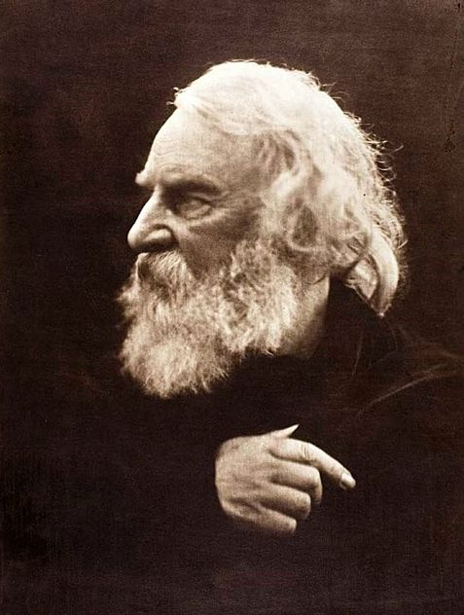
INTRODUCTION TO THE AUTHOR
Henry Wadsworth Longfellow (1807-1882)
American Poets of the 19th Century.
Born in Portland, marine in 1807, he became a national literary figure by the 1850s and world famous personality by the time of his death in 1882.
After retirement he devoted to literature only.
His famous works are “Voice of the Night”, “Evangeline” and “The song of Hiawatha”. His poetry is known for its lyrical quality.

Slide 4

Theme of the poem
Here poem gives the idea of alive life and be ready for challenges and opportunities to grab it. Past is past but the lively present is there with us to cherish with full enthusiasm.

Slide 5
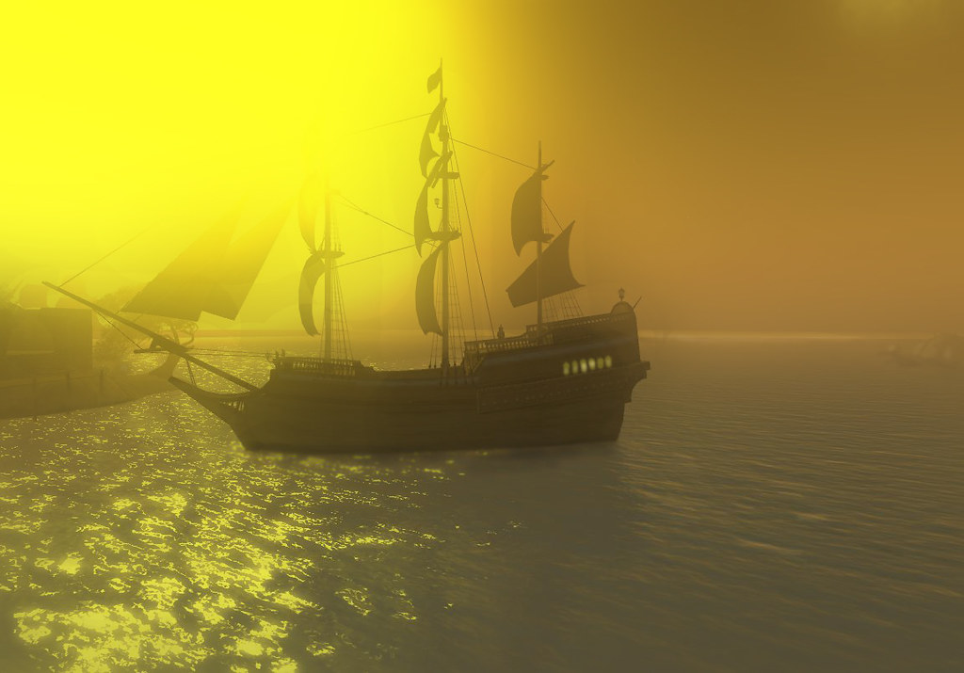
A wind came up out of the sea,
And said, "O mists, make room for me."
It hailed the ships, and cried, "Sail on,
Ye mariners, the night is gone."
Summary : The poet is explaining with eagle eye to clarify your goal to be archived in life because this is one life and we live with full enthusiasm and our work must get done.
The poet asks
to keep positive mindset and keep
working with true zest.
It is in haste and wants to make all awake. So it requests the mists not to obstruct it.
The ships should be set free from their anchor as the sun rises and darkness is over.

Slide 6
And hurried landward far away,
Crying, "Awake! it is the day."
It said unto the forest, "Shout!
Hang all your leafy banners out!"
Summary : The poet uses the word ‘awake’ - this is the time to fulfill your dream.
It calls the forests to rustle in the wind and unfurl their branches and leaves fully and freely.

Slide 7
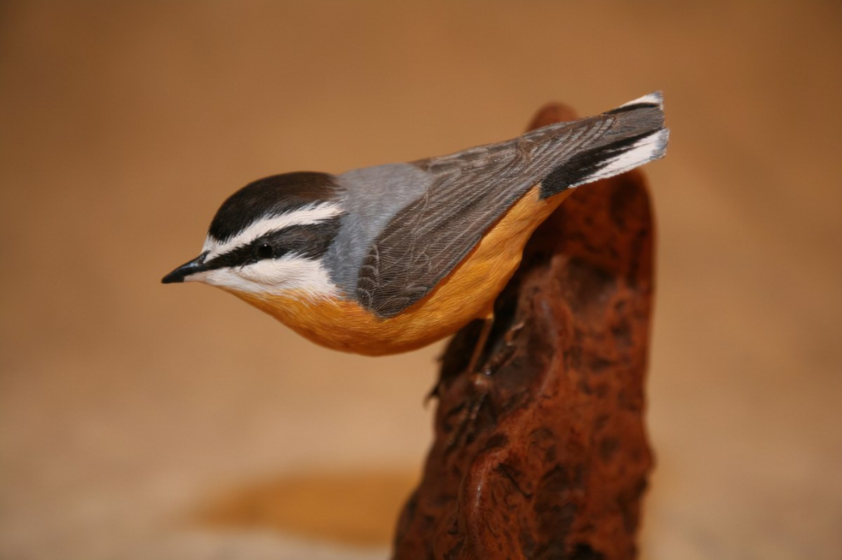
It touched the wood-bird's folded wing,
And said, "O bird, awake and sing."
And o'er the farms, "O chanticleer,
Your clarion blow; the day is near."
Summary :
It tenderly touches the folded wings of the wood bird and inspires it to get up and start singing merrily.
While blowing over the farm, the wind prompts the house cock to blow its clarion and announce the daybreak.

Slide 8
It whispered to the fields of corn,
"Bow down, and hail the coming morn."
It shouted through the belfry-tower,
"Awake, O bell! Proclaim the hour."
It crossed the churchyard with a sigh,
And said, "Not yet! in quiet lie."
Summary :By using this couplet poet explores the real sense of time and he is telling that the time is now so grab your opportunity. Make your way with this coming chance.
The wind visits the fields of corn and whispers to them to bow down and salute the coming morning. It then urges the church bell to ring and proclaim the sunrise. Finally as the wind blows over the graveyard, it heaves a sigh of grief for the dead lying buried in the graves. The wind does not want to disturb their sleep and so it says that they should not be awakened as the time has not yet come.

Slide 9
Difficult words:
hailed : called
ye : (old usage) you
mariner: sailors
landward : towards the land and away from the sea

Slide 10
THANKING YOU
ODM EDUCATIONAL GROUP

