Slide 1


DEEP WATER
WILLIAM DOUGLAS
SUBJECT : (ENGLISH)
CHAPTER NUMBER:3
CHAPTER NAME : DEEP WATER

Slide 2
LEARNING OUTCOME
Students can be able to relate their personal experience.
Students understand and relate that most challenging situations could be overcome with immense courage and determination.
Acquainting students with the ideas on USA, California & YMCA organization of the Christian community.
Students can understand the theme of the story and justify the theme “All we have to fear is fear itself".
Students can infer the importance determination, hard work and strong willpower in one’s life.
Students can express their ideas and can find ways to get rid of their Phobias.
If they are practiced, we can definitely achieve success in our future endeavour.

Slide 3
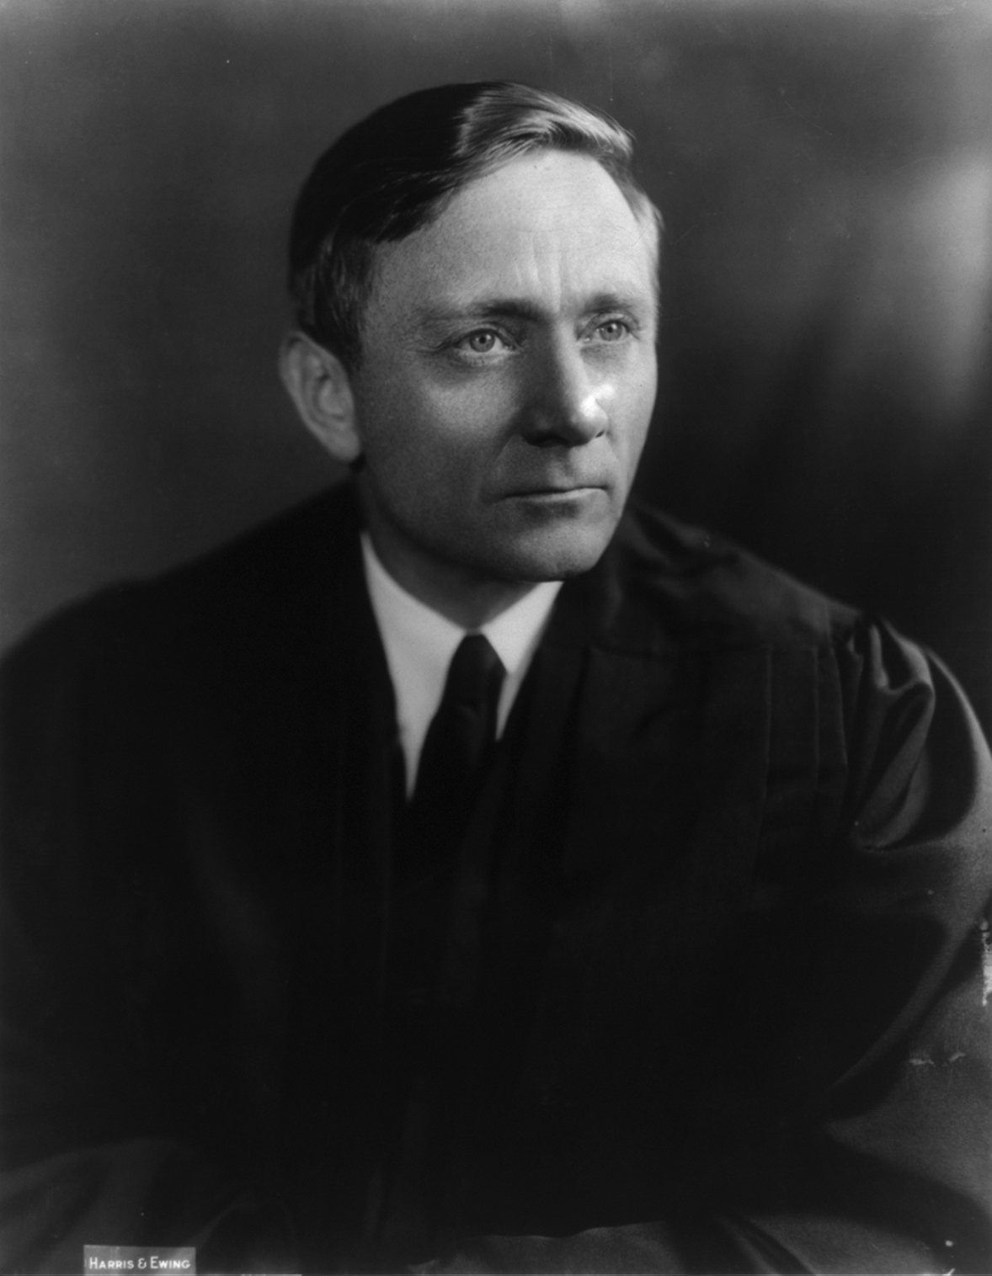
FACTS ABOUT THE WRITER – WILLIAM DOUGLAS
William Douglas (16th October, 1998 - 19th January, 1980) was born in Mainie, Minnesota and was raised in Washington.
Was professionally an American Jurist and Politician.
Served as Associate Justice of the Supreme court of the United States of America.
He was nominated at the age of 40 by President D. Roosevelt and was the youngest justice appointed to the court.
Served for the longest term in the history of the supreme Court.
A leading advocate of Individual rights.

Slide 4
VIDEO LINKS
https://www.youtube.com/watch?v=TBKzif2Y6pQ
https://youtu.be/TBKzif2Y6pQ
Swimming lessons at the YMCA

Slide 5

THEME
Overcoming Fear by Determination and Perseverance
Childhood fears must never be treated lightly . If left without tackling, might create Psychosis (mental disorder).
Fear, the hindrance to individual peace and happiness.
Will Power and Optimism constitute the real strength of man.

Slide 6
BACKGROUNGD INFORMATION
It’s an Anecdotal account.
Writer’s concern on peaceful and fearless living.
Initiative of awareness creation on: - meaningful living - with cultivated Optimism

Slide 7
SUB-CONCEPTS
Overcoming fear with courage, hard work determination and power of perseverance
Feasibility of triumph over fear
Realizing the true value of life by conquering fear
Optimism as an antidote to negativity
“Where there is a will ,there is a way.”

Slide 8
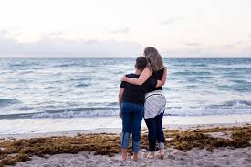
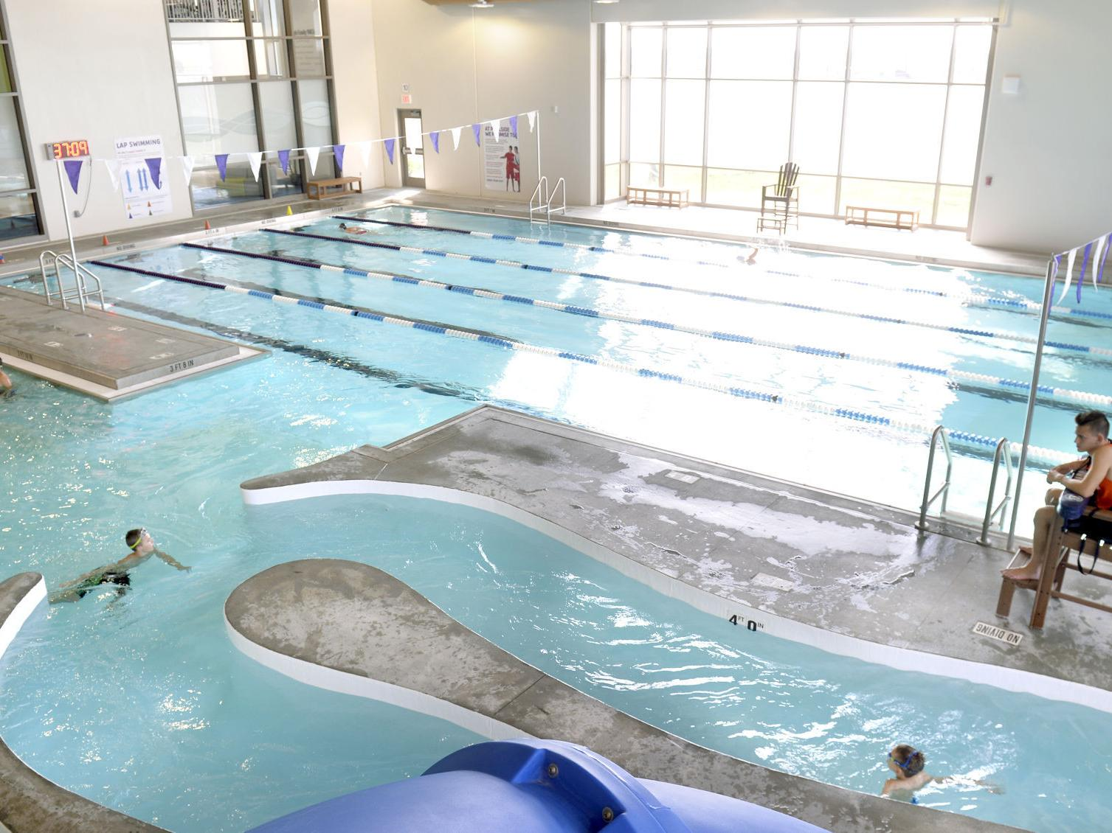
CHARACTERS
Predominantly One Character- William Douglas : - A determined man with a very strong will power.
- Autobiographical example for peaceful living
- A strategic thinker and a planner
- A positive thinker to try and conquer fear
Supporting characters : - His Mother - His trainer
Places involved : i. YMCA Pool: A swimming pool run by Young Men’s Christian Association
ii. Yakima: A US river

Slide 9
LESSON-CONCEPTS
And the Lesson B E G I N S…“ It had happened when I was ten or eleven years old. I had decided to learn to swim. There was a pool at the Y.M.C.A. in Yakima that offered exactly the opportunity. The Yakima River was treacherous. Mother continually warned against it, and kept fresh in my mind the details of each drowning in the river. But the Y.M.C.A. pool was safe. It was only two or three feet deep at the shallow end; and while it was nine feet deep at the other, the drop was gradual. ..” [ Page-23]
…Speaking about
- Writer’s intention of learning Swimming
- YMCA offered the expected facilities for learning the skill

Slide 10
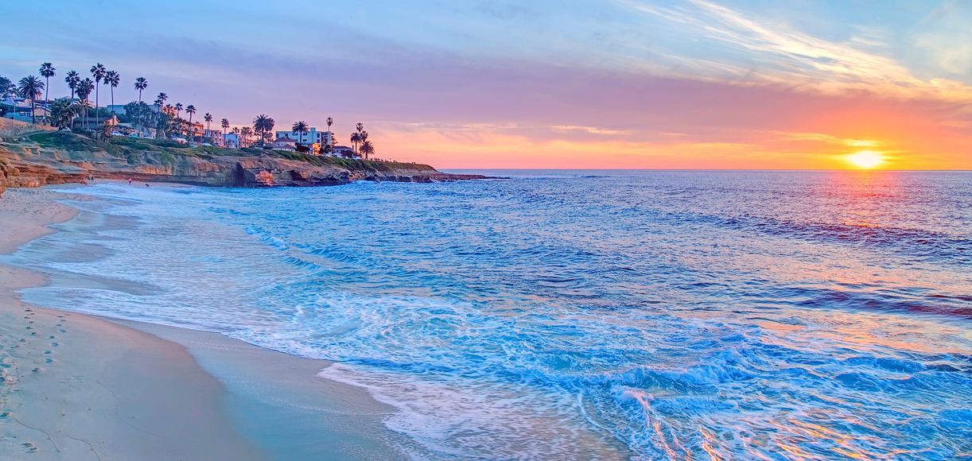
THE MISADVENTURE
California experience when he was three or four: - In California beach while enjoying with his father. - Got swept over & frightened. - Developed aversion towards water.
YMCA swimming pool & the fatal stroke therein: - Was thrown into water by bruiser of a boy. - Was drowning helplessly. - Planned to be saved by jumping from the bottom of the swimming pool. - But the reality was different. - Upward floatation was very slow.

Slide 11
CALIFORNIA EXPERIENCE & THE BRUSIER BOY...
California Experience : “...when I was three or four years old and father took me to the beach in California. He and I stood together in the surf. I hung on to him, yet the waves knocked me down and swept over me. I was buried in water. My breath was gone. I was frightened. Father laughed, but there was terror in my heart at the overpowering force of the waves.” [Page-25]
Bruiser of a boy : “...a big bruiser of a boy, probably eighteen years old. He had thick hair on his chest. He was a beautiful physical specimen, with legs and arms that showed rippling muscles. He yelled, “Hi, Skinny! How’d you like to be ducked?” [ Page- 25]

Slide 12
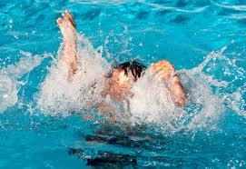
THE MISADVENTURE CONTINUES...
FIRST drowning made him panicky & suffocated. - Got only water around while trying to be saved. - Legs didn’t move …couldn’t get at the edge of the pool.
SECOND drowning took place immediately. - It was a nightmarish deal. - Lungs ached & head throbbed. - Was about to lose sense… was fully terrorized. - Jumping from bottom of the pool was the only survival option which failed totally. - Tried his best for, but failed in every effort. - Finally came up the surface of water, but again to go down.

Slide 13
EXPERIENCE OF TERROR
Here is Writer’s experience of terror-
“... I went down, down, endlessly. I opened my eyes. Nothing but water with a yellow glow — dark water that one could not see through. And then sheer, stark terror seized me, terror that knows no understanding, terror that knows no control, terror that no one can understand who has not experienced it. “ [Page-26]
And a sense of desperation- “… I looked for ropes, ladders, water wings. Nothing but water. A mass of yellow water held me. Stark terror took an even deeper hold on me, like a great charge of electricity. I shook and trembled with fright. My arms wouldn’t move. My legs wouldn’t move. I tried to call for help, to call for mother. Nothing happened.” [Page-26]

Slide 14
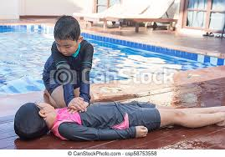
PEAK OF MISADVENTURE
THIRD sinking was deadly- - it made him senseless, as if into the domain of death.
“…Then all effort ceased. I relaxed. Even my legs felt limp; and a blackness swept over my brain. It wiped out fear; it wiped out terror. There was no more panic. It was quiet and peaceful. Nothing to be afraid of. This is nice... to be drowsy... to go to sleep... no need to jump... too tired to jump... it’s nice to be carried gently... to float along in space... tender arms around me... tender arms like Mother’s... now I must go to sleep “... I crossed to oblivion, and the curtain of life fell.” [PAGE- 27]
On regaining sense- - the bruiser boy pleaded innocent - At home the situation was traumatic…couldn’t sleep, eat, only cried of being phobic This phobic tendency surfaced when he grew up to enjoy phishing and boating.
(Vocabulary Supplements :
limp, oblivion, exertion, Cascades, salmon

Slide 15
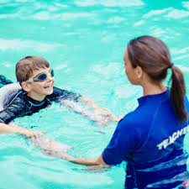
POST-ADVENTURE SCENARIO
Life was hell for him as he moved to enjoy fishing in the lakes like Tieton, Goat Rocks , Deschutes, Metolius, Bumping Lake
Finally felt determined to live a full life by overcoming fear of water, by… - appointing an Instructor for expertise in swimming - Practicing swimming in the presence & absence of the Tutor - Going for psychological tuning… “…now I could frown and say to that terror, “Trying to scare me, eh? Well, here’s to you! Look!” And off I’d go for another length of the pool.” [Page- 28]
Vocabulary Supplements: canoeing, exhale, inhale, vestiges

Slide 16
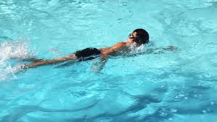
PHOBIAC TERROR DISAPPEARS
Undertook cleansing of the entire terror by going for independent swimming.
Lake Wentworth in New Hampshire, Triggs Island, Stamp Act Island.
Practiced all forms of swimming- crawl, breast stroke, side stroke, and back stroke.
Put in all daring feats like putting face in water and opening eyes under-water.
Finally swam across Warm Lake like the expert swimmer Doug Corpron , to be absolutely fearless.
“…At last I felt released — free to walk the trails and climb the peaks and to brush aside fear.”
Vocabulary Supplement: dived, miniature, residual, trails.

Slide 17

QUESTIONS
What are the specifications of Y.M.C.A. swimming pool as provided by the writer?
Which purpose is served by the reference to the writer’s mother, in the lesson?
“I was frightened. Father laughed”. What is the contradictory element present in the lines?
What was the writer’s conduct in the swimming pool, before the misadventure?
How is the bruiser of a boy described?
What was the proposed plan of the writer, while he was sinking?
What do you think about the actions and feelings of the writer during his first dipping?
Describe how a sense of helplessness came into the writer in his second dipping?
“The curtain of life fell”. Explain the statement.
In spite of repeated invading fear, the writer was bent on continued swimming practice. Why?

Slide 18
THANKING YOU
ODM EDUCATIONAL GROUP

