Slide 1

WELCOME TO ONLINE CLASS
CLASS : UKG
SUBJECT : ENGLISH
Chapter : DAYS OF THE WEEK

Slide 2
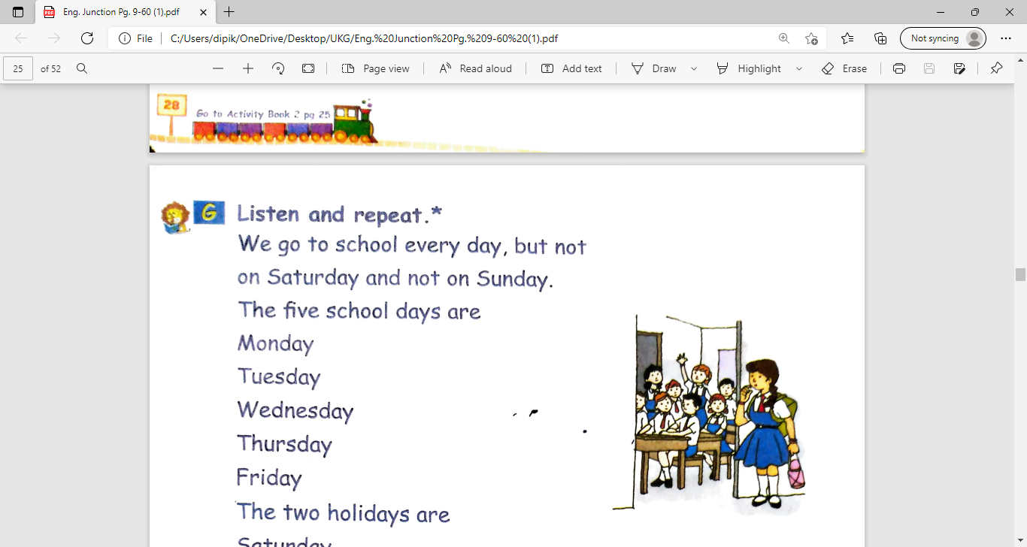
Listen and repeat
We go to school everyday,
but not on Saturday and not on Sunday.
The five school days are
Monday
Tuesday
Wednesday
Thursday
Friday
The two holidays are
Saturday
Sunday

Slide 3
DAYS OF THE WEEK
Sunday
Monday
Tuesday
Wednesday
Thursday
Friday
Saturday
The first day of the week is SUNDAY.
The last day of the week is SATURDAY.

Slide 4
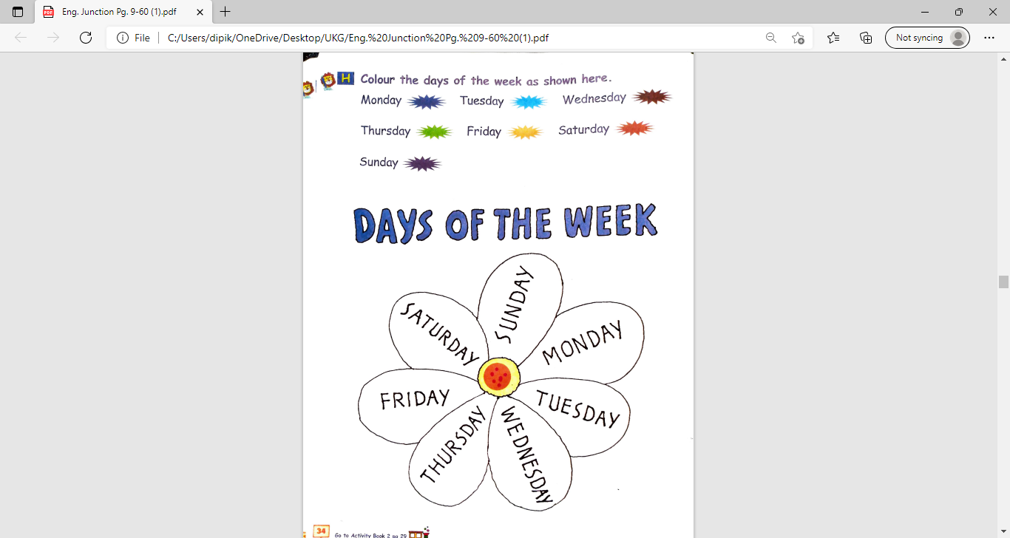
CLASS ASSIGNMENT
Page number- 34
of English Junction book

Slide 5
Home assignment
Write the days of the week in notebook(2 times)
Sunday
Monday
Tuesday
Wednesday
Thursday
Friday
Saturday

Slide 6

THANKING YOU
ODM EDUCATIONAL GROUP

