Slide 1


SESSION NO.: 1
CLASS: 5
SUBJECT: SCIENCE
CHAPTER NUMBER: 11
CHAPTER NAME: FORCE AND ENERGY
SUB TOPIC: INTRODUCTION, FORCE, EFFECTS OF FORCE, TYPES OF FORCE
Notes:
Simple machines- levers
Draw the pictures of different types of lever
Simple machines- the inclined plane, the pulley
Mention the names of all the simple machines and write a use of each in our daily life.
Simple machine- the wheel and axle, the screw
Learn Ch- 9
Revision-1
Choose the correct answer
Answer the following questions
Learn Ch- 10
Revision-2
Do as directed
Answer the following questions
Learn Ch- 9 & 10
Energy
Different forms of energy- mechanical energy, solar energy, geothermal energy
Do the oral Q& A of page no. 103
Different forms of energy- wind energy, hydro power, heat energy
Do the questions A, B & C in your notebook

Slide 2
LEARNING OBJECTIVE
To enable the learner to:
recall what is force and what are the various effects of force.
know different types of forces.
understand the use and importance of force and its effect in real life.
Notes:
Introduction
The brain
Write the difficult words
The spinal cord
Nerves
Kinds of nerves
Draw a labelled diagram of human brain
Sense organs- the eyes
Do the oral Q& A of page no. 93,
Do the questions A, B & C in your notebook
Sense organs- the ears, the nose, the tongue, the skin
Draw a labelled diagram of human eye
Long Q & A
Learn the Q & A
Activity
Class test

Slide 3
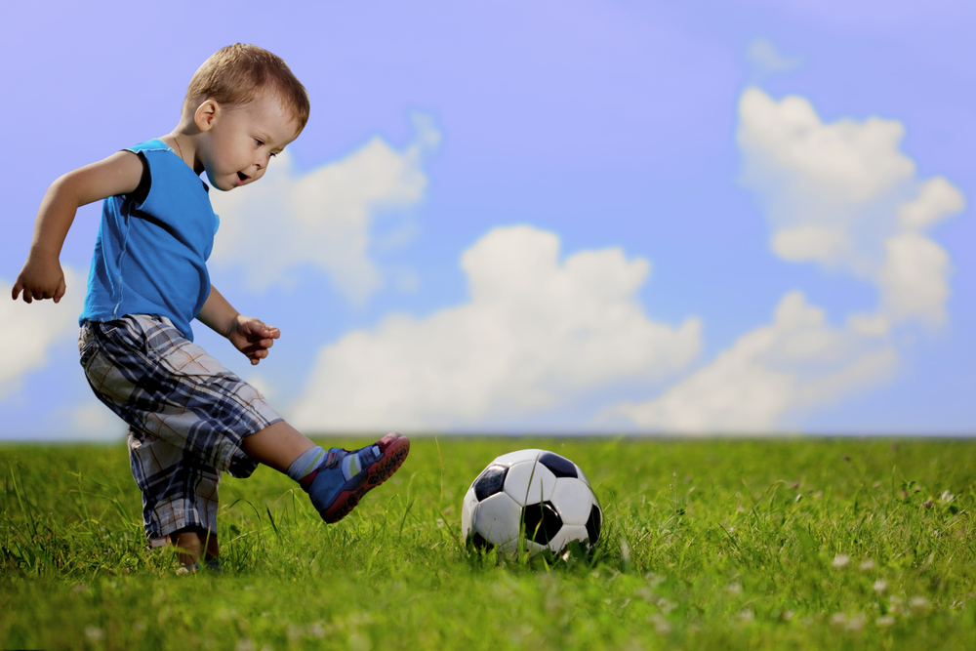
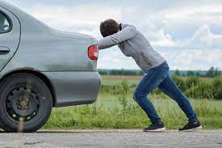
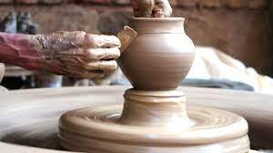
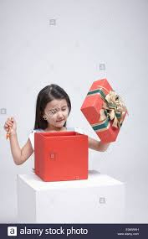
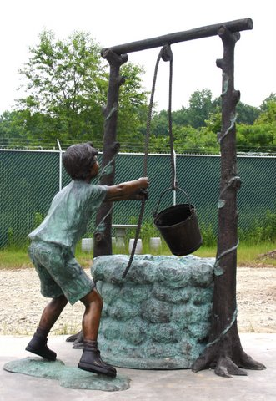
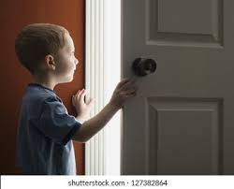
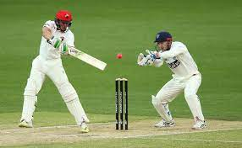
INTRODUCTION
Notes:
The brain
Write the difficult words
The spinal cord
Nerves
Kinds of nerves
Draw a labelled diagram of human brain
Sense organs- the eyes
Do the oral Q& A of page no. 93,
Do the questions A, B & C in your notebook
Sense organs- the ears, the nose, the tongue, the skin
Draw a labelled diagram of human eye
Long Q & A
Learn the Q & A
Activity
Class test

Slide 4
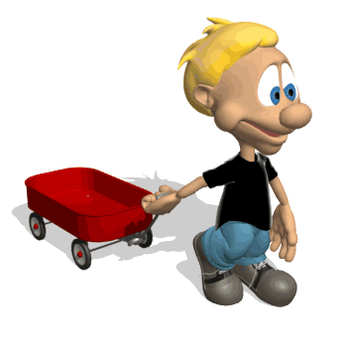
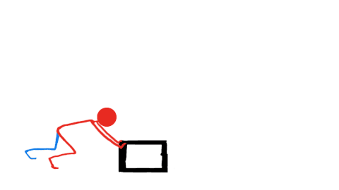
FORCE
A push or a pull acting on an object is a force.
PUSH
PULL

Slide 5
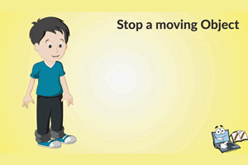
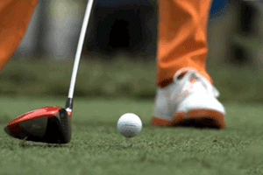
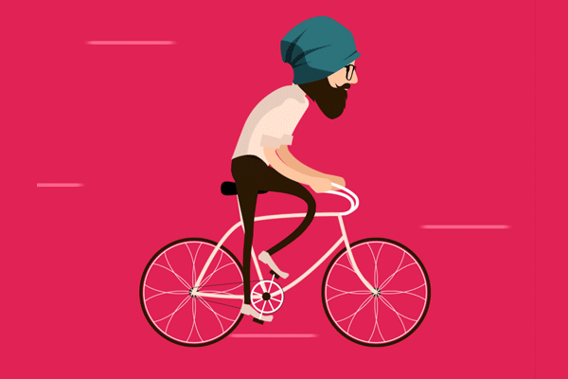
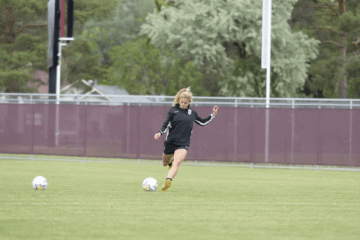
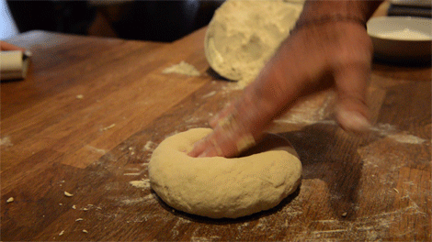
EFFECTS OF FORCE
Force can stop a moving object.
Force can move an object.
Force can change the speed of a moving object.
Force can change the direction of a moving object.
Force can change the shape and size of an object.

Slide 6
TYPES OF FORCE
Gravitational Force
Frictional Force
Muscular Force
Elastic Force
Electrostatic Force
Mechanical Force
Magnetic Force
Buoyant Force

Slide 7
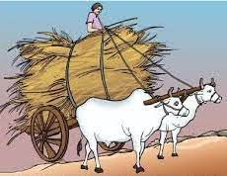
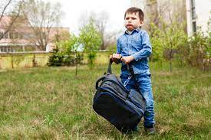
MUSCULAR FORCE
The force applied by the muscles of our body is called muscular force.
E.g.: lifting a bag, moving a box, pushing a chair, etc.

Slide 8
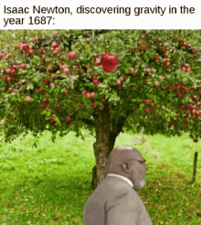
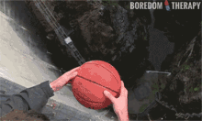
GRAVITATIONAL FORCE
The attractive force that exist between any two objects is called gravitational force.
For e.g.: we are able to stay on the ground because of gravitational force.

Slide 9
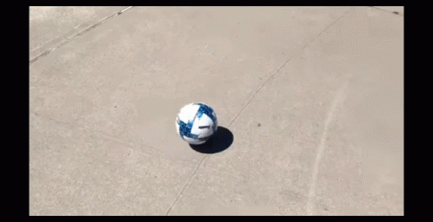
FRICTIONAL FORCE
The force that opposes the movement of one object over the other is called the frictional force or friction.
E.g.: Slowing down of a moving ball, writing on a paper, holding of objects, walking on the ground, etc.

Slide 10
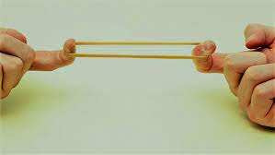
ELASTIC FORCE
The force that allows some materials to return to its original shape after being stretched or compressed is called the elastic force.
E.g.: stretched rubber band regains its shape when the force is removed.

Slide 11
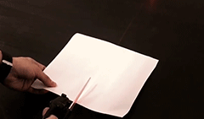
MECHANICAL FORCE
A force that involves contact with another object and which produces a change in state of rest or motion is called mechanical force.
E.g.: a pair of scissors is used to cut something.

Slide 12
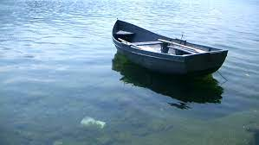
BUOYANT FORCE
The upward force exerted by a liquid on an object present in it, is called buoyant force or upthrust.
E.g.: a mug or a block of wood floating on water.

Slide 13
SUMMARY
A push or a pull acting on an object is called force.
Force can:
move an object.
stop a moving object.
change the speed of a moving object.
change the direction of a moving object.
change the shape and size of an object.
Forces are of different types- muscular, gravitational, frictional, elastic, mechanical and buoyant.

Slide 14


Slide 15
Which force helps a boat to float on a river?
Ans: Buoyant force

Slide 16
2. We are able to write on a piece of paper. Which force helps us to do so?
Ans: Frictional force

Slide 17
3. A ball thrown up ultimately comes down. Why?
Ans: Because gravitational force of the earth pulls or attracts it downward.

Slide 18
HOMEWORK
Write the difficult words in your notebook.

Slide 19
LEARNING OUTCOME
The learner will be able to:
recall what is force and what are the various effects of force.
know different types of forces.
understand the use and importance of force and its effect in real life.

Slide 20
THANKING YOU
ODM EDUCATIONAL GROUP

