Slide 1


SESSION NO.: 8
CLASS: 5
SUBJECT: SCIENCE
CHAPTER NUMBER: 11
CHAPTER NAME: FORCE AND ENERGY
SUB TOPIC: ENERGY, DIFFERENT FORMS OF ENERGY- WATER ENERGY, MECHANICAL ENERGY, HEAT ENERGY
Notes:
Different forms of energy- wind energy, hydro power, heat energy
Do the questions A, B & C in your notebook

Slide 2
LEARNING OBJECTIVE
To enable the learner to:
understand about energy.
identify the types of energy.
understand the importance of energy in real life.
Notes:
Introduction
The brain
Write the difficult words
The spinal cord
Nerves
Kinds of nerves
Draw a labelled diagram of human brain
Sense organs- the eyes
Do the oral Q& A of page no. 93,
Do the questions A, B & C in your notebook
Sense organs- the ears, the nose, the tongue, the skin
Draw a labelled diagram of human eye
Long Q & A
Learn the Q & A
Activity
Class test

Slide 3
LET’S RECAP
Name them:
  The energy that we get from the sun.
  The energy from the hot interior of the earth.
  A renewable source of energy.
What do you mean by renewable source of energy?

Slide 4
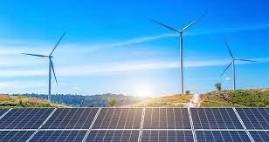
ENERGY
Energy is the ability to do work.
Energy is everywhere in nature: sunlight, water, wind, plants and animals.

Slide 5
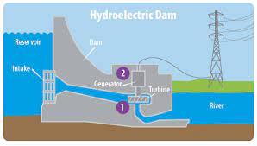
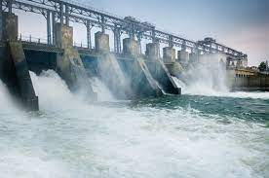
WATER ENERGY/ HYDRO ENERGY
It is another one important renewable sources of energy for generating power
It is one of the oldest sources of energy

Slide 6
DIFFERENT FORMS OF ENERGY
Mechanical energy
Heat energy
Light energy
Sound energy
Electrical energy

Slide 7
FORMS OF ENERGY
Heat energy
Mechanical energy
Light energy
Electrical energy
Sound energy

Slide 8
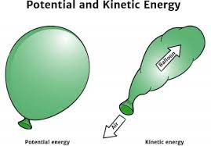
MECHANICAL ENERGY
The energy which is posed by an object due to its motion or due to its position is called mechanical energy.

Slide 9

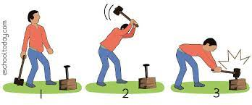
TYPES OF MECHANICAL ENERGY
Mechanical energy can be either kinetic energy or potential energy.

Slide 10
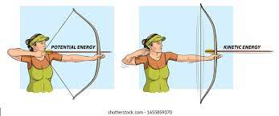
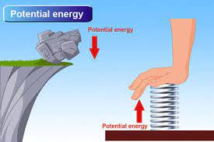
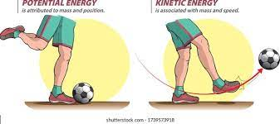
POTENTIAL ENERGY
The energy which is posed by an object due to its position is called potential energy.
For example- water that is behind a dam, a raised weight, a book on a table before it falls, etc. are examples of potential energy.

Slide 11
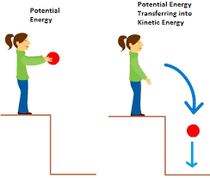
KINETIC ENERGY
The energy which is posed by an object to its motion is called kinetic energy.
For example- a falling ball, a moving car, a moving cycle, etc. are examples of kinetic energy.

Slide 12
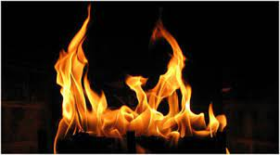

HEAT ENERGY
Heat is a form of energy.
It is used for cooking our food, boiling water, etc.
Heat energy comes from burning of fuels like coal, kerosene, petrol etc.

Slide 13
SUMMARY
Energy is the ability to do work.
The energy that we get from water is known as hydro energy.
There are different forms of energy.
They are:
  Mechanical energy
  Heat energy
  Light energy
  Sound energy
  Electrical energy
Mechanical energy can either be kinetic energy or potential energy.
Heat energy is used to keep our planet warm and do various other works.

Slide 14


Slide 15
A stretched rubber band possesses ____________ energy.
Ans: Potential

Slide 16
2. _____________ is one of the oldest sources of energy.
Ans: Water energy

Slide 17
3. A running cycle possess __________ energy.
Ans: Kinetic

Slide 18
HOMEWORK
Do the questions A, B & C in your notebook.

Slide 19
D. Write short answers.
Name the different types of forces.
Ans: The different types of forces are:
muscular force
gravitational force
frictional force
elastic force
mechanical force
buoyant force
2. What are simple machines?
Ans: Tools that make our work easier, faster and with less force are called simple machines. They have only few simple parts.
3. Why is geothermal energy referred to as a renewable source of energy?
Ans: Geothermal energy is referred to as a renewable source of energy because the heat is continuously produced inside the earth.

Slide 20
D. Write short answers.
4. From where does most of the heat energy come?
Ans: Most of the heat energy comes from the sun and from the burning of fuels like coal, kerosene and petrol.
5. Name four different forms of energy.
Ans: The four different forms of energy are:
heat energy
light energy
sound energy
electrical energy

Slide 21
LEARNING OUTCOME
The learner will be able to:
understand about energy.
identify the types of energy.
understand the importance of energy in real life.

Slide 22
THANKING YOU
ODM EDUCATIONAL GROUP

