Slide 1


SESSION NO.: 2
CLASS: 5
SUBJECT: SCIENCE
CHAPTER NUMBER: 11
CHAPTER NAME: FORCE AND ENERGY
SUB TOPIC: SIMPLE MACHINES- LEVERS
Notes:
Simple machines- the inclined plane, the pulley
Mention the names of all the simple machines and write a use of each in our daily life.
Simple machine- the wheel and axle, the screw
Learn Ch- 9
Revision-1
Choose the correct answer
Answer the following questions
Learn Ch- 10
Revision-2
Do as directed
Answer the following questions
Learn Ch- 9 & 10
Energy
Different forms of energy- mechanical energy, solar energy, geothermal energy
Do the oral Q& A of page no. 103
Different forms of energy- wind energy, hydro power, heat energy
Do the questions A, B & C in your notebook

Slide 2
LEARNING OBJECTIVE
To enable the learner to:
understand about machines.
identify the types of simple machines commonly used.
understand the importance of machines in real life.
Notes:
Introduction
The brain
Write the difficult words
The spinal cord
Nerves
Kinds of nerves
Draw a labelled diagram of human brain
Sense organs- the eyes
Do the oral Q& A of page no. 93,
Do the questions A, B & C in your notebook
Sense organs- the ears, the nose, the tongue, the skin
Draw a labelled diagram of human eye
Long Q & A
Learn the Q & A
Activity
Class test

Slide 3
LET’S RECAP
Name the type of force used in the following.
A ball thrown up comes down.
Lifting a box.
Pulling a catapult.
Using a knife to cut an apple.
Boat floats on water.
Mention some of the effects of force.

Slide 4
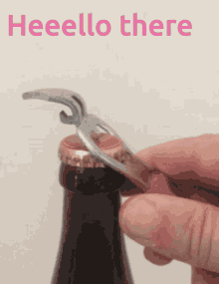
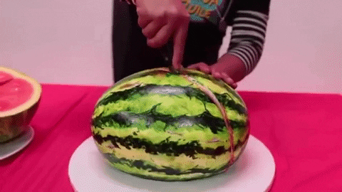
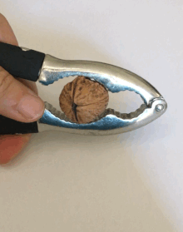
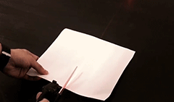
MACHINE
Machines are the tools that make our work easier, faster and with less force.

Slide 5
TYPES OF MACHINES
Simple Machine
Complex Machine
E.g. Knife, needle, scissors, bottle opener, hammer, etc.
E.g. fan, bicycle, grinder, car,washing machine etc.

Slide 6
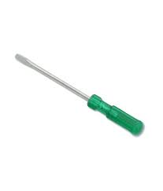
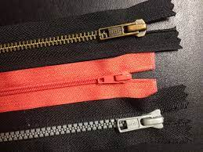
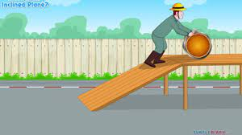
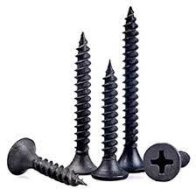
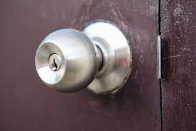
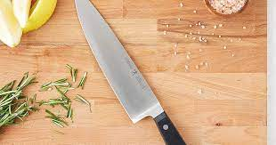
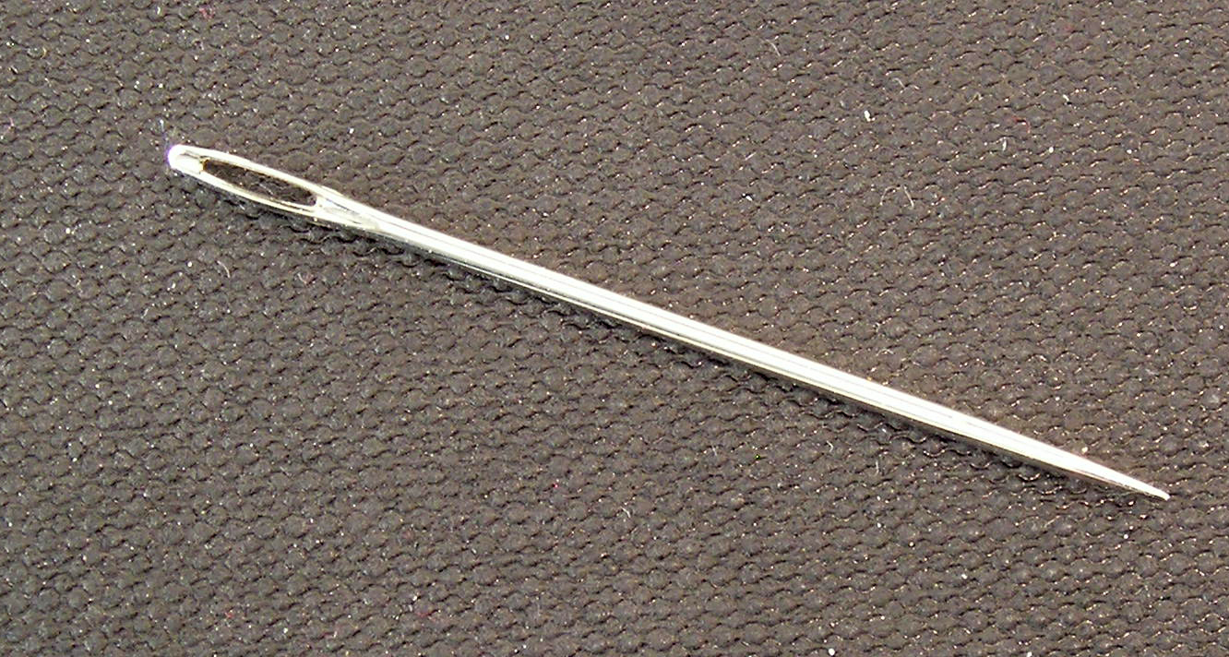
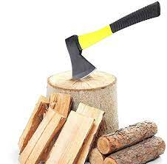
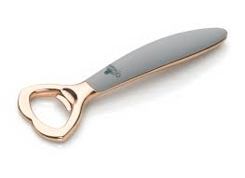
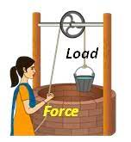
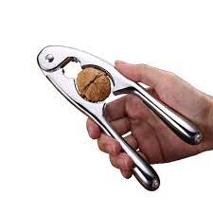
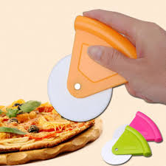
SIMPLE MACHINES
Tools which make our work easier and faster are called machines.
Simple machines help us to do work by applying force at a convenient point which either changes the direction of force or increases the force applied.

Slide 7
TYPES OF SIMPLE MACHINES
Inclined Plane
Pulley
Lever
Wheel and axle
Wedge
Screw

Slide 8
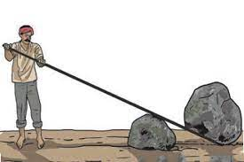
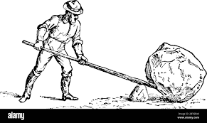
LEVER
A lever is a rigid rod arranged in such a manner that it can move freely around a fixed point.

Slide 9
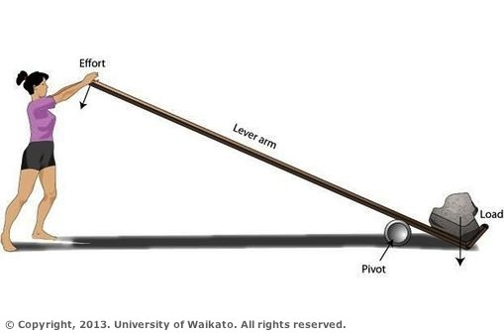
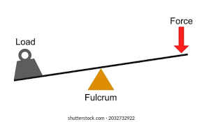
LEVER
Fulcrum: The point of support or the pivot point of the lever.
Effort: The force which is used to lift the object is the effort.
Load: The weight which need to be lifted is called the load.

Slide 10
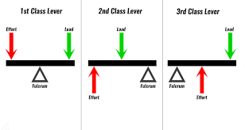
TYPES OF LEVER
First-class lever
Second-class lever
Third-class lever

Slide 11
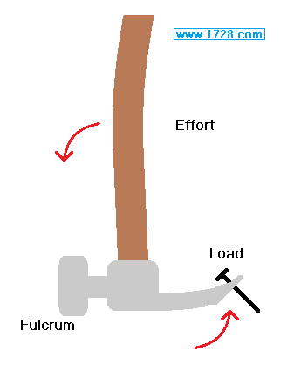
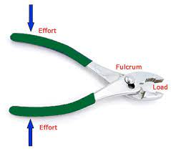
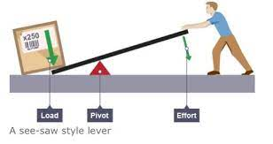
FIRST-CLASS LEVER
When fulcrum is between load and effort, it is a first-class lever.
E.g.:

Slide 12
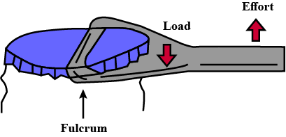
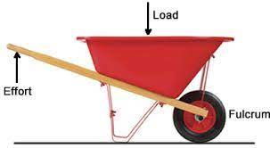
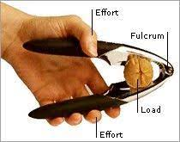
SECOND-CLASS LEVER
When load is between fulcrum and effort, it is a second-class lever.
E.g.:

Slide 13
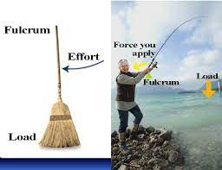
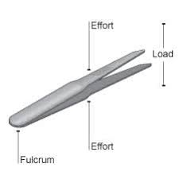
THIRD-CLASS LEVER
When effort is between fulcrum and load, it is a third-class lever.
E.g.:

Slide 14
SUMMARY
Simple machines make our work easier.
There are six types of simple machines: lever, inclined plane, pulley, wheel and axle, screw and wedge.
Lever is a rigid rod arranged in such a manner that it can move freely around a fixed point.
Lever are of three types:
First- class lever
Second- class lever
Third- class lever.

Slide 15


Slide 16
Ice tongs is an example of ____________ class lever.
Ans: Third

Slide 17
2. Scissors are which type of lever.
Ans: First- class lever

Slide 18
3. Tools that make our work easier.
Ans: Simple machine/ machine

Slide 19
HOMEWORK
Draw the pictures of different types of lever.

Slide 20
LEARNING OUTCOME
The learner will be able to:
understand about machines.
identify the types of simple machines commonly used.
understand the importance of machines in real life.

Slide 21
THANKING YOU
ODM EDUCATIONAL GROUP

