Slide 1


SESSION NO.: 4
CLASS: 5
SUBJECT: SCIENCE
CHAPTER NUMBER: 11
CHAPTER NAME: FORCE AND ENERGY
SUB TOPIC: SIMPLE MACHINES- THE WHEEL AND AXLE, THE SCREW
Notes:
Simple machine- the wheel and axle, the screw
Learn Ch- 9
Revision-1
Choose the correct answer
Answer the following questions
Learn Ch- 10
Revision-2
Do as directed
Answer the following questions
Learn Ch- 9 & 10
Energy
Different forms of energy- mechanical energy, solar energy, geothermal energy
Do the oral Q& A of page no. 103
Different forms of energy- wind energy, hydro power, heat energy
Do the questions A, B & C in your notebook

Slide 2
LEARNING OBJECTIVE
To enable the learner to:
understand about machines.
identify the types of simple machines commonly used.
understand the importance of machines in real life.
Notes:
Introduction
The brain
Write the difficult words
The spinal cord
Nerves
Kinds of nerves
Draw a labelled diagram of human brain
Sense organs- the eyes
Do the oral Q& A of page no. 93,
Do the questions A, B & C in your notebook
Sense organs- the ears, the nose, the tongue, the skin
Draw a labelled diagram of human eye
Long Q & A
Learn the Q & A
Activity
Class test

Slide 3
LET’S RECAP
_______________ are tools that make our work easier and faster.
Simple machines change the _____________ of applied force.
The upward push of water on a floating object.
The class of lever in which fulcrum is in the middle.
Steering wheel is an example of which type of simple machine?

Slide 4
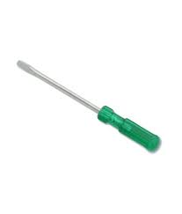
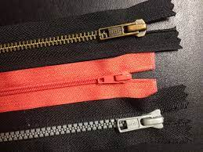
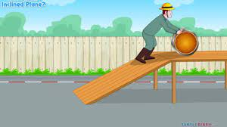
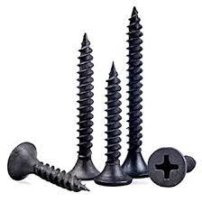
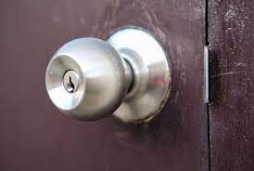
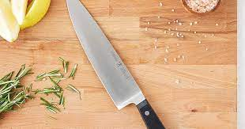
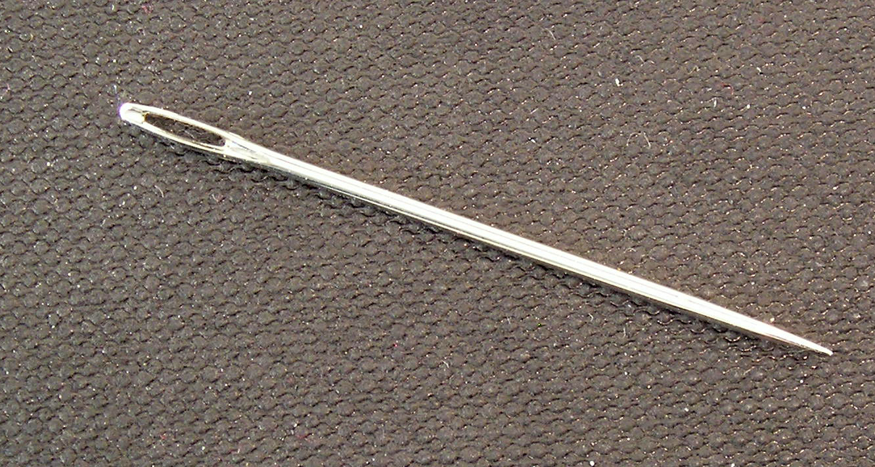
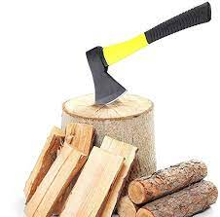
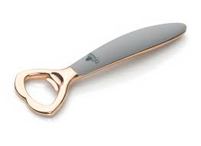
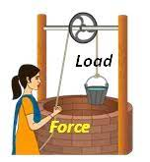
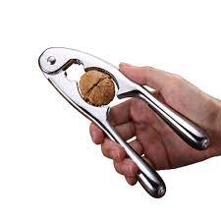
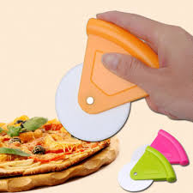
SIMPLE MACHINES
Tools which make our work easier and faster are called machines.
Simple machines help us to do work by applying force at a convenient point which either changes the direction of force or increases the force applied.

Slide 5
TYPES OF SIMPLE MACHINES
Inclined Plane
Pulley
Lever
Wheel and axle
Wedge
Screw

Slide 6
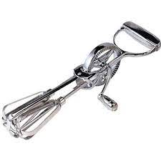
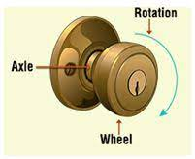
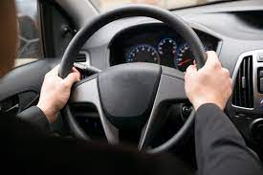
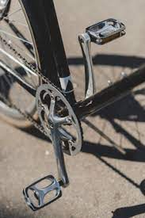
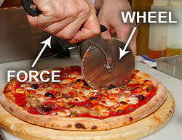
WHEEL AND AXLE
A wheel with a rod attached to it is known as a wheel and axle.
This arrangement is used in big machines.

Slide 7
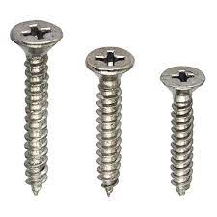
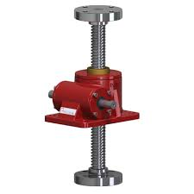
SCREW
A screw is a simple machine used to hold things tightly.
A screw is actually an inclined plane wrapped around a rod.
Screw is a nail with grooves around it.
Biggest screws, called screw jacks, are used to lift cars and other heavy objects.

Slide 8
SCREW BETTER THAN A NAIL
When we join things together with the screw they are held together through a longer distance and thus cannot be forced apart easily.
On the other hand, when we join things with the nail they are held together only for a short distance, that is through the length of the nail. That is why a screw is better than a nail.

Slide 9
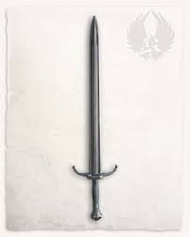
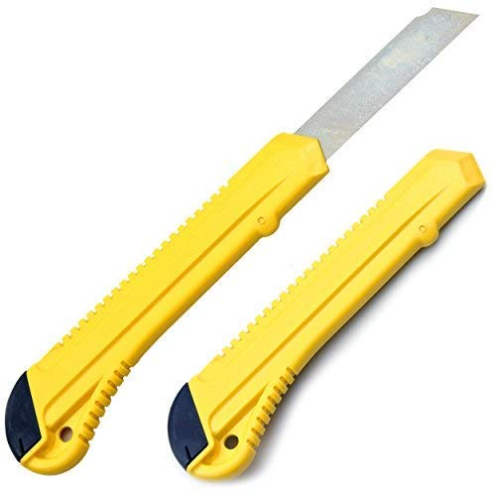
WEDGE
A wedge is an object with one pointed edge and one thick edge.
It is actually two inclined planes joined together.
It is used to cut things.

Slide 10
SUMMARY
Tools which make our work easier and faster are called machines.
Simple machines help us to do work by applying force at a convenient point which either changes the direction of force or increases the force applied.
A wheel with a rod attached to it is known as a wheel and axle.
A screw is actually an inclined plane wrapped around a rod.
Screw is a nail with grooves around it.
A wedge is an object with one pointed edge and one thick edge.
It is actually two inclined planes joined together.

Slide 11


Slide 12
A ______________ is a simple machine used to hold things tightly together.
Ans: Screw

Slide 13
2. Egg-beater is an example of _______________.
Ans: Wheel and axle

Slide 14
3. Needle is an example of ________________.
Ans: Wedge

Slide 15
HOMEWORK
Learn Ch-9.

Slide 16
LEARNING OUTCOME
The learner will be able to:
understand about machines.
identify the types of simple machines commonly used.
understand the importance of machines in real life.

Slide 17
THANKING YOU
ODM EDUCATIONAL GROUP

