Slide 1


SESSION NO.: 7
CLASS: 5
SUBJECT: SCIENCE
CHAPTER NUMBER: 11
CHAPTER NAME: FORCE AND ENERGY
SUB TOPIC: ENERGY, DIFFERENT FORMS OF ENERGY- SOLAR ENERGY, GEOTHERMAL ENERGY, WIND ENERGY
Notes:
Different forms of energy- wind energy, hydro power, heat energy
Do the questions A, B & C in your notebook

Slide 2
LEARNING OBJECTIVE
To enable the learner to:
understand about energy.
identify the types of energy.
understand the importance of energy in real life.
Notes:
Introduction
The brain
Write the difficult words
The spinal cord
Nerves
Kinds of nerves
Draw a labelled diagram of human brain
Sense organs- the eyes
Do the oral Q& A of page no. 93,
Do the questions A, B & C in your notebook
Sense organs- the ears, the nose, the tongue, the skin
Draw a labelled diagram of human eye
Long Q & A
Learn the Q & A
Activity
Class test

Slide 3
LET’S RECAP
All big machines are combinations of ________________ machines.
Ans: simple
A ___________________ is simple machine used to hold things more tightly than a nail.
Ans: screw
A flagpole used to hoist a flag has ____________ pulley.
Ans: fixed
A _________________ is a simple machine which consists of a wheel attached with a rod.
Ans: wheel and axle
A slide is an _________________.
Ans: inclined plane

Slide 4
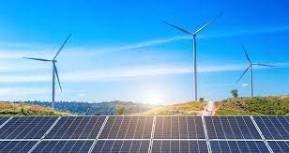
ENERGY
Energy is the ability to do work.
Energy is everywhere in nature: sunlight, water, wind, plants and animals.

Slide 5
DIFFERENT SOURCES OF ENERGY
The sun- which gives us solar energy.
The wind - which provides us wind energy.
The water- which provides us with hydro energy.
The hot interior of the earth- which provides us with geothermal energy.

Slide 6
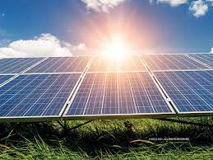
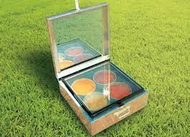
SOLAR ENERGY
It is the most readily available source of energy.
It is non polluting.
We can use solar energy to dry our clothes.
It can also be used for cooking food, heating water, etc.

Slide 7
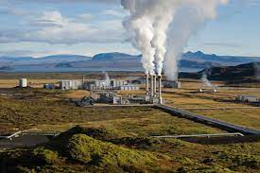
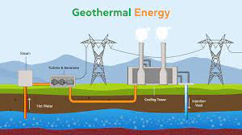
GEOTHERMAL ENERGY
The word geothermal comes from the Greek words Geo meaning earth and therme means heat. So, geothermal energy is heat from within the earth.
It is a renewable source of energy because of the water cycle which continuously goes on in our atmosphere.

Slide 8
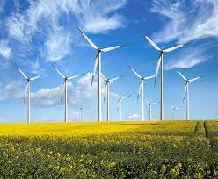
WIND ENERGY
Wind energy is a renewable, widely distributed, clean and non polluting sources of energy.
It is considered to be the most environmentally friendly energy source.
Wind energy can be converted into electricity by using wind turbines.

Slide 9
SUMMARY
Energy is the ability to do work.
There are many different sources from which we get energy like the sun, wind, water and the hot interior of the earth.
The energy that we get from these sources are non-polluting and renewable.

Slide 10


Slide 11
The most readily available source of energy.
Ans: Solar energy

Slide 12
2. The energy that we get from the hot interior of the earth.
Ans: Geothermal energy

Slide 13
3. The energy used to run the wind turbines.
Ans: Wind energy

Slide 14
HOMEWORK
Do the oral Q & A of page no. 103 in your notebook.

Slide 15
D. Write short answers.
Name the different types of forces.
Ans: The different types of forces are:
muscular force
gravitational force
frictional force
elastic force
mechanical force
buoyant force
2. What are simple machines?
Ans: Tools that make our work easier, faster and with less force are called simple machines. They have only few simple parts.
3. Why is geothermal energy referred to as a renewable source of energy?
Ans: Geothermal energy is referred to as a renewable source of energy because the heat is continuously produced inside the earth.

Slide 16
LEARNING OUTCOME
The learner will be able to:
understand about energy.
identify the types of energy.
understand the importance of energy in real life.

Slide 17
THANKING YOU
ODM EDUCATIONAL GROUP

