Slide 1


WELCOME TO THE ONLINE CLASS
SESSION NO.: 5
CLASS: 5
SUBJECT: SCIENCE
CHAPTER NUMBER: 9
CHAPTER NAME: OUR SKELETAL SYSTEM
SUB TOPIC: MUSCLES AND MOVEMENTS
Notes:
Long Q & A
Learn the Q & A
Activity / Class Test

Slide 2
LEARNING OBJECTIVE
To enable the learner to:
know the importance of muscles.
understand how the bones and muscles together help in movement.

Slide 3
LET’S RECAP
Give answer in one word.
The meeting point of two bones held together by strong tissues called ligaments.
Strong tissues that bind the bones at a joint.
The joints that do not allow any kind of movement of the bones.
The joint found in our wrist.
The joint found in between our skull and first vertebra.

Slide 4
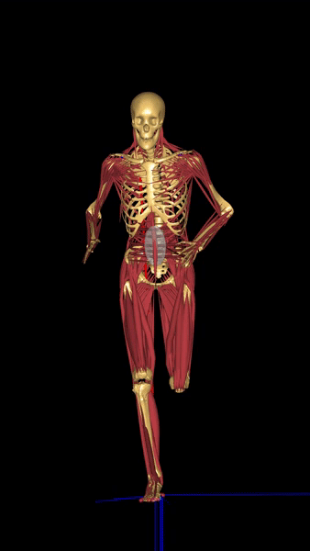
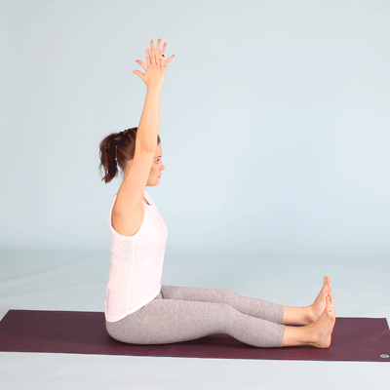
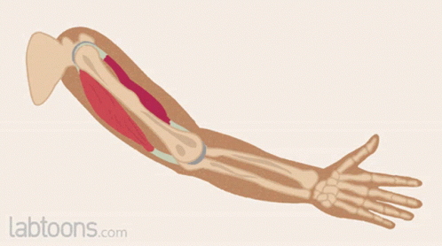
MUSCLES AND MOVEMENT
The muscles in the body tighten and relax to produce movement.
There are about 650 muscles in the body and each one causes a particular movement.

Slide 5
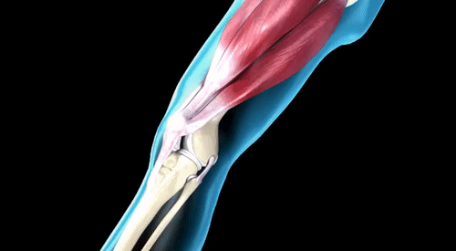
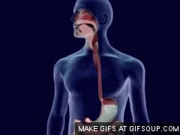
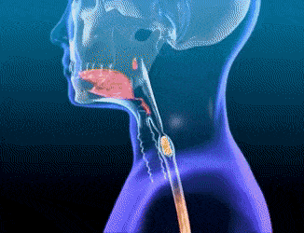
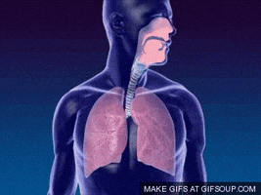
MUSCLES AND MOVEMENT
Muscles help us to bend our arms and knees.
Muscles help us to chew our food.
Muscles push food into the digestive canal.
Muscles allow us to inhale air into our lungs.
Notes:
,,, and make our heartbeat.

Slide 6
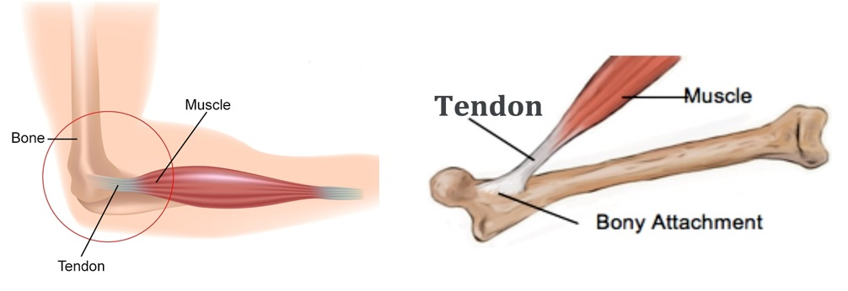
TENDONS
Muscles are attached to the bones by strong fibres called tendons.
These tendons or fibres become stronger with regular exercise.

Slide 7
TYPES OF MUSCLES
Voluntary muscles
Involuntary muscles

Slide 8
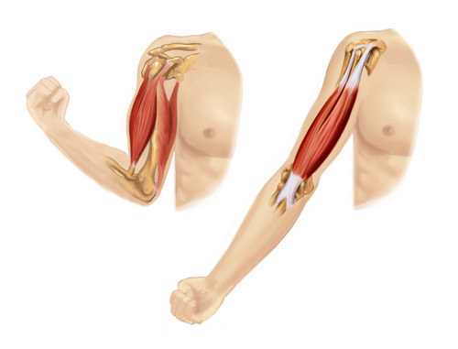
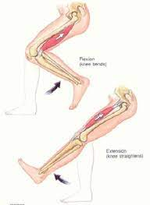
VOLUNTARY MUSCLES
The muscles which are under our control are called voluntary muscles.
E.g.: the muscles attached to our skeleton.

Slide 9
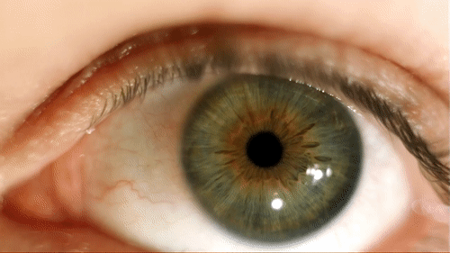
INVOLUNTARY MUSCLES
The muscles which are not under our control are called involuntary muscles.
They control actions like the movement of food in the alimentary canal, the flow of blood and the movement of the eye muscles.

Slide 10
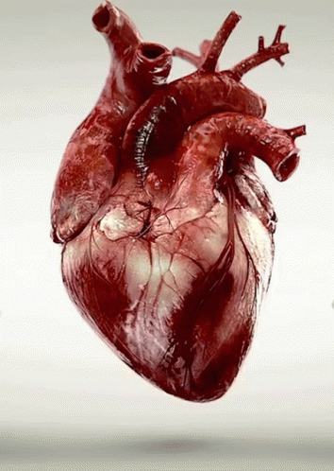
CARDIAC MUSCLES
The muscles of the heart are known as cardiac muscles.
They are also involuntary muscles .

Slide 11
HOW DO MUSCLES WORK?
Muscles produce movement in the body by pulling on the bones.
The contraction and expansion of muscles helps to move over body parts.
When the knee bends, one muscle contracts and get shorter whereas the other one relaxes. When the leg stretches the reverse happens.

Slide 12
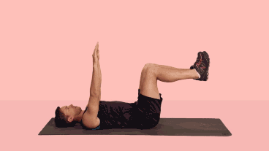
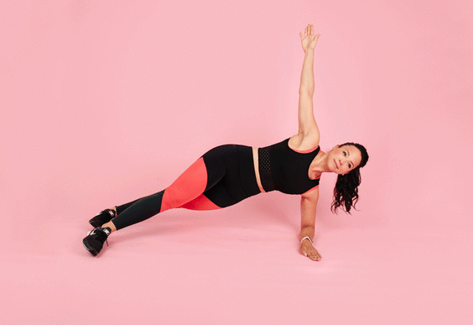
HOW DO MUSCLES WORK?
A good posture is needed to be maintain the muscles in good shape.
We must exercise and rest properly and have a healthy diet in order to keep our body healthy.

Slide 13
SUMMARY
The muscles in the body tighten and relax to produce movement.
There are about 650 muscles in the body and each one causes a particular movement.
Strong fibres with which muscles are attached to bones is known as tendons.
There are two types of muscles- voluntary and involuntary.
The muscles of the heart are known as cardiac muscles.

Slide 14
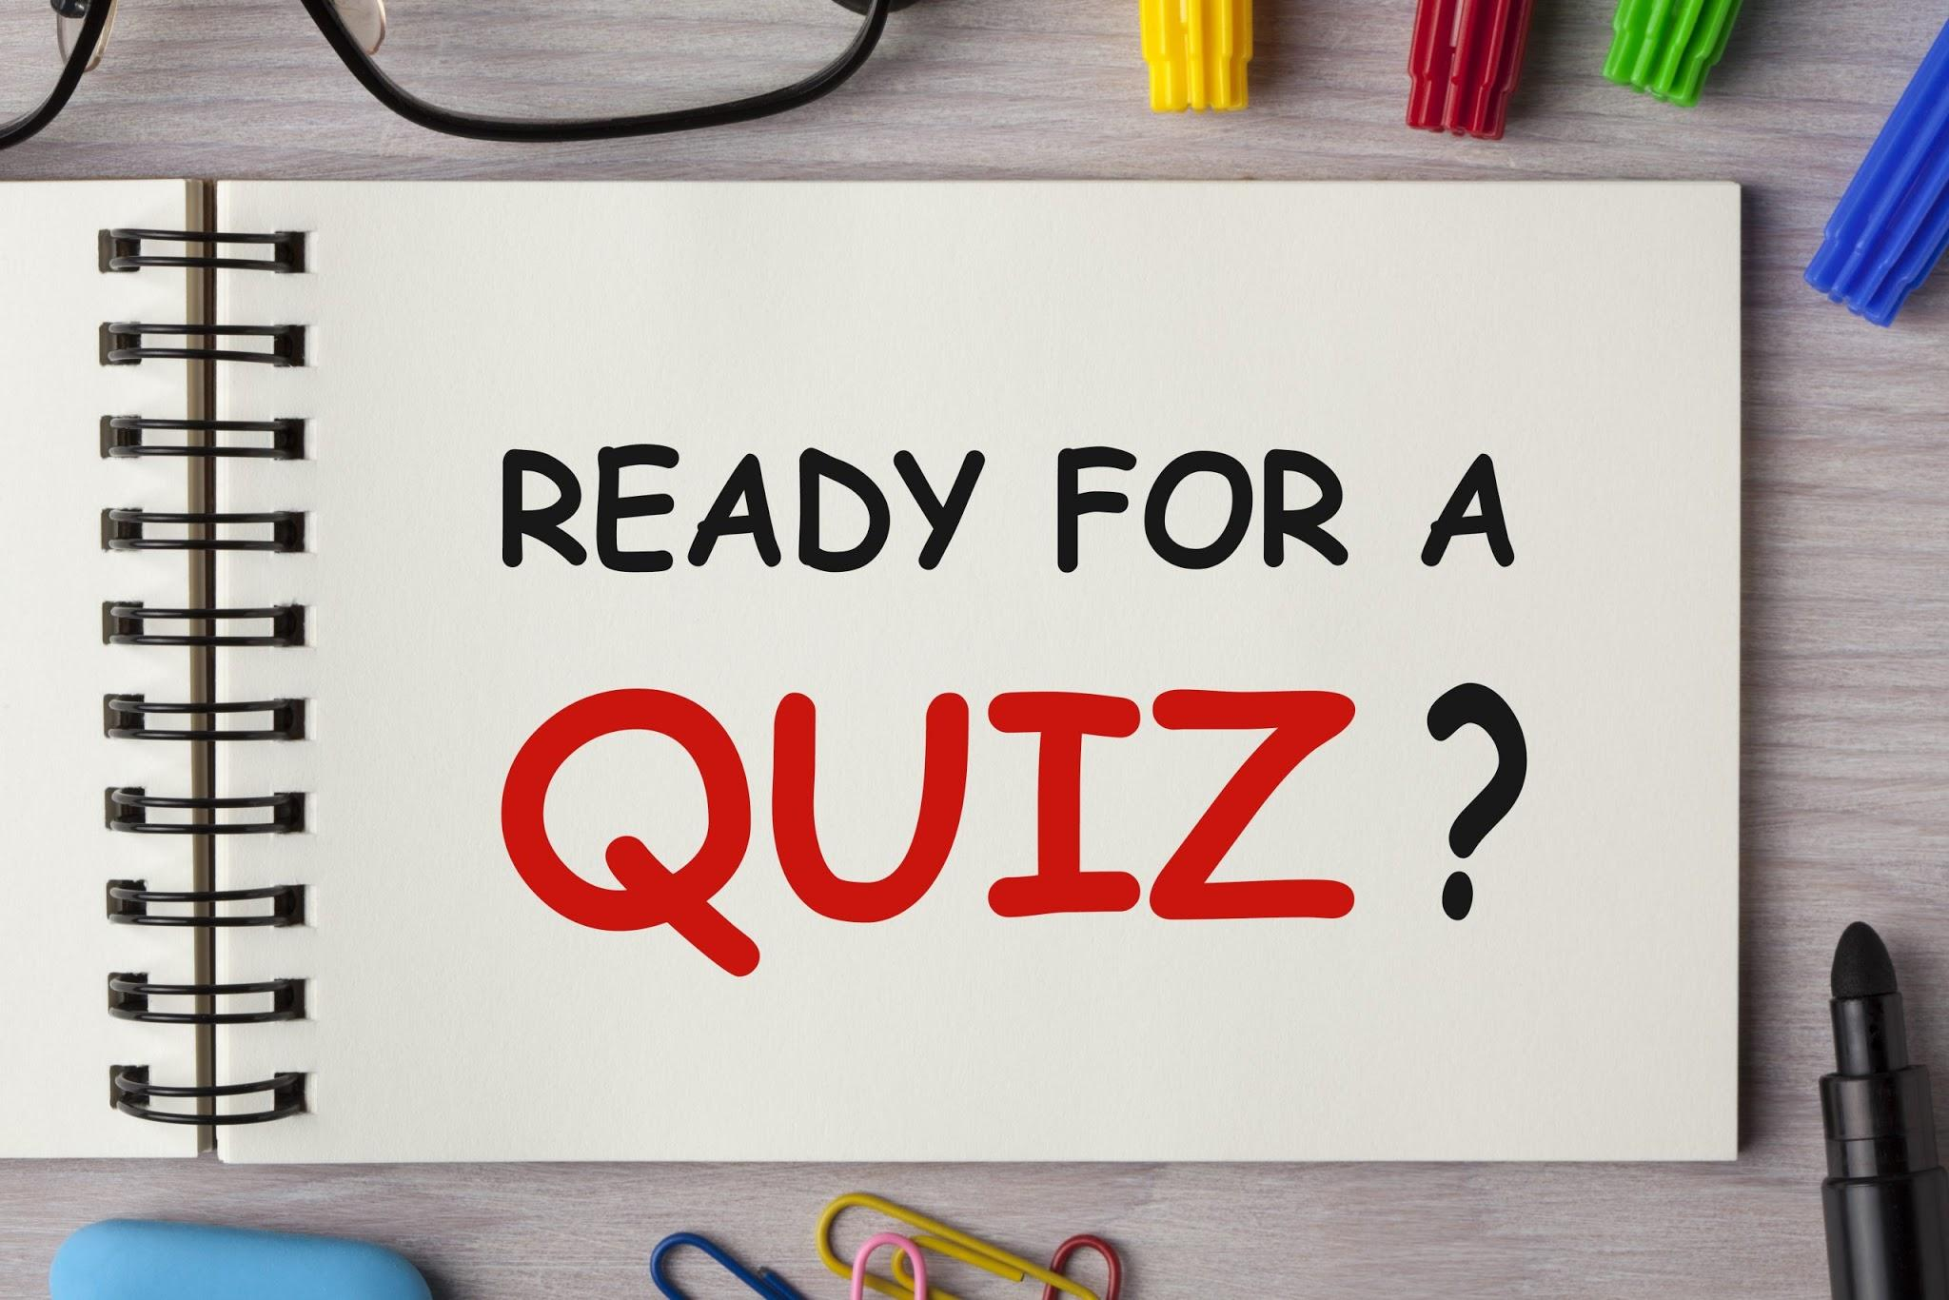

Slide 15
Strong fibres with which muscles are attached to bones.
Ans: Tendons

Slide 16
2. Muscles attached to our skeleton are __________ muscles.
Ans: voluntary

Slide 17
3. The movement of food in the alimentary canal happens because of ___________ muscles.
Ans: Involuntary

Slide 18
HOMEWORK
What disadvantages would you face if your backbone is made up of just one long bone?

Slide 19
D. Write short answers.
What is a joint?
Ans: A joint is the meeting point of two bones held together by ligaments.
Name the different kinds of movable joints in your body.
Ans: The different kinds of movable joints in our body are:
the hinge joint
the ball and socket joint
the pivot joint
the gliding joint
Which part of the facial region is movable? How does it help us?
Ans: The lower jaw of the facial region is movable. It helps us to eat and talk.

Slide 20
D. Write short answers.
4. What is bone marrow?
Ans: The soft, spongy material found inside the cavities of long bones is known as bone marrow.
5. What are tendons?
Ans: Tendons are the strong fibres with which muscles are attached to bones.

Slide 21
LEARNING OUTCOME
The learner will be able to:
know the importance of muscles.
understand how the bones and muscles together help in movement.

Slide 22
THANKING YOU
ODM EDUCATIONAL GROUP

