Slide 1


WELCOME TO THE ONLINE CLASS
SESSION NO.: 4
CLASS: 5
SUBJECT: SCIENCE
CHAPTER NUMBER: 9
CHAPTER NAME: OUR SKELETAL SYSTEM
SUB TOPIC: JOINTS
Notes:
MUSCLES AND MOVEMENTS
What disadvantages would you face if your backbone is made up of just one long bone?
Long Q & A
Learn the Q & A
Activity / Class Test

Slide 2
LEARNING OBJECTIVE
To enable the learner to:
understand about joints and ligaments
recognize the different kinds of joints found in our skeleton
learn about the location of each joint.
Notes:
know the importance of muscles.
understand how the bones and muscles together help in movement.

Slide 3
LET’S RECAP
Name the longest bone present in our body.
What do you call the spongy material found in the cavities of long bones?
Each small bone of the vertebral column is known as _________.
The __________ are delicate, curved bones which are joined to the backbone and the breastbone.
What will you call the ribs that are only joined to the backbone?

Slide 4
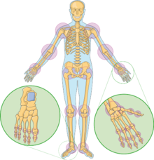
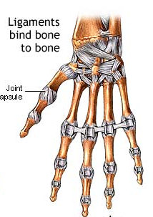
JOINTS
A joint is the meeting point of two bones held together by strong tissues called ligaments.

Slide 5
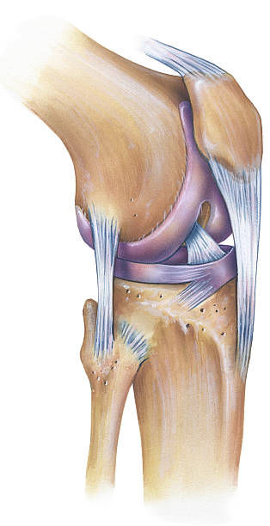
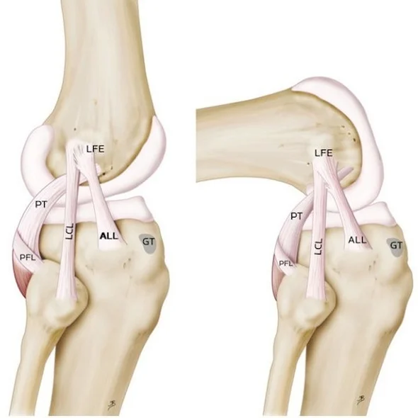
LIGAMENTS
Strong tissues that bind the bones at a joint.

Slide 6
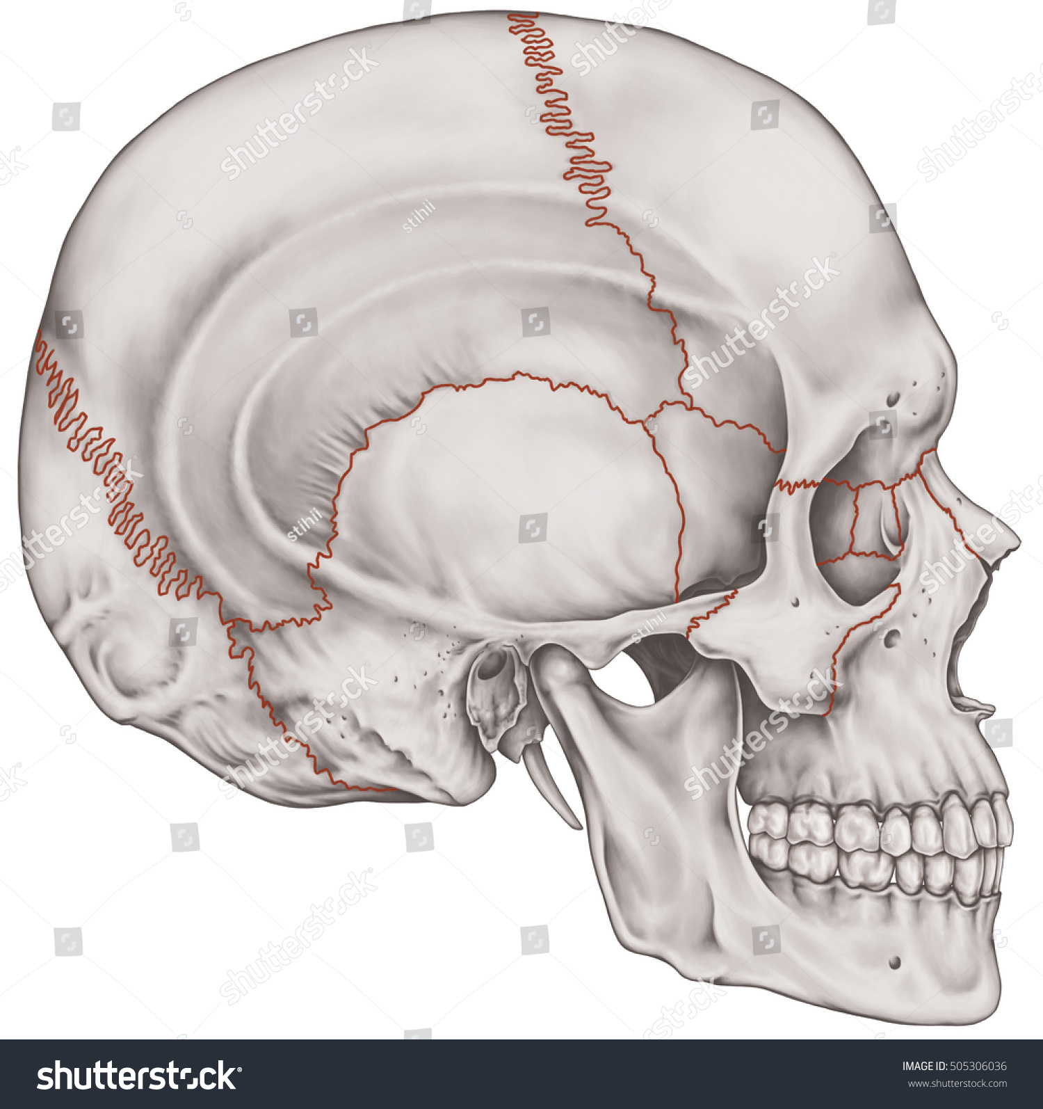
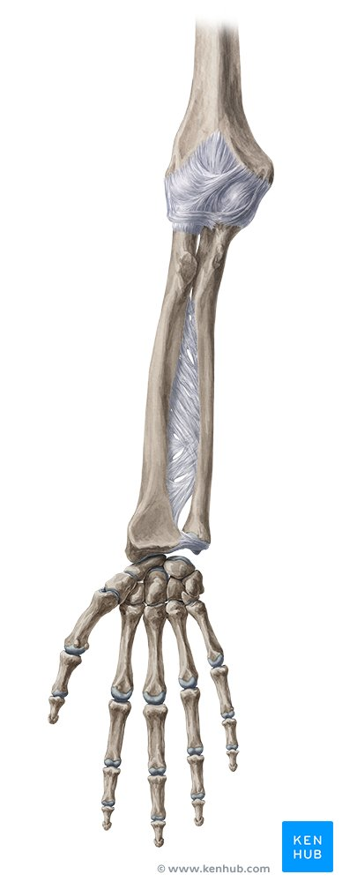
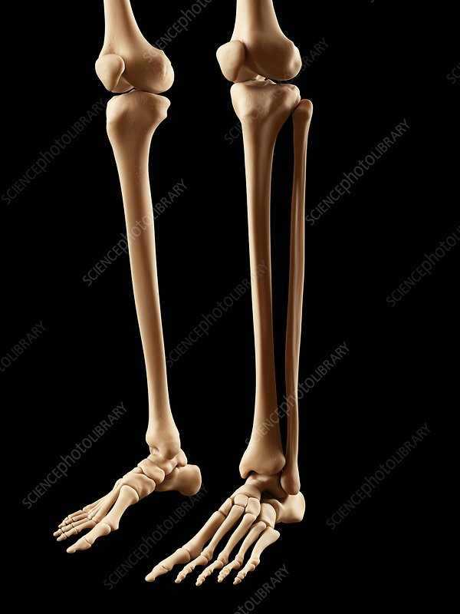
TYPES OF JOINTS
Immovable joints
Movable joints

Slide 7
IMMOVABLE JOINTS
The joints that do not allow any kind of movement of the bones are called immovable joints.
E.g.: The joints which are found in skull.
The bones in the skull are interlocked, making the joints immovable.

Slide 8
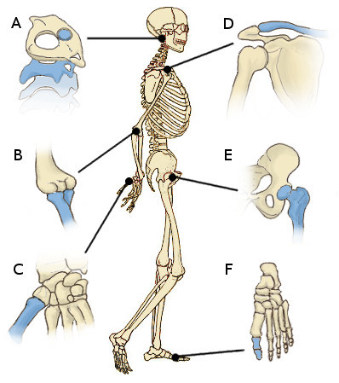
MOVABLE JOINTS
The joint that allows different kinds of movement of the bones are called movable joints.
E.g.: The joints which are found in wrist, shoulder, etc.

Slide 9
TYPES OF MOVABLE JOINTS
The hinge joints
The ball and socket joint
The pivot joints
The gliding joints

Slide 10
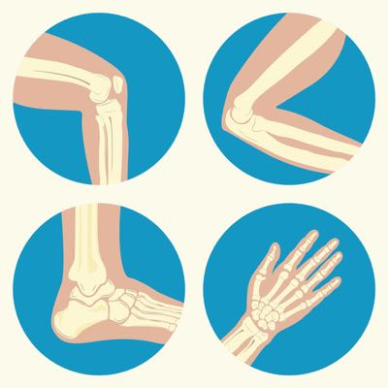
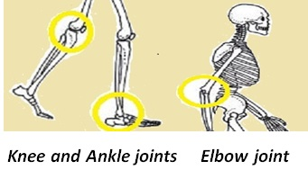
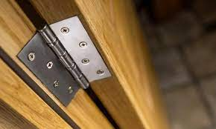
THE HINGE JOINT
It is like the hinges in a door.
We can move the bones only in one direction.
The elbows, knees, fingers and toes have hinge joints.

Slide 11
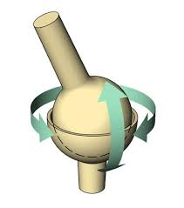
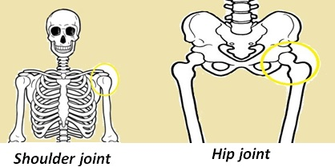
THE BALL AND SOCKET JOINT
It allows maximum movement as displayed by ballet dancers.
One bone that ends in a ball fit into the socket of the other.
Hip and shoulder joints are of this type.

Slide 12
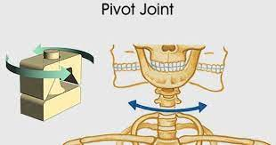
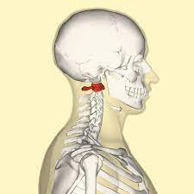
THE PIVOT JOINT
A pivot joint is found between the skull and the first two vertebrae of the spine.
The uppermost vertebra in the neck is called atlas.
We can move our head sideways, upward and downward with the help of the pivot joint.
ATLAS

Slide 13
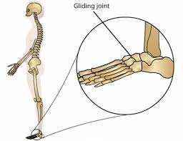
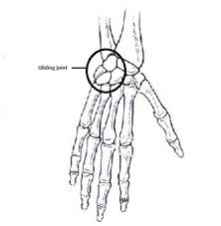
THE GLIDING JOINT
It allows movement at the wrist and ankle and also between any two vertebrae of the spine.
It allows our back to bend, twist and turn at each joint.

Slide 14
SUMMARY
A joint is the meeting point of two bones held together by strong tissues called ligaments.
Strong tissues that bind the bones at a joint are called ligaments.
There are two types of joints- movable and immovable joints.
Immovable joints are of 4 types- hinge joint, ball and socket joint, pivot joint and gliding joint.

Slide 15


Slide 16
The joint found in our arm.
Ans: Hinge joint

Slide 17
2. The uppermost vertebra in the neck is called ____________.
Ans: Atlas

Slide 18
3. The joint that do not allow any movement.
Ans: Immovable joint

Slide 19
D. Write short answers.
What is a joint?
Ans: A joint is the meeting point of two bones held together by ligaments.
Name the different kinds of movable joints in your body.
Ans: The different kinds of movable joints in our body are:
the hinge joint
the ball and socket joint
the pivot joint
the gliding joint
Which part of the facial region is movable? How does it help us?
Ans: The lower jaw of the facial region is movable. It helps us to eat and talk.

Slide 20
D. Write short answers.
4. What is bone marrow?
Ans: The soft, spongy material found inside the cavities of long bones is known as bone marrow.
5. What are tendons?
Ans: Tendons are the strong fibres with which muscles are attached to bones.

Slide 21
LEARNING OUTCOME
The learner will be able to:
understand about joints and ligaments
recognize the different kinds of joints found in our skeleton
learn about the location of each joint.

Slide 22
THANKING YOU
ODM EDUCATIONAL GROUP

