Slide 1


WELCOME TO THE ONLINE CLASS
SESSION NO.: 3
CLASS: 5
SUBJECT: SCIENCE
CHAPTER NUMBER: 9
CHAPTER NAME: OUR SKELETAL SYSTEM
SUB TOPIC: THE SKELETON- THE RIB CAGE, THE LIMBS, FUNCTIONS OF THE SKELETON
Notes:
Joints
Muscles and movements
What disadvantages would you face if your backbone is made up of just one long bone?
Long Q & A
Learn the Q & A
Activity / Class Test

Slide 2
LEARNING OBJECTIVE
To enable the learner to:
recognize the different kinds of bones found in our skeleton
learn about the function of each bone.
know the importance of the skeleton.

Slide 3
LET’S RECAP
________________ protects the delicate spinal cord. (Fill in the blanks)
The backbone is made up of _________ vertebrae.(Fill in the blanks)
There are _____________ bones in the facial region.(Fill in the blanks)
_____________ : 22 bones :: Spine : 33 bones (Complete the series)
How many bones are there in the human body?
The limbs are attached to two pairs of girdles. (True/False)

Slide 4
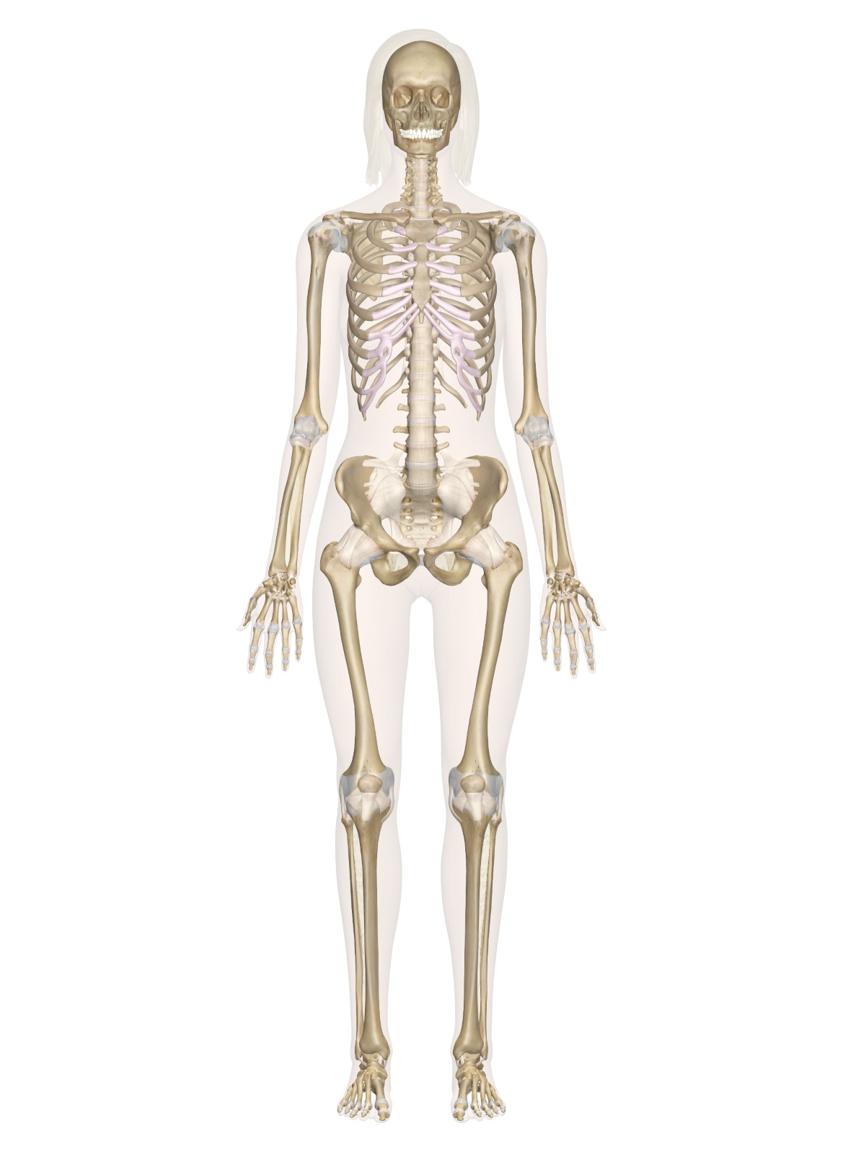
THE SKELETON
Skull
Shoulder girdle
Rib cage
Backbone
Hip girdle
Femur

Slide 5
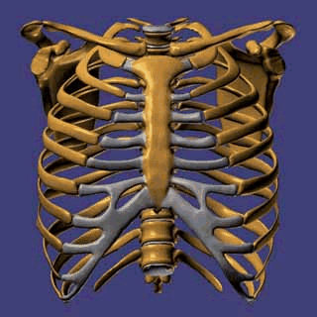
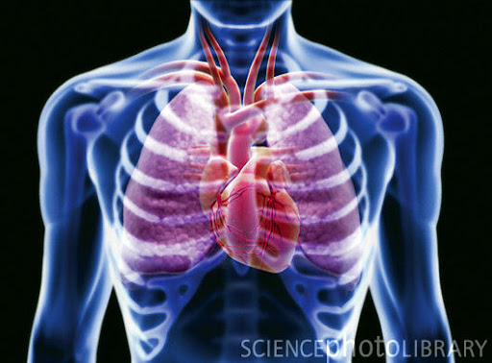
THE RIB CAGE
There are 12 pairs of bow-shaped ribs which form a cage and encloses the heart and the lungs.

Slide 6
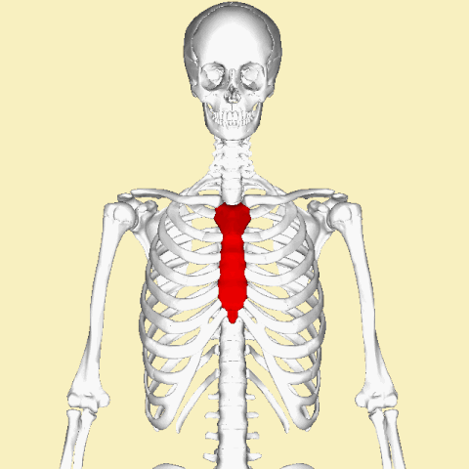
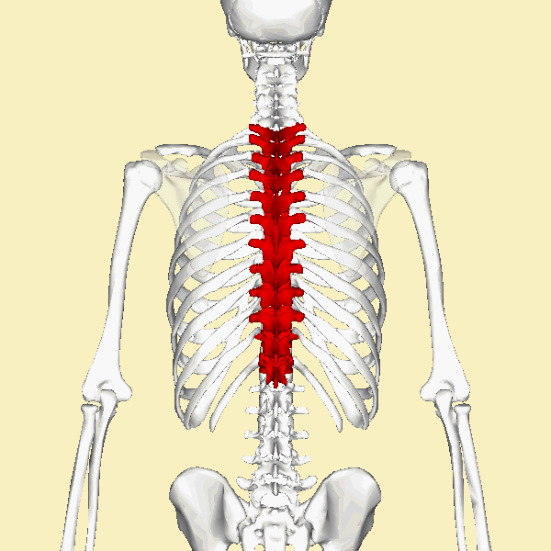
THE RIB CAGE
The ribs are delicate, curved bones which are joined to the backbone and the breastbone.
BREASTBONE
BACKBONE

Slide 7
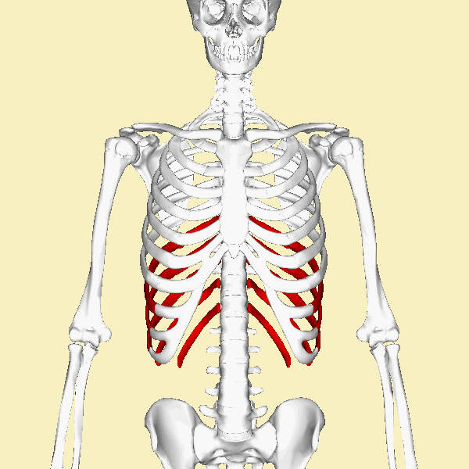
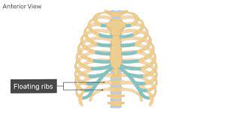
THE RIB CAGE
The lowest two pairs called floating ribs are joined only to the backbone.
FLOATING RIBS

Slide 8
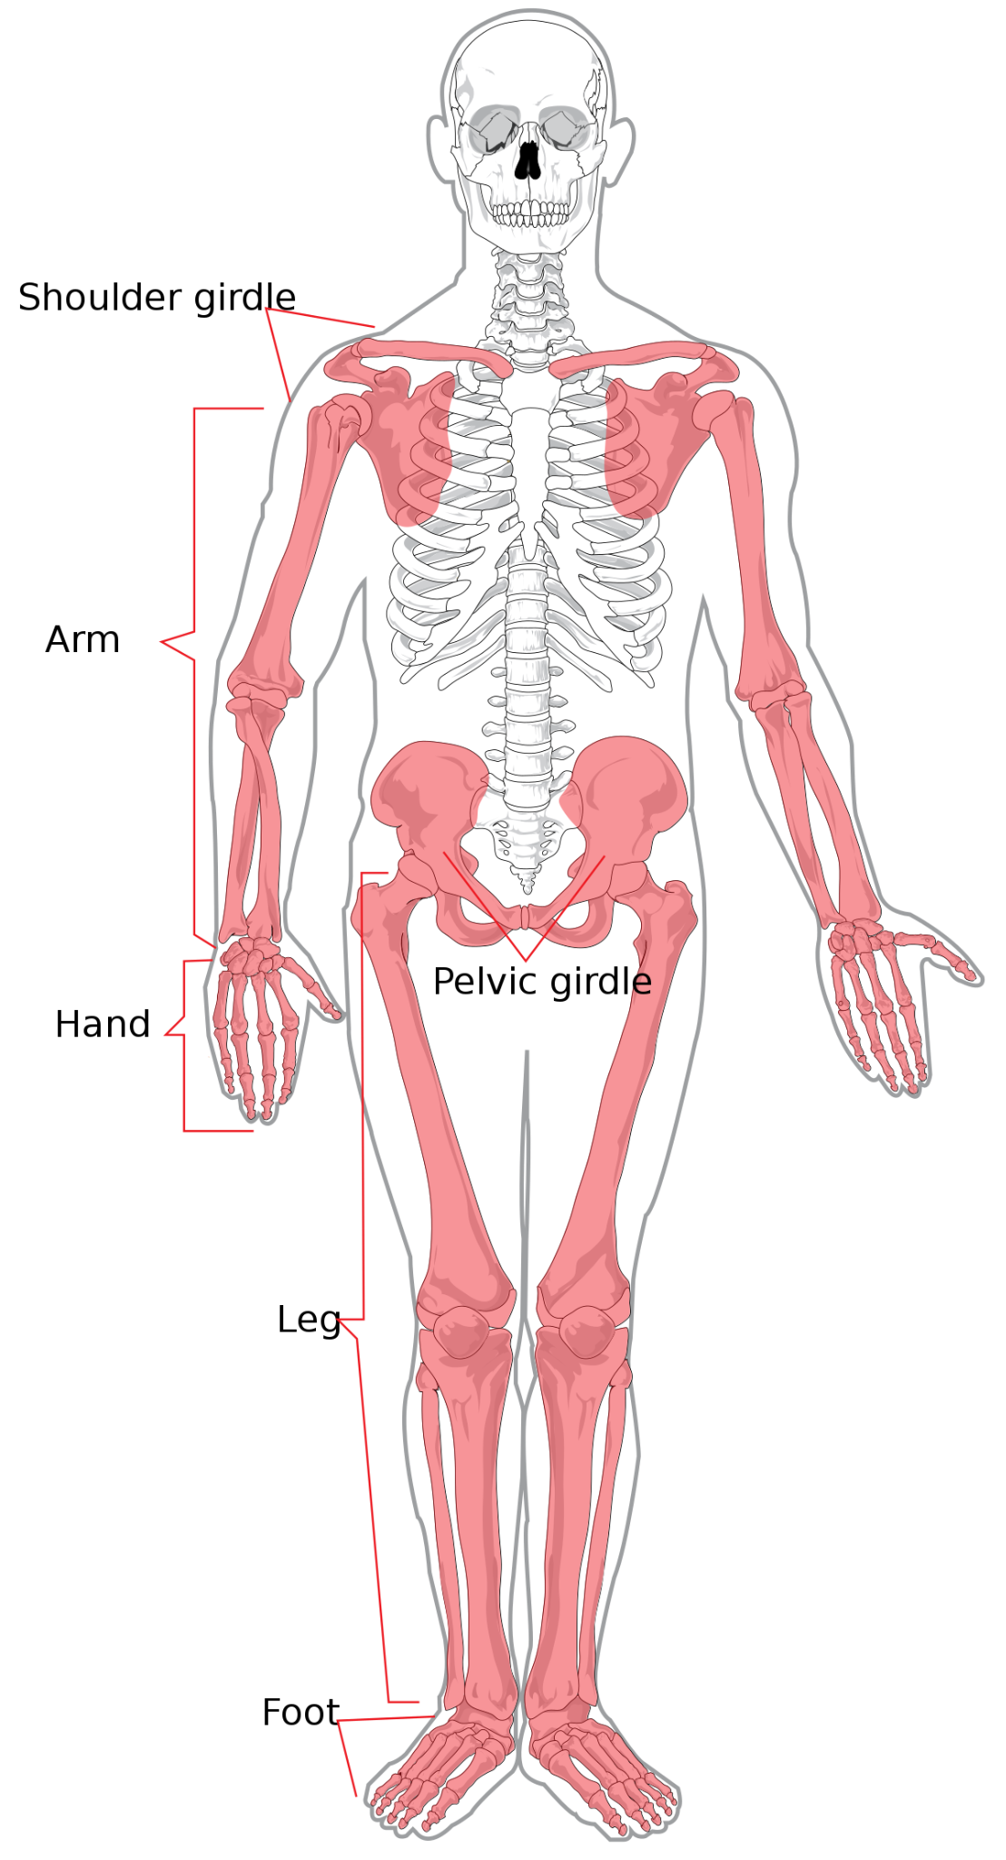
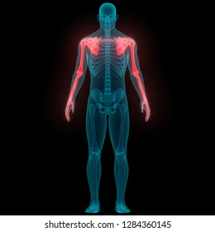
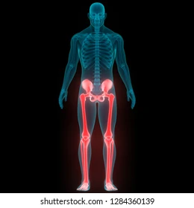
THE LIMBS
FORELIMBS
HINDLIMBS

Slide 9
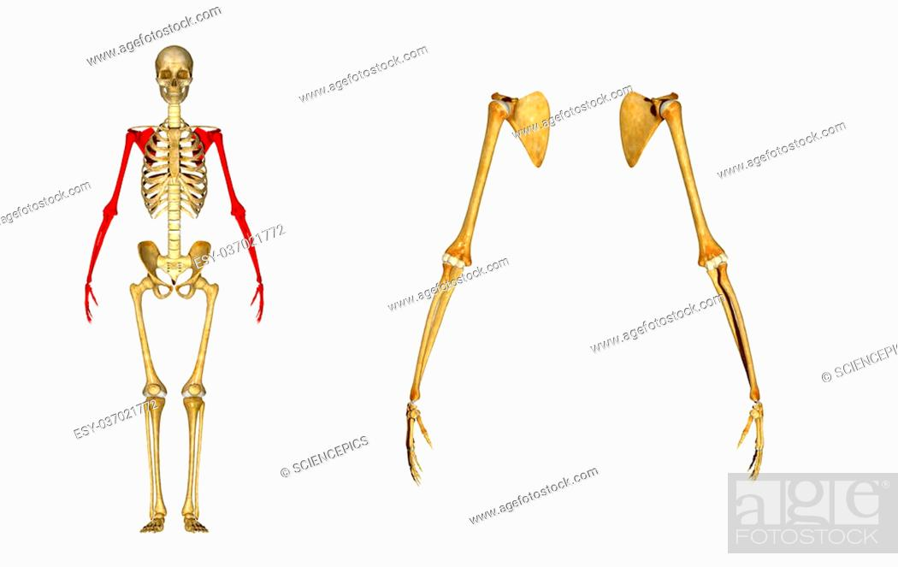
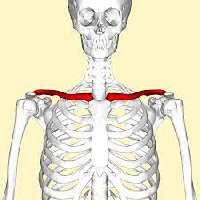
THE FORELIMBS
The forelimbs or the arms are joined to spine with the help of the shoulder girdle which consist of a pair of shoulder blades and a pair of collarbones.
SHOULDER GIRDLES
FORELIMBS
COLLARBONES

Slide 10
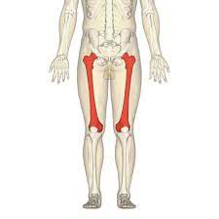
THE HINDLIMBS
The powerful thigh bone called femur bears the weight of the whole body.
Femur is the longest bone in human body.
HINDLIMBS
FEMUR

Slide 11
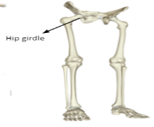
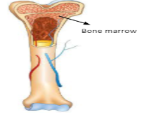
THE HINDLIMBS
It fits into the hip girdle with a ball and socket joint and is connected to the lower leg at the knee joint.
The long bones of the skeleton are hollow and are filled with a soft fatty substance called bone marrow.

Slide 12
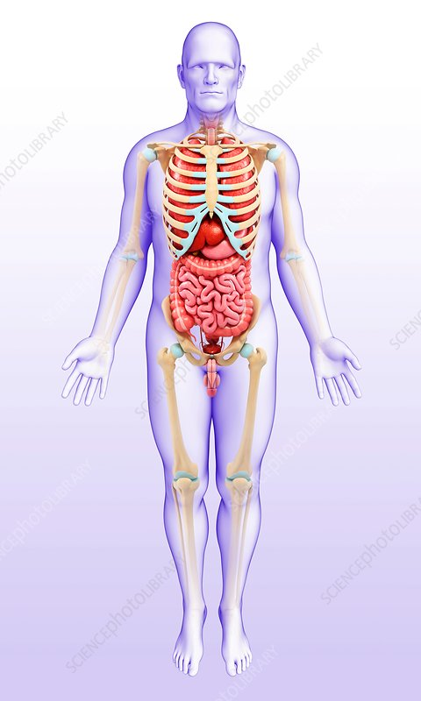
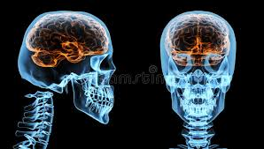
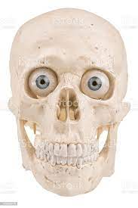
FUNCTIONS OF THE SKELETON
It gives shape, strength and support to our body.
It also protects our internal organs.
The skull protects the delicate brain.
The eyeballs rest inside the bony eye sockets.

Slide 13
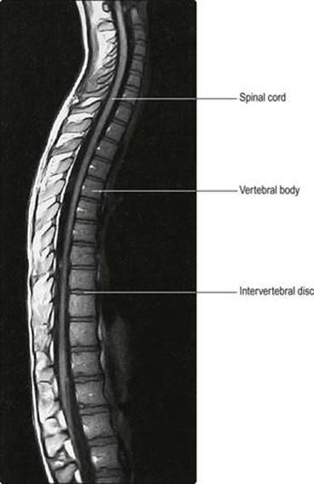
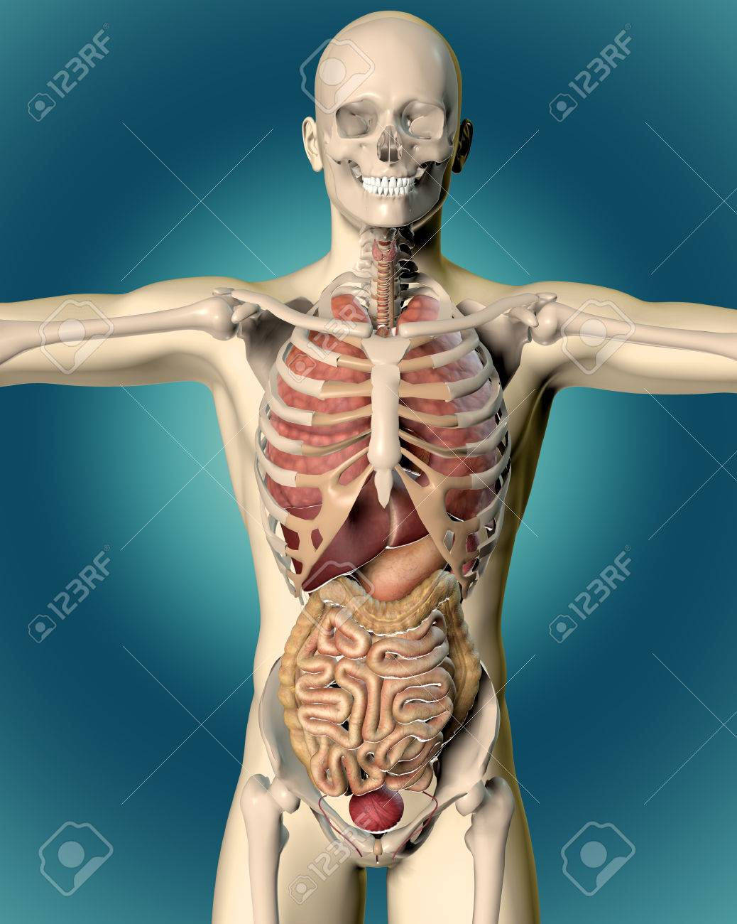
FUNCTIONS OF THE SKELETON
The backbone protects the spinal cord.
The rib cage protects the lungs and the heart.
The hip girdle protects the urinary bladder.

Slide 14
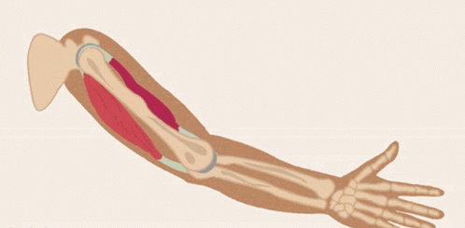
FUNCTIONS OF THE SKELETON
Muscles are attached to bones and make movement possible.
White blood cells and red blood cells are produced by the bone marrow in hollow bones.
White blood cells fight for an organism that invade our body.

Slide 15
SUMMARY
There are 12 pairs of bow-shaped bones which form rib cage.
Rib cage protects the internal organs like heart, lungs,etc.
There are two types of limbs- forelimbs and hindlimbs.
Femur is the longest bone in human body.
Skeleton gives shape, strength and support to our body.

Slide 16


Slide 17
The soft, spongy material found inside the cavities of long bones.
Ans: Bone marrow

Slide 18
2. The ____________ ribs are joined only to the backbone.
Ans: Floating

Slide 19
3. Bow-shaped bones that encloses the heart and the lungs.
Ans: The rib cage

Slide 20
4. The forelimbs are attached to the spine with the help of the __________ ____________.
Ans: Shoulder girdle

Slide 21
HOMEWORK
Do the oral Q & A of page no. 85.

Slide 22
LEARNING OUTCOME
The learner will be able to:
recognize the different kinds of bones found in our skeleton
learn about the function of each bone.
know the importance of the skeleton.

Slide 23
THANKING YOU
ODM EDUCATIONAL GROUP

