Slide 1


WELCOME TO THE ONLINE CLASS
SESSION NO.: 2
CLASS: 5
SUBJECT: SCIENCE
CHAPTER NUMBER: 9
CHAPTER NAME: OUR SKELETAL SYSTEM
SUB TOPIC: THE SKELETON- THE SKULL, THE BACKBONE OR SPINE
Notes:
The skeleton- the rib cage, the limbs, Functions of the skeleton
Do the oral Q& A of page no. 85
Joints
Muscles and movements
What disadvantages would you face if your backbone is made up of just one long bone?
Long Q & A
Learn the Q & A
Activity / Class Test

Slide 2
LEARNING OBJECTIVE
To enable the learner to:
know about the human skeleton.
recognize the different kinds of bones found in our skeleton
learn about the function of each bone.
know the importance of the skeleton.

Slide 3
LET’S RECAP
LET’S PLAY
https://www.jigsawplanet.com/?rc=play&pid=14758a4d1e8d
Name some internal organs.
List some organ systems of our body.

Slide 4
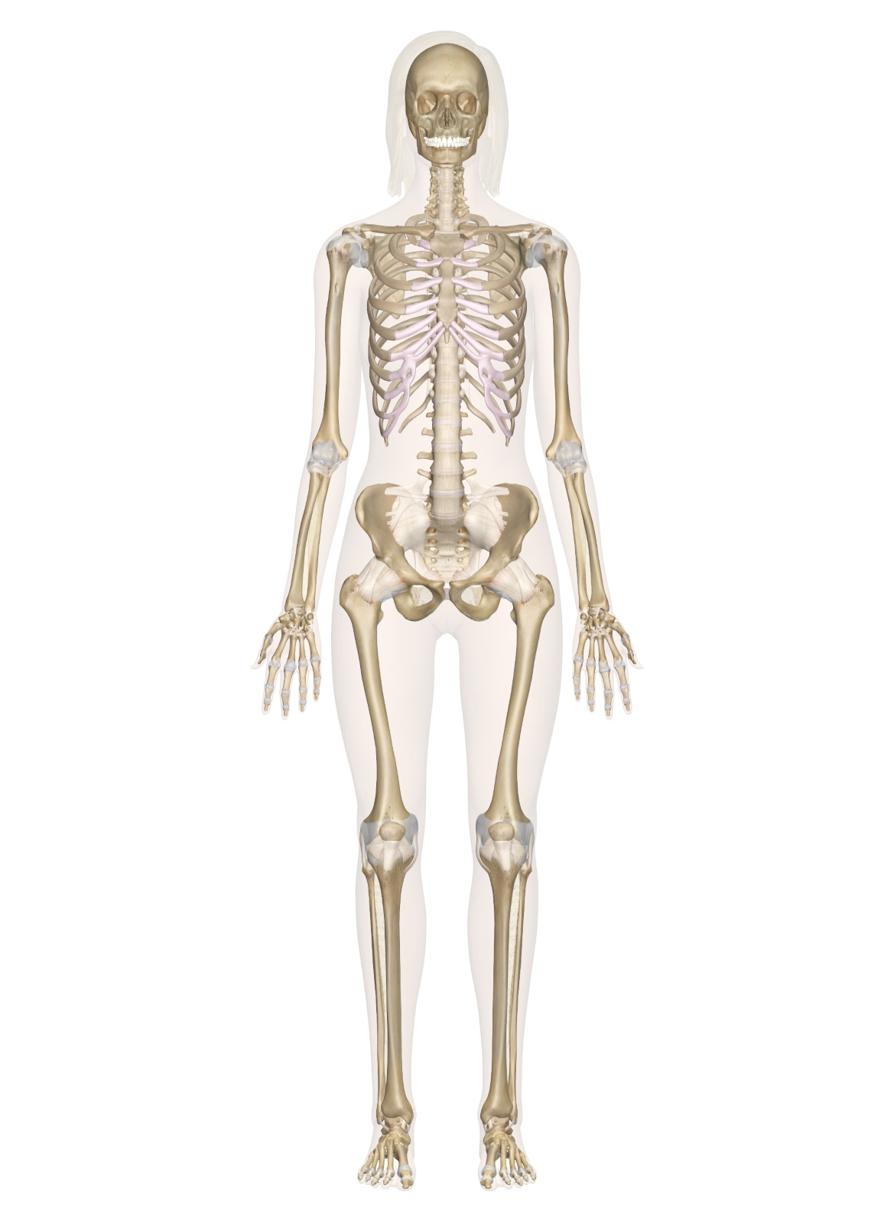
THE SKELETON
Skull
The human skeleton is a framework of bones which encloses and protects all the internal organs and gives support, strength and shape to the body.
There are 206 bones in an adult.
Shoulder girdle
Rib cage
Backbone
Hip girdle
Femur

Slide 5
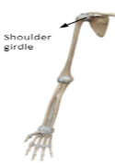
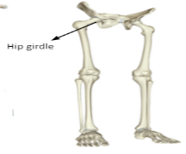
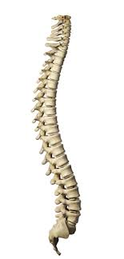
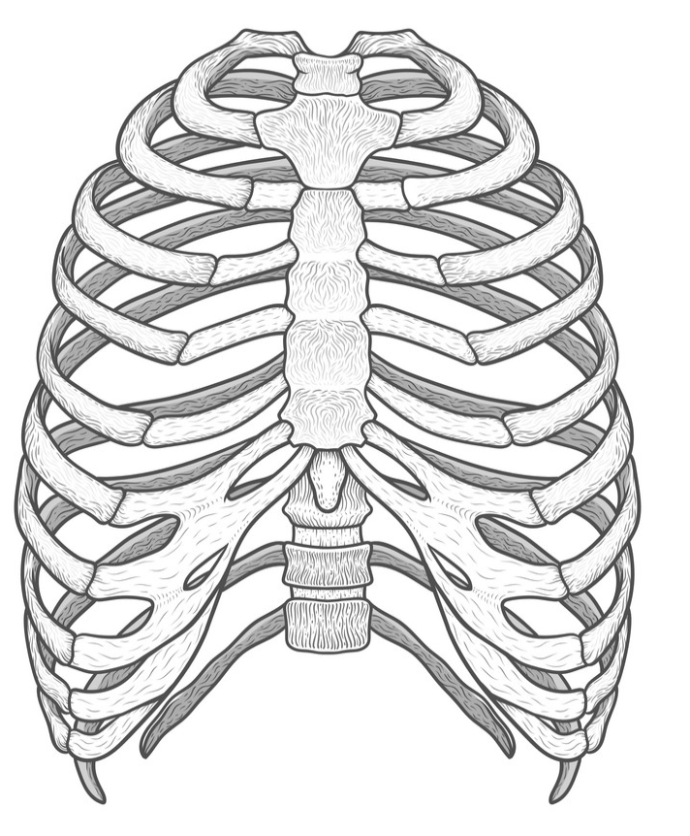
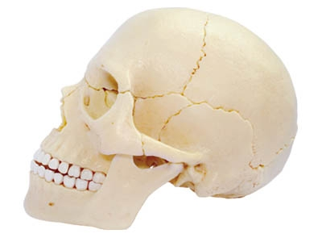
DIFFERENT PARTS OF THE SKELETON
SKULL
RIB CAGE
FORELIMBS
HINDLIMBS
SPINE/
BACKBONE
LIMBS

Slide 6
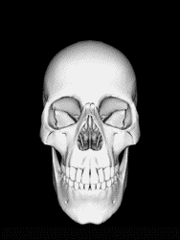
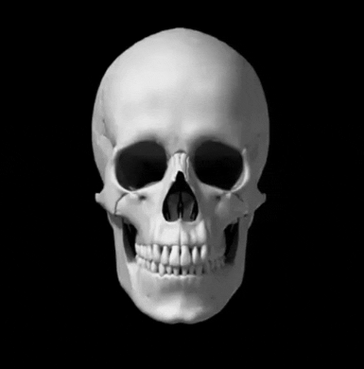
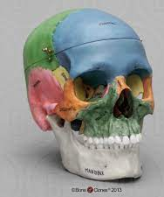
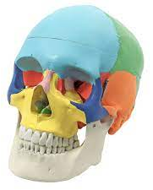
THE SKULL
It is made up of 22 bones.
Eight flat bones, interlock together, enclose the delicate brain inside it.
There are 14 bones in the facial regions and among them only the lower jaw is movable which enables us to eat and talk.

Slide 7
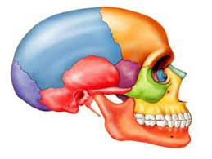
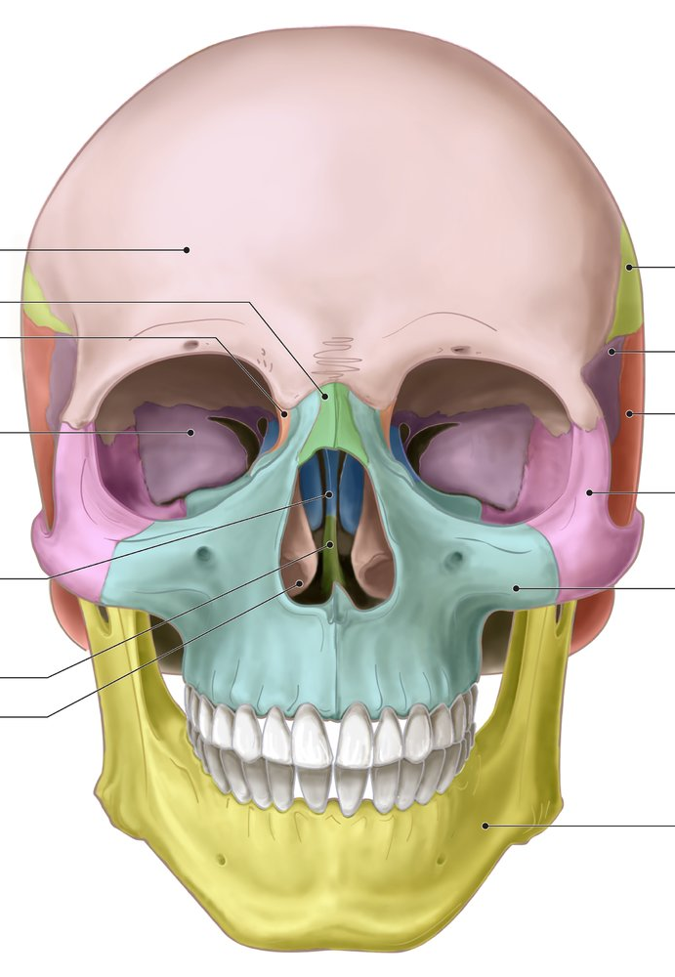
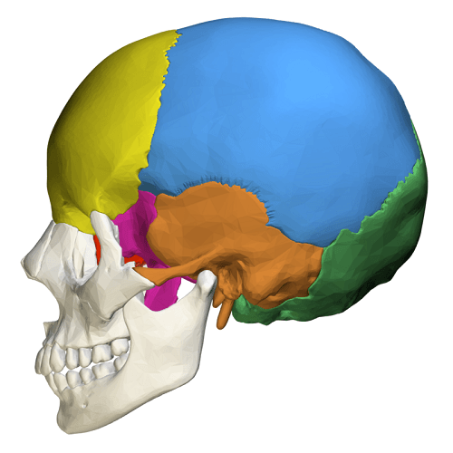
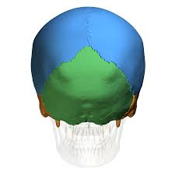
THE SKULL

Slide 8
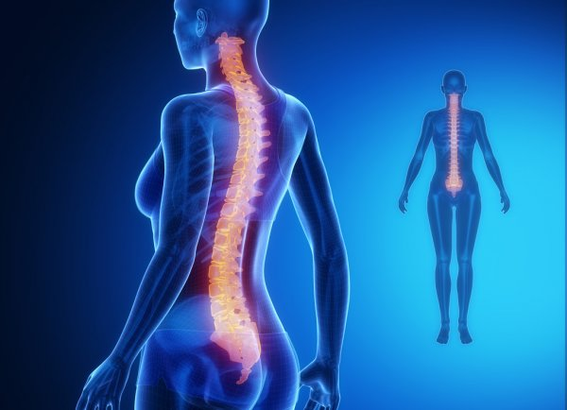
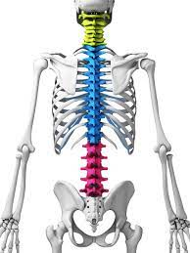
THE BACKBONE OR SPINE
The skull is attached to the backbone which forms the main axis of the skeleton.
It is made up of 33 small bones called vertebrae which forms a strong column called the vertebral column.

Slide 9
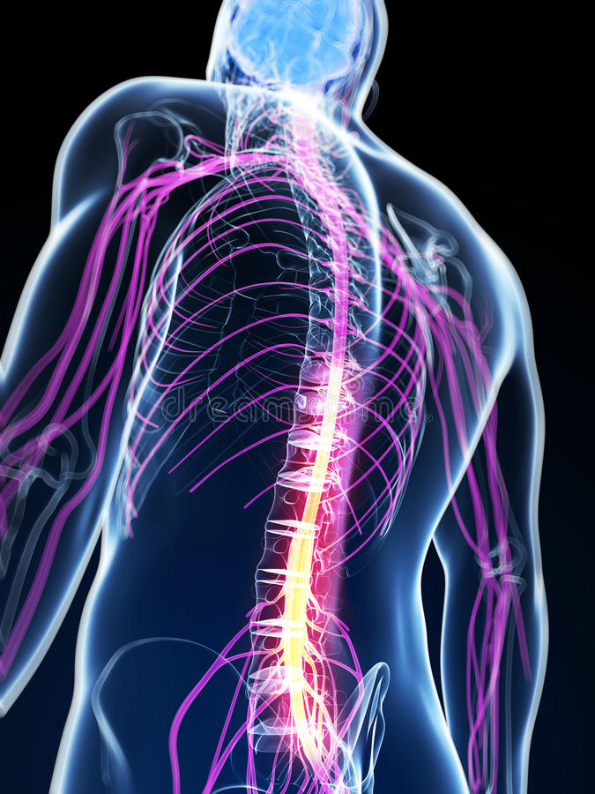
THE BACKBONE OR SPINE
The vertebral column protects the delicate spinal cord.

Slide 10
SUMMARY
The human skeleton is a framework of bones which encloses and protects all the internal organs and gives support, strength and shape to the body.
There are 206 bones in an adult.
The skeleton consists of the skull, the spine, the ribcage and the limbs.
The skull is made up of 22 bones and only lower jaw is movable.
It is made up of 33 small bones called vertebrae which forms a strong column called the vertebral column and protects the spinal cord.

Slide 11


Slide 12
A framework of bones that protects all the internal organs.
Ans: Skeleton

Slide 13
2. The skull is made up of ______________ bones.
Ans: 22

Slide 14
3. Which part of the facial region is movable? How it helps us?
Ans: The lower jaw of the facial region is movable. It helps us to eat and talk.

Slide 15
4. Spine is made up of ____________ small bones called _______________ which form a strong column called the ____________ column.
Ans: 33, vertebrae, vertebral

Slide 16
HOMEWORK
Do the questions A, B & C in your notebook.

Slide 17
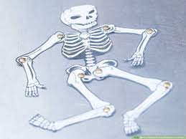
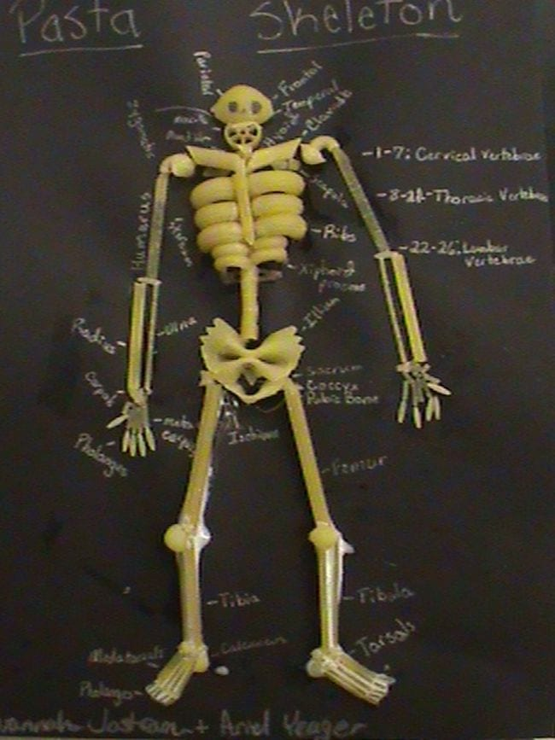
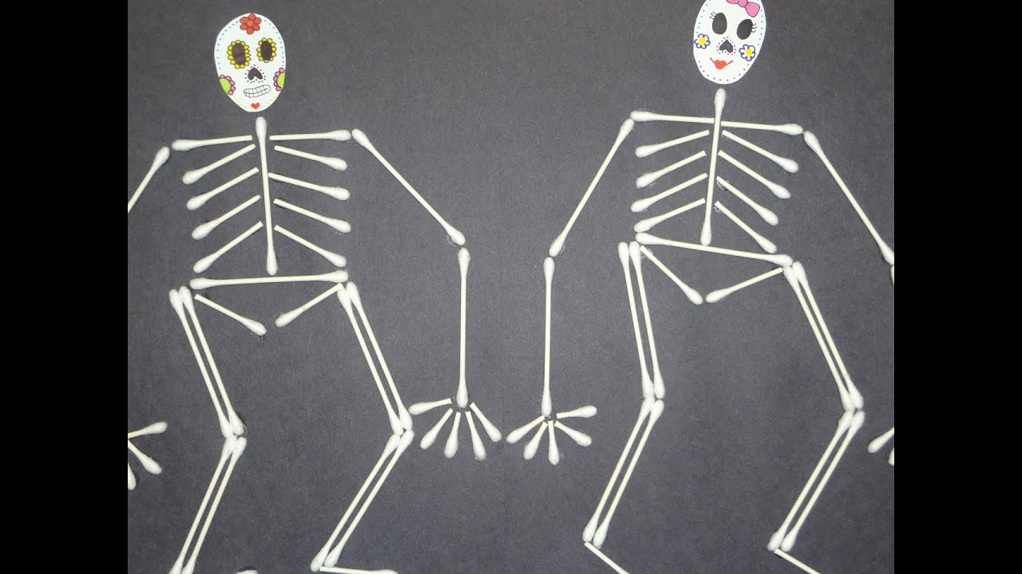
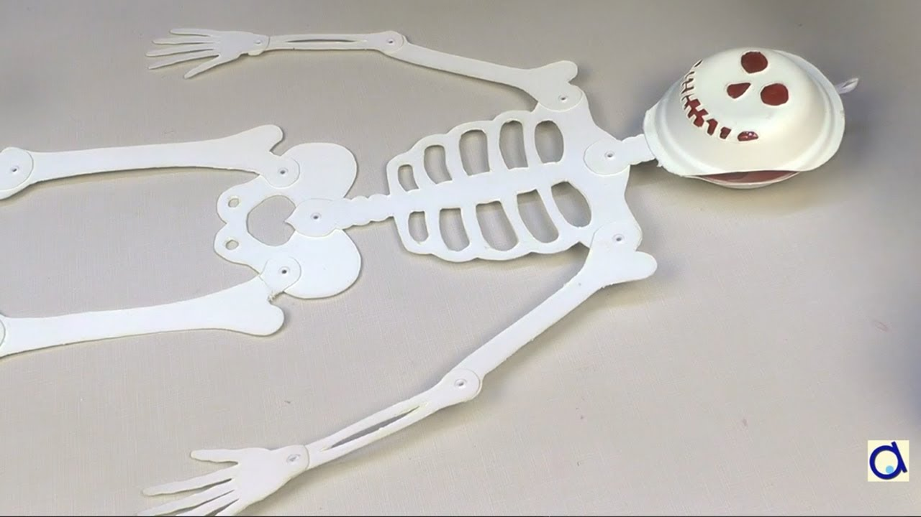
SCIENCE INTERACTIVE ACTIVITY
Make a model of the human skeletal system.

Slide 18
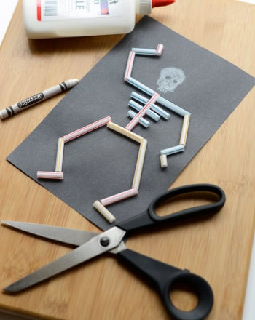
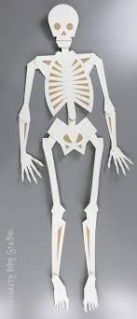
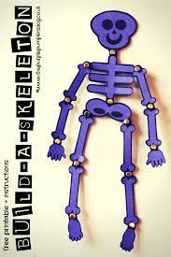
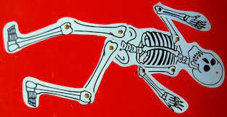
SCIENCE INTERACTIVE ACTIVITY
Make a model of the human skeletal system.

Slide 19
LEARNING OUTCOME
The learner will be able to:
know about the human skeleton.
recognize the different kinds of bones found in our skeleton
learn about the function of each bone.
know the importance of the skeleton.

Slide 20
THANKING YOU
ODM EDUCATIONAL GROUP

