Slide 1


WELCOME TO THE ONLINE CLASS
SESSION NO.: 1
CLASS: 5
SUBJECT: SCIENCE
CHAPTER NUMBER: 9
CHAPTER NAME: OUR SKELETAL SYSTEM
SUB TOPIC: INTRODUCTION, ORGAN SYSTEM

Slide 2
LEARNING OBJECTIVE
To enable the learner to:
know that our body is made up of many organs.
understand that organs work together to make the organ system.
understand that our body is a wonderful machine.

Slide 3
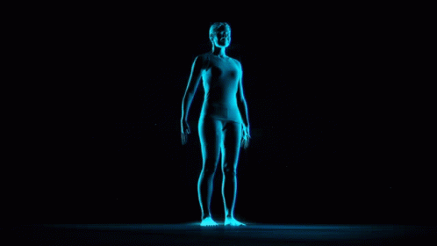
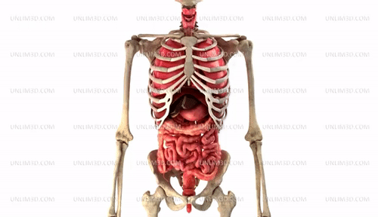
INTRODUCTION
Our body is just like a machine.
It has various parts and each part has its own function.
Notes:
Name some external organs.
Name some internal organs.

Slide 4
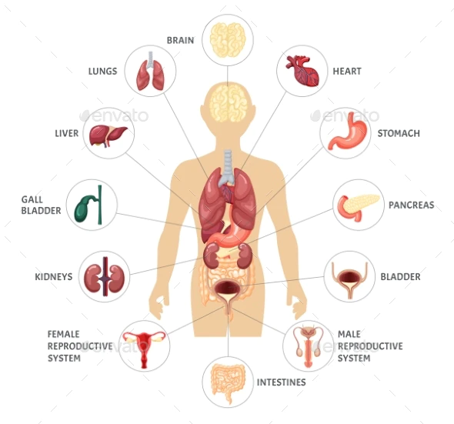
ORGAN
A part of our body which is specialized to perform a particular function is known as an organ.
E.g.: kidney, heart, stomach, etc.

Slide 5
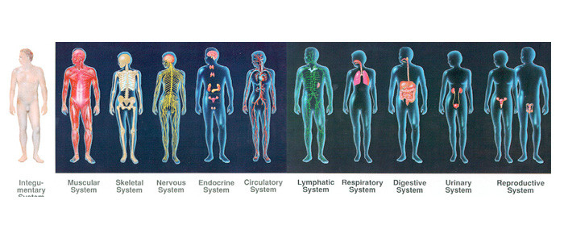
ORGAN SYSTEM
A group of organs together make up an organ system.
E.g.: Digestive system, muscular system, etc.

Slide 6
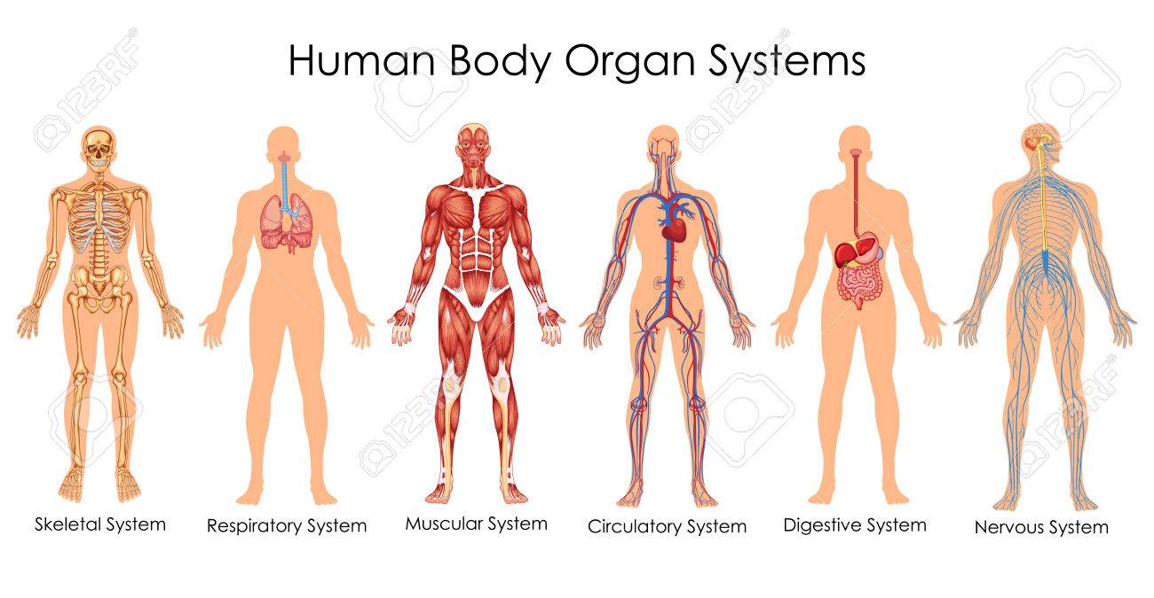
TYPES OF ORGAN SYSTEMS
The nervous system
The circulatory system
The digestive system
The respiratory system
The skeletal system
The muscular system
The reproductive system
The excretory system

Slide 7
SUMMARY
The part of our body which is specialized to perform a particular function is known as an organ.
E.g.: kidney, heart, stomach, etc.
A group of organs together make up an organ system.
E.g.: Digestive system, muscular system, etc.

Slide 8


Slide 9
Name some internal organs of our body.
Ans: Stomach, lungs, heart, intestines, kidney, etc.

Slide 10
2. The part of our body which is specialized to perform a particular function is known as ___________.
Ans: Organ

Slide 11
3. A group of organs together make up an _____________.
Ans: Organ system

Slide 12
HOMEWORK
Write the difficult words in your notebook.

Slide 13
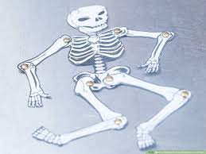
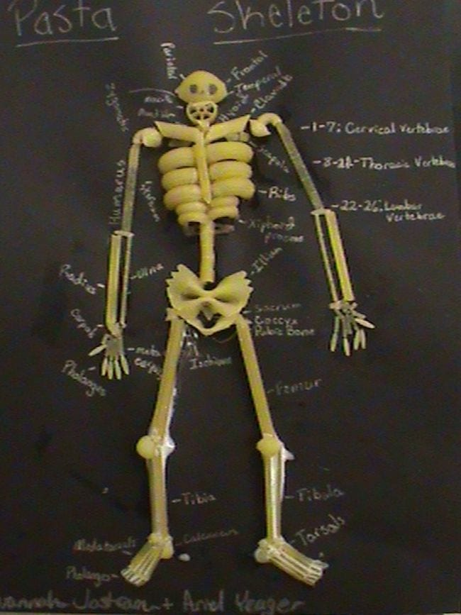
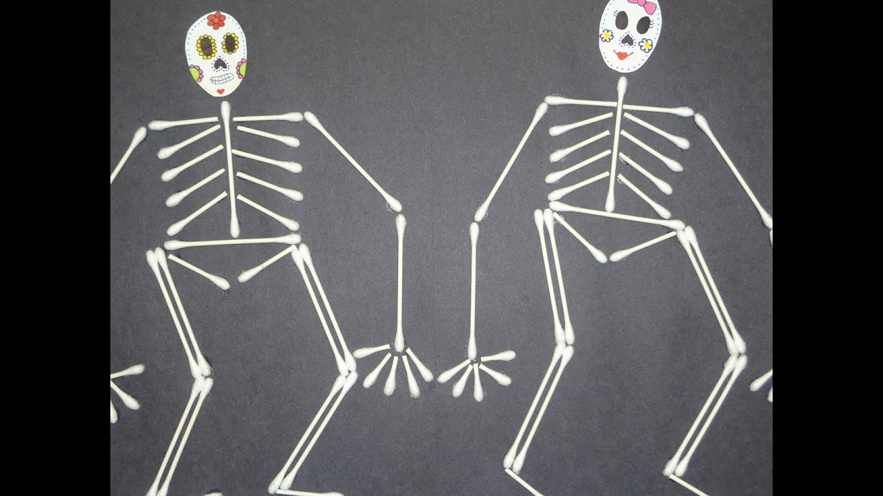
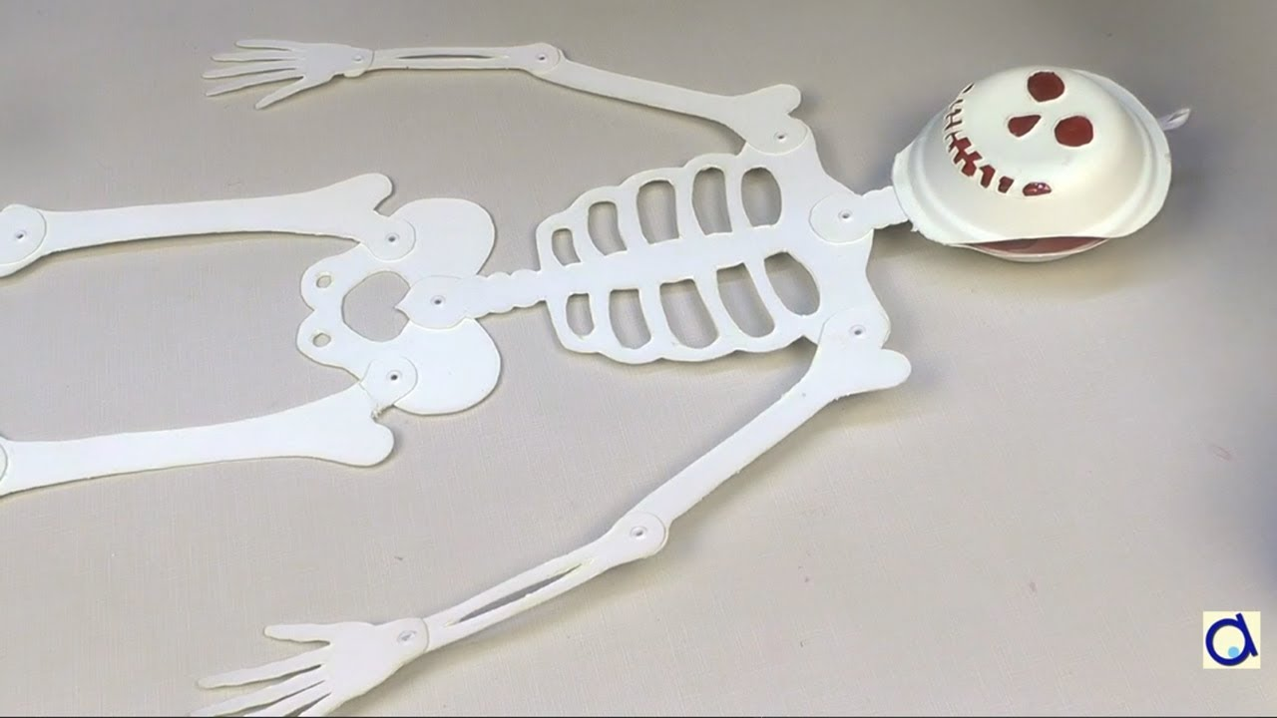
SUBJECT ENRICHMENT ACTIVITY
Make a model of the human skeletal system.

Slide 14
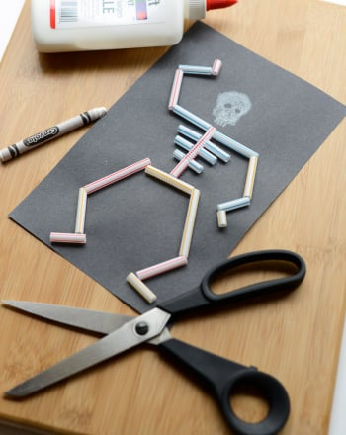
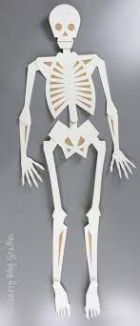

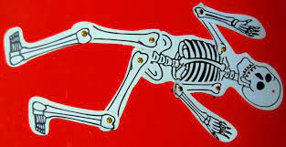
SUBJECT ENRICHMENT ACTIVITY
Make a model of the human skeletal system.

Slide 15
LEARNING OUTCOME
The learner will be able to:
know that our body is made up of many organs.
understand that organs work together to make the organ system.
understand that our body is a wonderful machine.

Slide 16
THANKING YOU
ODM EDUCATIONAL GROUP

