Slide 1

WELCOME TO ONLINE CLASS
CLASS-UKG
SUBJECT- CONVERSATION
TOPIC- L : 5 WHAT DO YOU DO
AT HOME

Slide 2


A - When do you take your breakfast ?
B - How do you take your breakfast ?

Slide 3

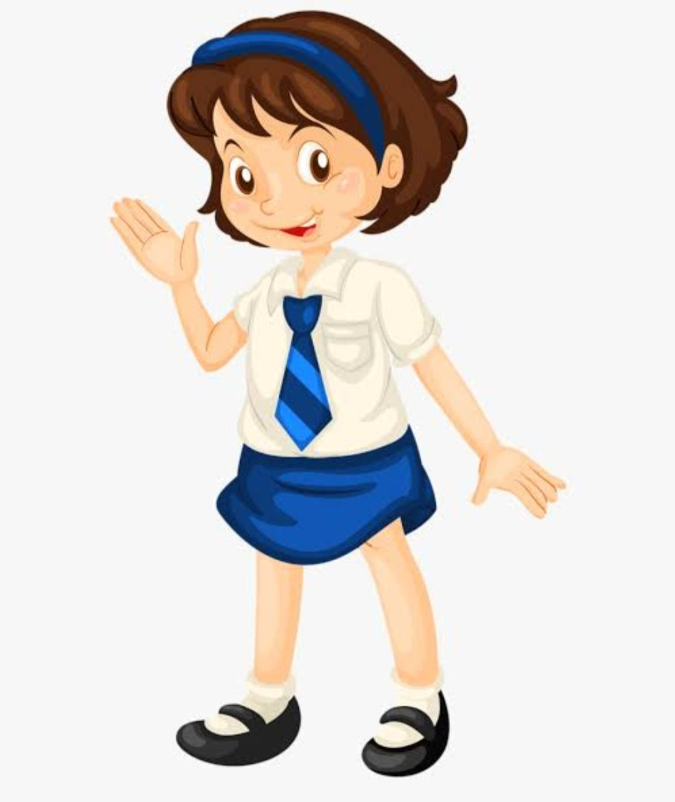
A - When do you wear your school uniform ?
B - What do you wear when you come to school ?

Slide 4

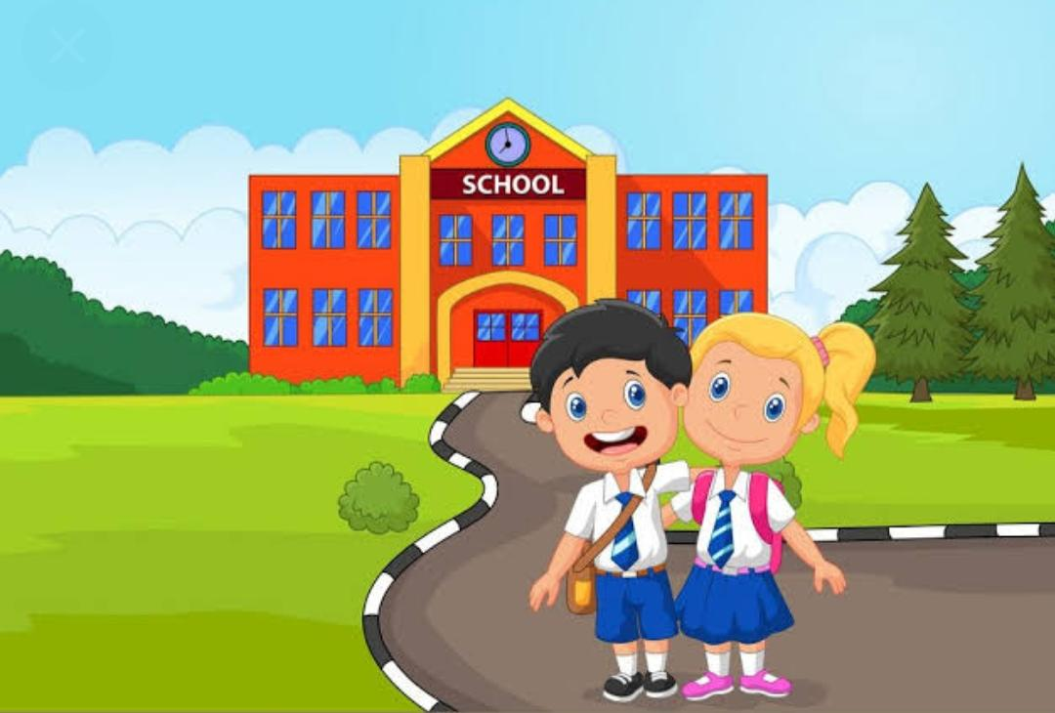
A - When do you come to school ?
B - With whom do you come to school ?
C - How do you come to school ?

Slide 5

THANKING YOU
ODM EDUCATIONAL GROUP

