Slide 1

WELCOME TO ONLINE CLASS
CLASS-UKG
SUBJECT- CONVERSATION
TOPIC- L : 5 WHAT DO YOU DO
AT HOME

Slide 2

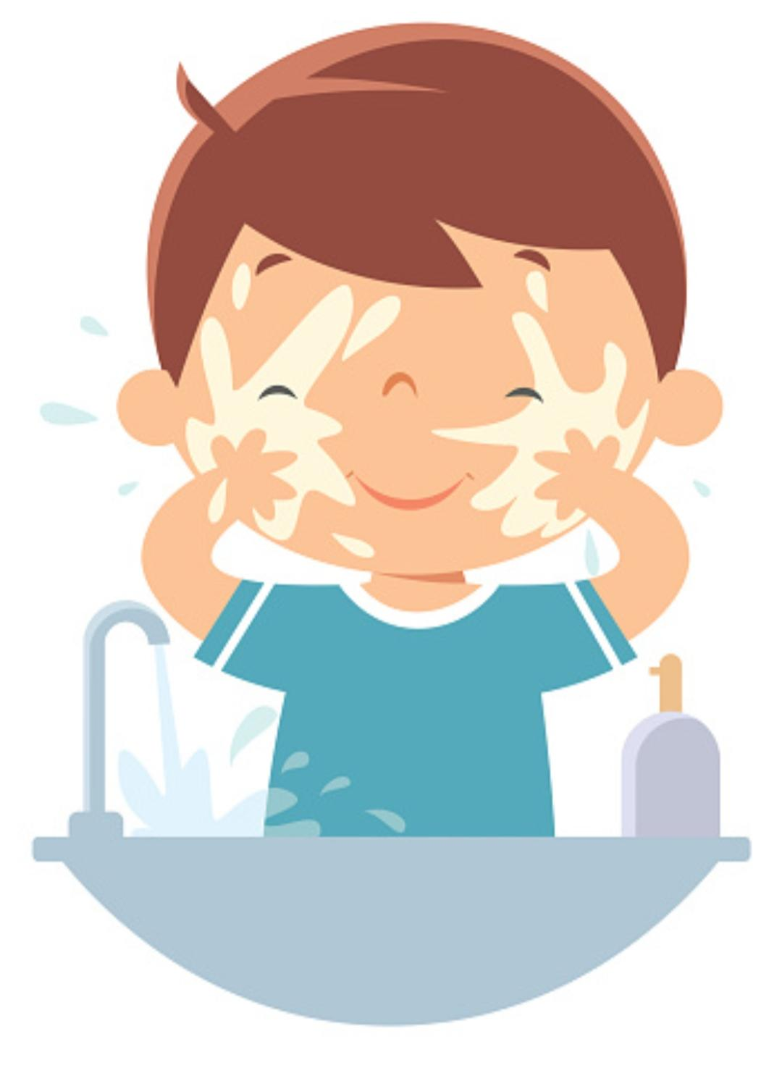
A - Where do you wash your face?
B - When do you wash your face?
C - How do you wash your face?

Slide 3
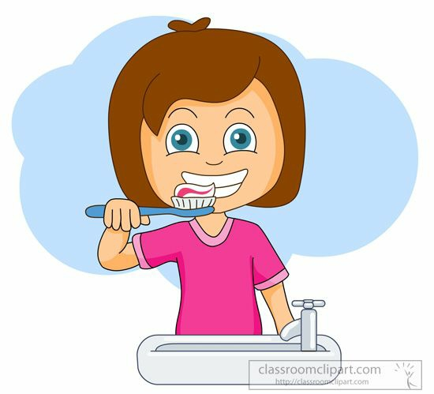
A - When do you brush your teeth?
B - Where do you brush your teeth?
C - How do you brush your teeth?

Slide 4

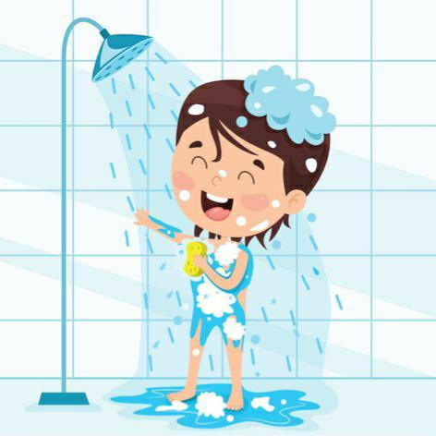
A - When do you take your bath?
B - Where do you take your bath?
C - How do you take your bath?

Slide 5

THANKING YOU
ODM EDUCATIONAL GROUP

