Slide 1

-MAGIC WORDS (ONCE AGAIN)
L – 6,7,9,10 & 11

Slide 2
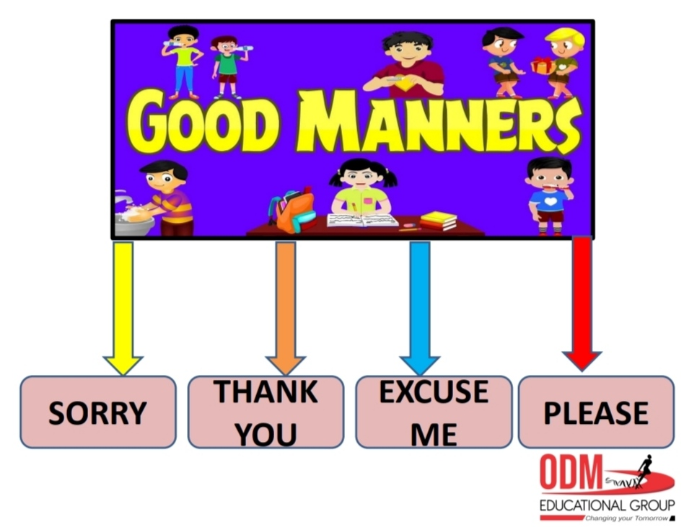

Slide 3

Answer the following questions
Q 1- What should you say,when someone helps you?
Q 2 - What should you say,when you sneeze or cough?
Q 3 - When someone gives you a gift,which magic word you should use?
Q 4 - What should you say, when you join late in class?
Q 5 - What should you say, when you want to ask a question?

Slide 4
Q 6 - What should you say when you ask for something?
Q 7 - When you hurt someone, which magic word you should use?

