Slide 1

Topic – Myself, My family & I can count
L – 1 , 2 & 4 ( Once again)

Slide 2


Introducing myself and my family

Slide 3
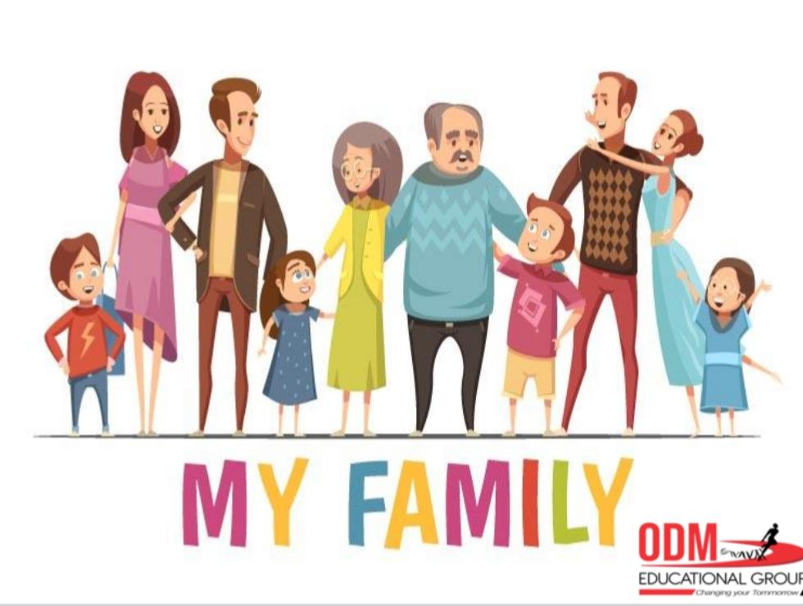

Slide 4
Answer the following questions
1- Where do you live ? ( with full address) ?
2- How many members are there in your family?
3- Are you a boy or a girl ?
4- What is the name of your Principal ?
5- What is the name of your Academic Head ?
6- How many doors are there in your home, count and say.
7- Can you count the boggies of a train ? ( yes / no)
8- Which is your favourite colour ?
9. What is the name of your class teacher ?

Slide 5


