Slide 1


THE COMEDY OF ERRORS
BY William Shakespeare
STD-VII
SUBJECT : ENGLISH(Literature)
CHAPTER NUMBER: 13
CHAPTER NAME : The Comedy of Errors

Slide 2
EXPECTED LEARNING OUTCOMES
GENERAL OBJECTIVES
Reading Comprehension followed by questions
Be acquainted with genre of Drama
Understanding the plot
Understanding characters
Developing LSRW Skills
SPECIFIC OBJECTIVES/ EXTENDED OBJECTIVES
Develop LSRW
Appreciating the plot, characters, writing style
Developing skill of Critical appreciation
Be acquainted with typical vocabulary meant for drama
Appreciating varieties of style and diction in literary writing

Slide 3
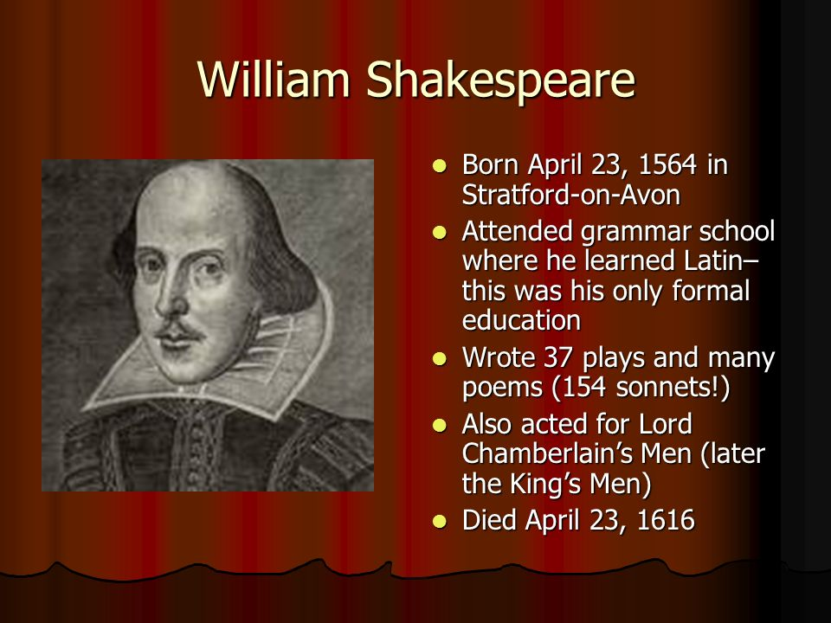
INTRODUCTION TO THE PLAYWRIGHT
William Shakespeare

Slide 4
Theme
Nearly all of the comedic mistakes that drive the plot of The Comedy of Errors result from the confusion and mistaken identities of Antipholus and Dromio of Ephesus, and Antipholus and Dromio of Syracuse. Additionally, the fact that these two sets of twins have the same names creates even more confusion between who is really who. Each one is constantly mixed up with his twin because they have the same physical appearance. However, they act very differently, which makes it seem like they have gone completely mad.

Slide 5
Characters
Antipholus of Syracuse
The twin brother of Antipholus of Ephesus and the son of Egeon; he has been traveling the world with his slave, Dromio of Syracuse, trying to find his long-lost brother and mother.
Dromio of Syracuse
The bumbling, comical slave of Antipholus of Syracuse. He is the twin brother of Dromio of Ephesus.
Dromio of Ephesus
The bumbling, comical slave of Antipholus of Ephesus. He is the Syracusan Dromio's twin brother.

Slide 6
Characters
Adriana
The wife of Antipholus of Ephesus, she is a fierce, jealous woman.
Luciana
Adriana's unmarried sister and the object of Antipholus of Syracuse's affections.
Merchant
An Ephesian friend of Antipholus of Syracuse.

Slide 7
Pre- Reading
Aegeon is a merchant from Syracuse, who has traveled to the city of Ephesus.
The two cities are in a feud, and the Duke of Ephesus, Solinus, has made a decree that anyone from Syracuse found in Ephesus will pay a 1000 mark fine or be executed. Aegeon does not have enough money for the fine, so Solinus prepares to execute him. First, though, he wants to hear what has brought Aegeon to Ephesus.
Aegeon explains that he and his wife had twin sons, and had another pair of twins as servants for their sons. They were all on a ship during a big storm, and suffered a shipwreck.
Aegeon took one son and one servant, and tied himself to a mast for safety. His wife did the same. The ship broke in two, and Aegeon and his wife were rescued by two separate groups of sailors who went off in two different directions.
Years later, Aegeon’s son left Syracuse to find his long-lost twin brother and mother, and Aegeon followed suit, eventually coming to Ephesus in his quest to find his wife and sons. Solinus takes (some) pity on Aegeon and says that he will give him 24 hours to find someone to pay his fine. Otherwise, Aegeon will be executed.

Slide 8
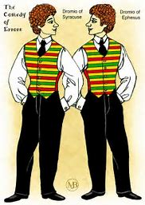
Scene I (Explanation)
Pg- 99-100
Setting- Marketplace (Enter Antipholus of Syracuse, Dromio of Syracuse, and a merchant.)
Unknown to Aegeon, his son Antipholus and Dromio of Syracuse have come to Ephesus looking for Antipholus's twin and mother.
In a nearby marketplace, a merchant has befriended two tourists: Antipholus of Syracuse (Aegeon's son) and his servant companion, Dromio.
Merchant warns them to say that they come from somewhere other than Syracuse, lest they suffer the penalty already meted out to Aegeon.
Learning of the ban on Syracusians, they put on local dress before going to explore the town. Unknown to them, their twin brothers (with identical names) have been living there after being saved from the storm by fishermen.

Slide 9
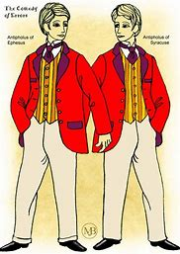
Scene I (Explanation)
Pg- 101-102
Antipholus, having sent Dromio to find lodging for them, is utterly bewildered when the servant returns and says that Antipholus’s wife waits dinner for him.
What happens is that the Dromio who returns to Antipholus is Dromio of Ephesus, servant and attendant to Antipholus of Ephesus.
Antipholus of Syracuse gives his Dromio money to pay for lodging, and when he hears a tale of a wife about whom he knows nothing he thinks his servant tricked him and asks for the return of the money.
Dromio of Ephesus was given no money, however, and when he professes no knowledge of the sum.
Antipholus of Syracuse leaves for the inn where he was staying to find the money, suspecting Dromio of deception.
SCENE ENDS

Slide 10
THANK YOU
ODM EDUCATIONAL GROUP

