Slide 1


Ideas and ideals the Indian Constitution
SUBJECT : CIVICS CHAPTER NUMBER:2
CHAPTER NAME :Ideas and ideals the Indian Constitution

Slide 2

Fundamental Rights

Slide 3

Fundamental Duties
Each citizen has their own duties. All rights come with certain duties.
The Indian Constitution also lays down a list of Fundamental Duties.

Slide 4
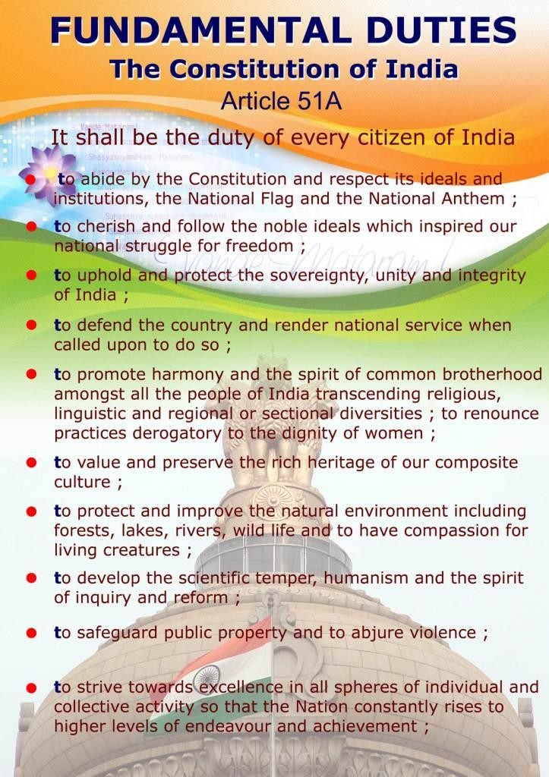
According to the 42nd amendment of our Constitution enacted in 1976, a set of duties is prescribed for the citizen. These duties are not enforceable by law, all citizens should faithfully carry them out

Slide 5
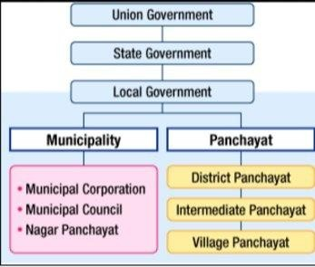
Federal Structure
Federal structure of Govt means the power is distributed between centre govt, state govt and local Govt. Each level has-been assigned separate areas of subjects.
Union List, State List, Concurrent List

Slide 6
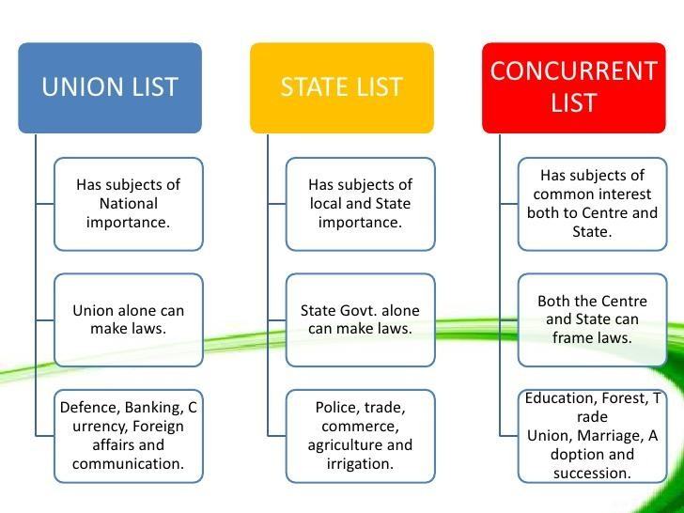
The Union Lists consists of 100 subjects like Defence, foreign affairs, and finance. The State List consists of 61 subjects like police , health , sanitation ,and agriculture . The Concurrent Lists of 52 subjects like education ,electricity , labour welfare etc.

Slide 7
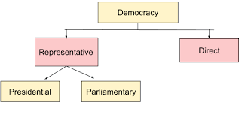
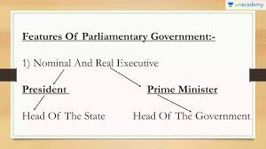
In a Parliamentary form of Govt there is a nominal head of the Govt, president. The real power lies in the hands of The Prime minister and council of ministers
Presidential form of Govt, power is concentrated in the hands of the president only but parliamentary form of Government power lies in the hands of the prime –
minister and council of ministers.

Slide 8
THANKING YOU
ODM EDUCATIONAL GROUP

