Slide 1


Ideas and ideals the Indian Constitution
SUBJECT : CIVICS CHAPTER NUMBER:2
CHAPTER NAME :Ideas and ideals the Indian Constitution

Slide 2
Recapitulation
Define the term Preamble?
What do you mean by sovereign state?
India is a republic country. What does it mean?
India is secular country. What does it mean?

Slide 3
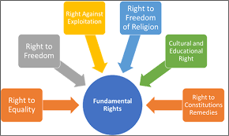
Fundamental Rights

Slide 4

Fundamental Duties
Each citizen has their own duties. All rights come with certain duties.
The Indian Constitution also lays down a list of Fundamental Duties.

Slide 5
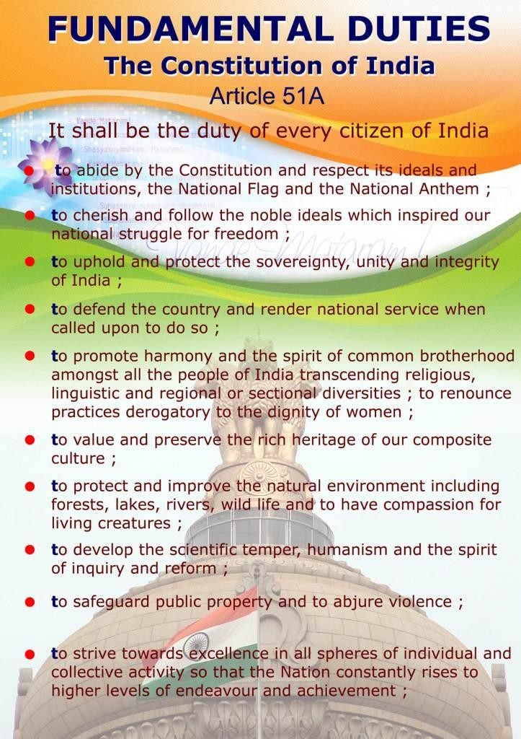
According to the 42nd amendment of our Constitution enacted in 1976, a set of duties is prescribed for the citizen. These duties are not enforceable by law, all citizens should faithfully carry them out

Slide 6
Home Assignment
What do you mean by fundamental rights?
How many fundamental rights are there? What are they?
What is meant to right to constitutional remedies?
What is meant by right to religion?

Slide 7
THANKING YOU
ODM EDUCATIONAL GROUP

Slide 8
Recapitulation
What do you mean by fundamental rights?
How many fundamental rights are there? What are they?
What is meant to right to constitutional remedies?
What is meant by right to religion?

Slide 9
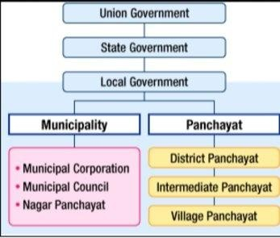
Federal Structure
Federal structure of Govt means the power is distributed between centre govt, state govt and local Govt. Each level has-been assigned separate areas of subjects.
Union List, State List, Concurrent List

Slide 10
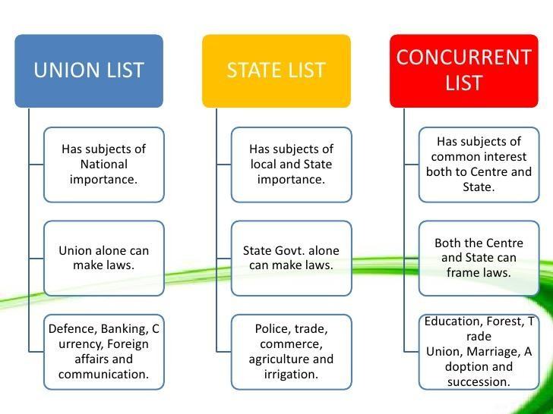
The Union Lists consists of 100 subjects like Defence, foreign affairs, and finance. The State List consists of 61 subjects like police , health , sanitation ,and agriculture . The Concurrent Lists of 52 subjects like education ,electricity , labour welfare etc.

Slide 11
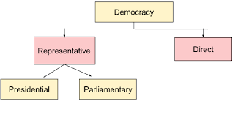
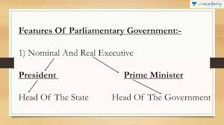
In a Parliamentary form of Govt there is a nominal head of the Govt, president. The real power lies in the hands of The Prime minister and council of ministers
Presidential form of Govt, power is concentrated in the hands of the president only but parliamentary form of Government power lies in the hands of the prime –
minister and council of ministers.

Slide 12
Home Assignment
What is meant by the term Parliamentary Democracy?
What are the three branches of the government?
Describe the federal structure of the Indian Democracy?

Slide 13
THANKING YOU
ODM EDUCATIONAL GROUP

