Slide 1


Ideas and ideals the Indian Constitution
SUBJECT : CIVICS CHAPTER NUMBER:2
CHAPTER NAME :Ideas and ideals the Indian Constitution

Slide 2
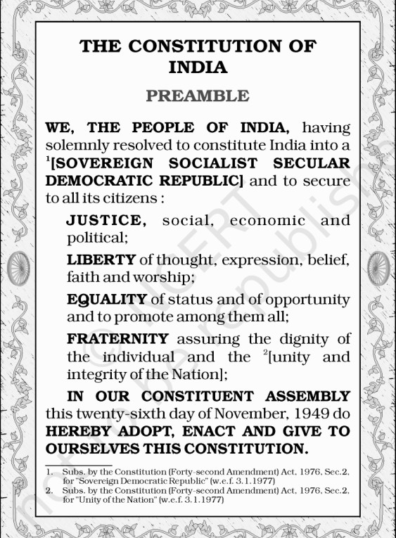
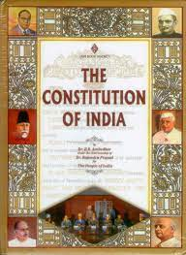
Key Features of Indian Constitution

Slide 3
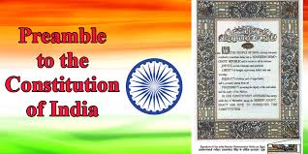
Our Constitution begins with a introduction came to known as Preamble. It highlights the goals and aspirations of the Indian people, and it describes India as Sovereign, socialist, secular, democratic, republic country.

Slide 4

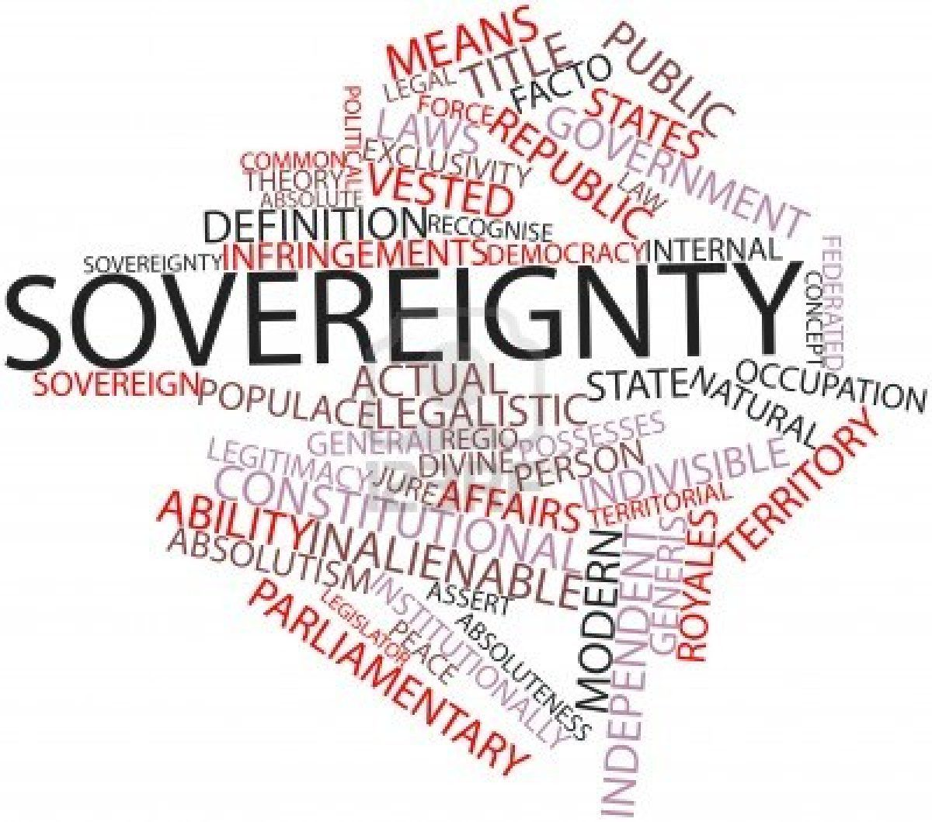

Slide 5


S o c i a l i st C o u n t r y
Everyone is given equal opportunities to make use of the resources of the country.

Slide 6
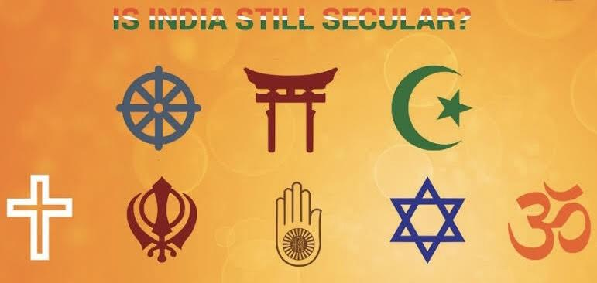
Se c ul ar C ountr y
Every citizen has the freedom to profess, practice, and propagate the religion of his liking and no discrimination on the basis of religion.

Slide 7
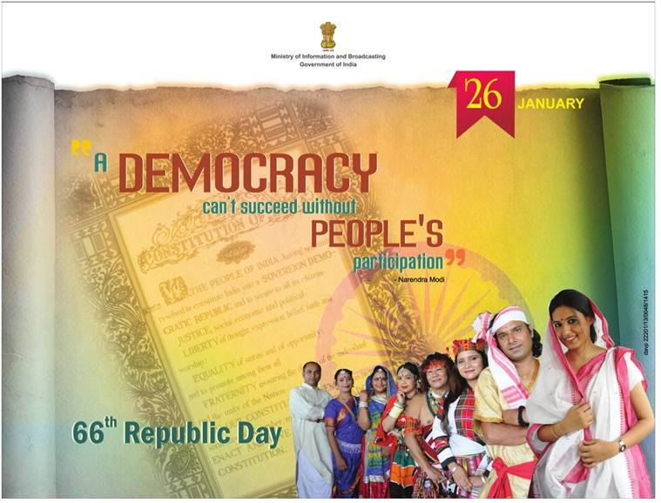
D e m o c r a t i c C o u n t r y
The country which is governed by elected representatives. Election is conducted at fixed intervals.

Slide 8
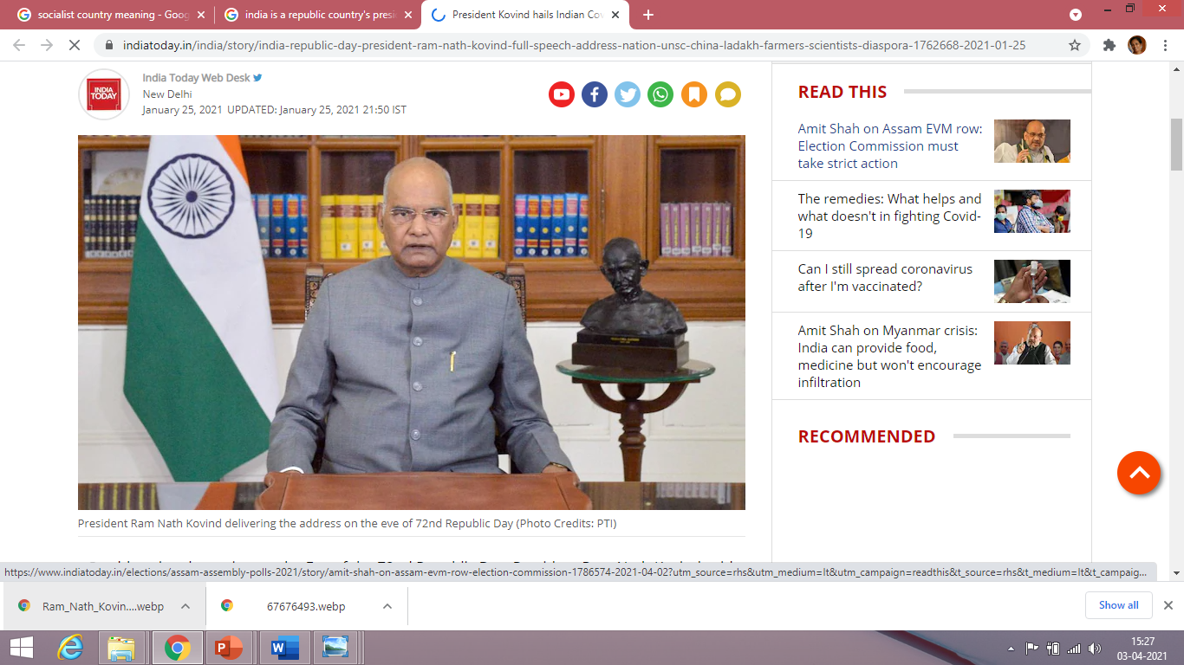

R e p u b l i c C o u n t r y
India is a Republic country because our head of the state –president is an elected person not a hereditary one. He is elected for 5 years which is a fixed term of office.

Slide 9

D i r e c t i v e P r i n c i p l e s o f S t a t e P o l i c y
Every Govt. which comes to power is expected to be guided by some
principles when making policies and laws. These principles are called Directive Principles.

Slide 10

THANKING YOU
ODM EDUCATIONAL GROUP

