Slide 1

WELCOME TO ONLINE CLASS
CLASS : UKG
SUBJECT : ENGLISH
TOPIC : Unit-VI – “Ch” sound words

Slide 2

POINT TO THE PICTURE, LISTEN AND REPEAT
CHAIR

Slide 3
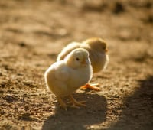
CHICK

Slide 4

CHIN

Slide 5

CHURCH

Slide 6

CHILDREN

Slide 7

WATCH

Slide 8

BENCH

Slide 9
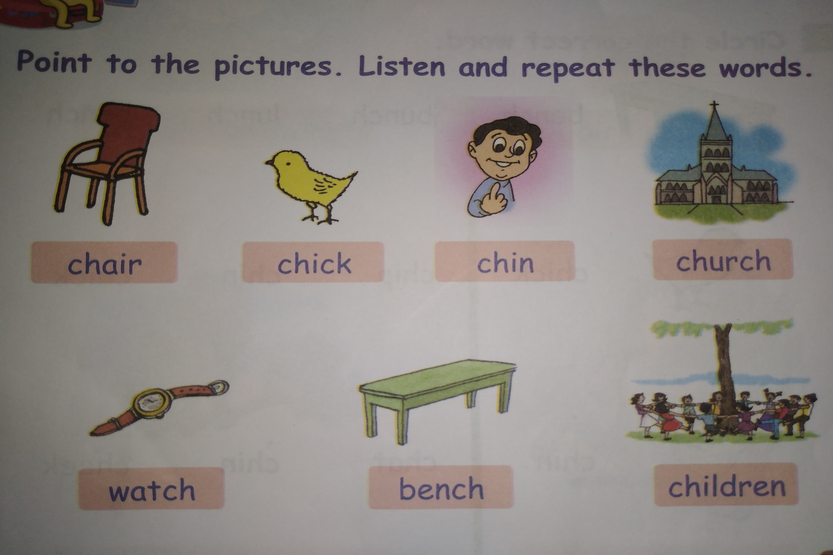

Slide 10

THANKING YOU
ODM EDUCATIONAL GROUP

