Slide 1


PERIOD 2
MATHEMATICS
CHAPTER NUMBER :~ 3
CHAPTER NAME :~ COORDINATE GEOMETRY
SUB TOPIC :~ CARTESIAN SYSTEM (ABSCISSA, ORDINATE, QUADRANT)

Slide 2
PREVIOUS knowledge Test
1. Describe the position of the student A with respect to B.
2. Describe the position of your study table with respect to the door.

Slide 3
LEARNING OUTCOME:-
Students will learn
Cartesian System(Abscissa, Ordinate, Quadrant, Origin) .

Slide 4
https://www.youtube.com/watch?v=mgx0kT5UbKk
“Coordinate geometry is the branch of mathematics which is a fusion of algebra and geometry. In the honour of Descartes, the subject is called cartesian geometry.…”
- Rene Descartes …

Slide 5
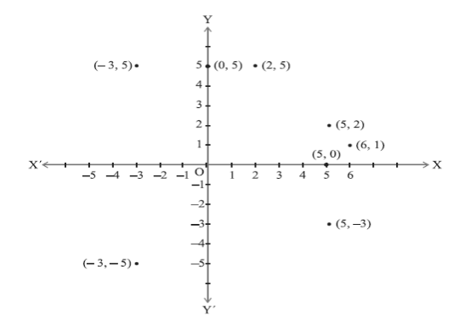
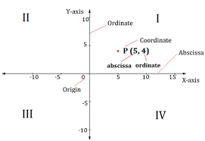
CARTESIAN PLANE

Slide 6
Evaluation:-
Explain the key words of Cartesian system-
(a) origin
(b) quadrant
(c) ordinate
(d) abscissa

Slide 7
Homework:-
Exercise – 3.2

Slide 8
Question 1.
Write the answer of each of the following questions:
(i) What is the name of horizontal and the vertical lines drawn to determine the position of any point in the Cartesian plane? (ii) What is the name of each part of the plane formed by these two lines? (iii) Write the name of the point where these two lines intersect.
Solution:
(i) The horizontal line: x – axis and the vertical line: y – axis. (ii) Each part is called “Quadrant”. (iii) Origin

Slide 9
Question 2
See the given figure and write the following:
(i) The coordinates of B. (ii) The coordinates of C. (iii) The point identified by the coordinates (-3,-5). (iv) The point identified by the coordinates (2,-4). (v) The abscissa of the point D. (vi) The ordinate of the point H. (vii) The coordinates of the point L. (viii) The coordinates of the point M.

Slide 10
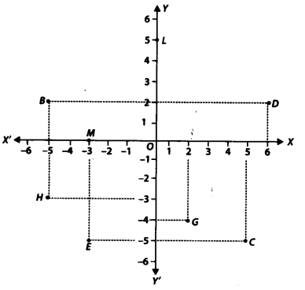

Slide 11
Solution:
From the figure, we have
(i) The coordinates of B are (-5,2). (ii) The coordinates of C are (5, -5). (iii) The point E is identified by the coordinates (-3,-5). (iv) The point G is identified by the coordinates (2,-4). (v) The abscissa of the point D is 6. (vi) The ordinate of the point H is -3. (vii) The coordinates of the point L are (0,5).
(viii) The coordinates of the point M are (-3,0).

Slide 12
AHA:-
A point lies on x-axis at a distance of 9 units from y-axis . What are its co-ordinates ? What will be it’s coordinate if it lies on y-axis at a distance of ––9units from x-axis ?

Slide 13
THANKING YOU
ODM EDUCATIONAL GROUP

