Slide 1


MODEL LESSON
MATHEMATICS
CHAPTER NUMBER :~3
CHAPTER NAME :~COORDINATE GEOMETERY
SUB TOPIC :~ INTRODUCTION TO COORDINATE GEOMETERY

Slide 2
LEARNING OUTCOME:-
Students will learn
Introduction to Coordinate Geometry.

Slide 3
https://www.youtube.com/watch?v=8Oe_kswv0Pg
“Coordinate geometry is the branch of mathematics which is a fusion of algebra and geometry. In the honour of Descartes, the subject is called cartesian geometry.…”
-Rene Descartes…

Slide 4
Coordinate geometry:-
Coordinate Geometry is considered to be one of the most interesting concepts of mathematics. Coordinate Geometry (or the analytic geometry) describes the link between geometry and algebra through graphs involving curves and lines.
It provides geometric aspects in Algebra and enables them to solve geometric problems. It is a part of geometry where the position of points on the plane is described using an ordered pair of numbers.
Here, the concepts of coordinate geometry (also known as Cartesian geometry) are explained along with its formulas and their derivations.

Slide 5
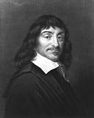
RENE DESCARTES
FATHER OF CARTESIAN SYSTEM.

Slide 6
Evaluation:-
1. Describe the position of the student A with respect to B.
2. Describe the position of your study table with respect to the door.

Slide 7
Homework:-
Exercise - 3.1

Slide 8
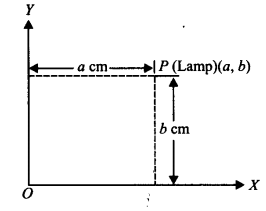
Question 1.
How will you describe the position of a table lamp on your study table to another person?
Solution:
To describe the position of a table lamp placed on the table, let us consider the table lamp as P and the table as a plane. Now choose two perpendicular edges of the table as the axes OX and OY. Measure the perpendicular distance ‘a’cm of P (lamp) from OY. Measure the perpendicular distance ‘b’ cm of P (lamp) from OX.
Thus, the position of the table lamp P is described by the ordered pair (a, b).

Slide 9
Question 2.
(Street Plan): A city has two main roads which cross each other at the centre of the city. These two roads are along the North-South direction and East-West direction. All other streets of the city run parallel to these roads and are 200 m apart. There are 5 streets in each direction.
Using 1 cm = 200 m, draw a model of the city on your notebook. Represent the roads/streets by single lines.
There are many cross-streets in your model. A particular cross-street is made by two streets, one running in the North-South direction and another in the East-West direction. Each cross street is referred to in the following manner:
If the 2nd street running in the North-South direction and 5th in the East-West direction meet at some crossing, then we will call this cross-street (2,5). Using this convention, find:
(i) how many cross-streets can be referred to as (4,3).
(ii) how many cross-streets can be referred to as (3,4).
Solution: (i) A unique cross street as shown by the point A(4, 3). (ii) A unique cross street as shown by the point B(3,4). The two cross streets are uniquely found because of the two reference lines we have used for locating them.

Slide 10
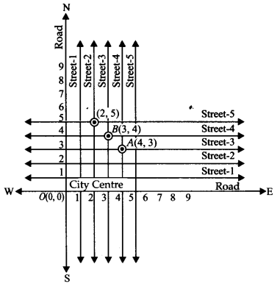

Slide 11
AHA:-
Draw a plan for the seating arrangement of 42 students of a class. Each student occupies a separate desk how will you specify the position of a student/a desk uniquely?

Slide 12
THANKING YOU
ODM EDUCATIONAL GROUP

