Slide 1

WELCOME TO ON LINE CLASS
CLASS-UKG
SUBJECT-CONVERSATION
TOPIC-ONCE AGAIN
(SORRY AND EXCUSE ME)

Slide 2
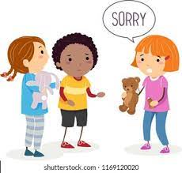



We should say sorry when,
We hurt or tease someone.
We lose something that belong to someone else.
If we break something knowingly or by mistake.
If we lie or break a rule knowingly.
We don’t follow what our parents say.

Slide 3

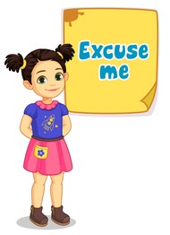


We should say excuse me when,
1. You need to pass by someone who is in your path.
2. You burp, sneeze or cough.
3. You didn’t hear or couldn’t understand what someone said and need them to repeat it. Here you say it as a question, “Excuse me?”.
4. You need to exit the room for a moment during a meal or an conversation.
5. To get someone’s attention to ask a question.

Slide 4
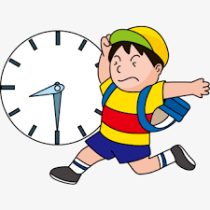
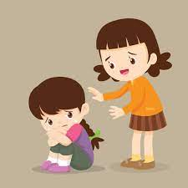
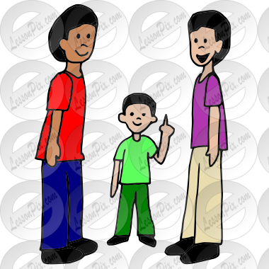
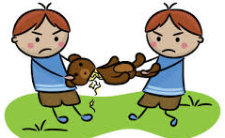
What do we say,
When we arrive late in class?
When we hurt someone?
SORRY
SORRY
When we want to seek someone’s attention?
When we break something which belongs to someone else?
EXCUSE ME
SORRY

Slide 5
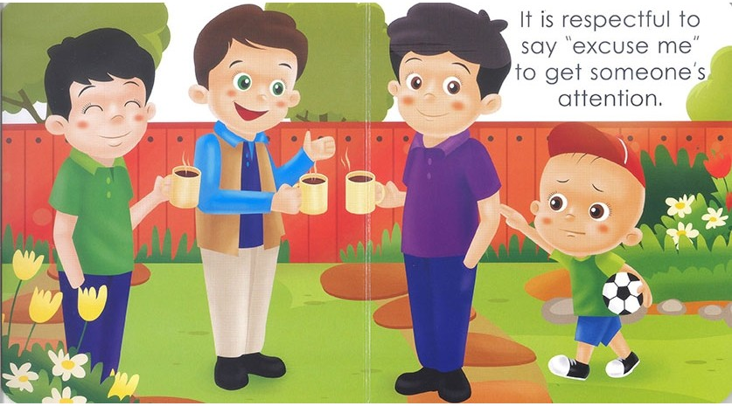
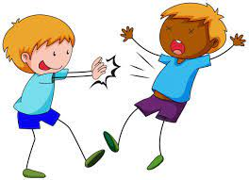
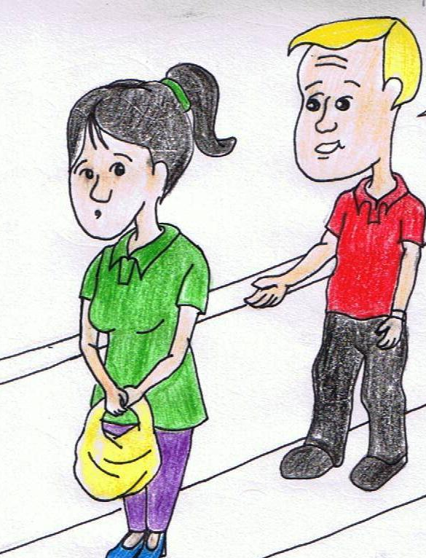
What do we say?
When we want to ask something in between a meeting?
When we push someone?
EXCUSE ME
SORRY
When we want to pass through in a line?
EXCUSE ME

Slide 6
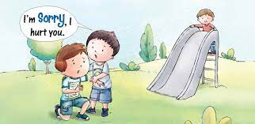

When we want our teacher to repeat a sentence?
EXCUSE ME
When someone falls because of us?
When you are asked for a pencil but you have only one which you are using?
SORRY
SORRY

Slide 7
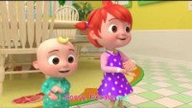

Slide 8

THANKING YOU
ODM EDUCATIONAL GROUP

