Slide 1

WELCOME TO ONLINE CLASS
CLASS-UKG
SUBJECT-CONVERSATION
TOPIC-REVISION
(lesson-6,7,9,10,11)

Slide 2
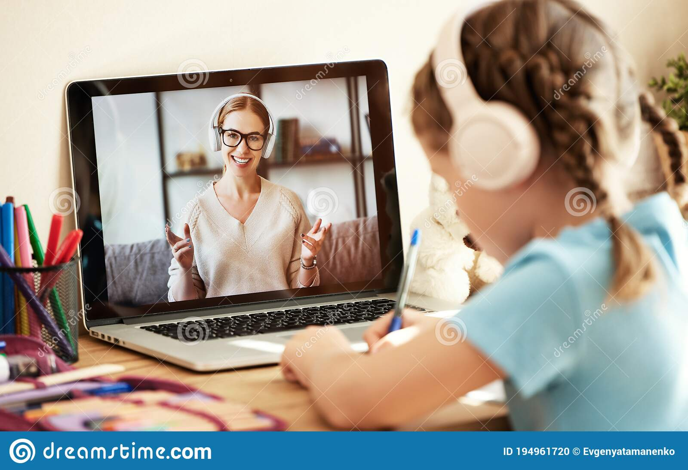
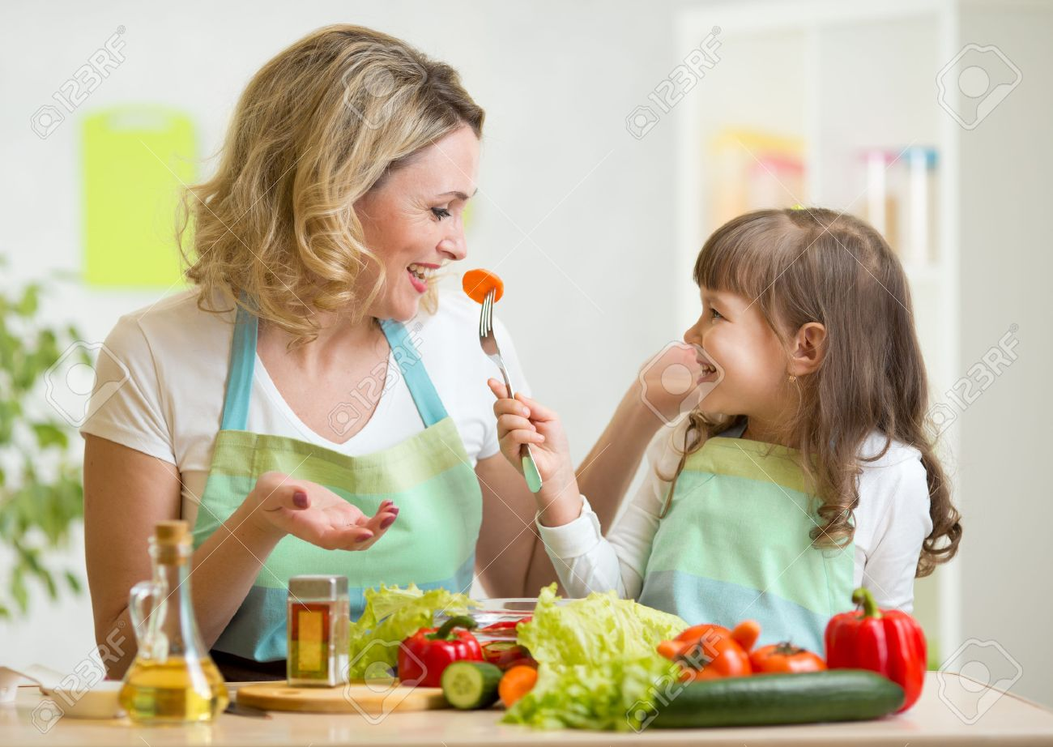
When you are late to join in the
zoom class which magic word
you are going to use?
You are hungry and want to
eat food then which word
word you are going to use?

Slide 3
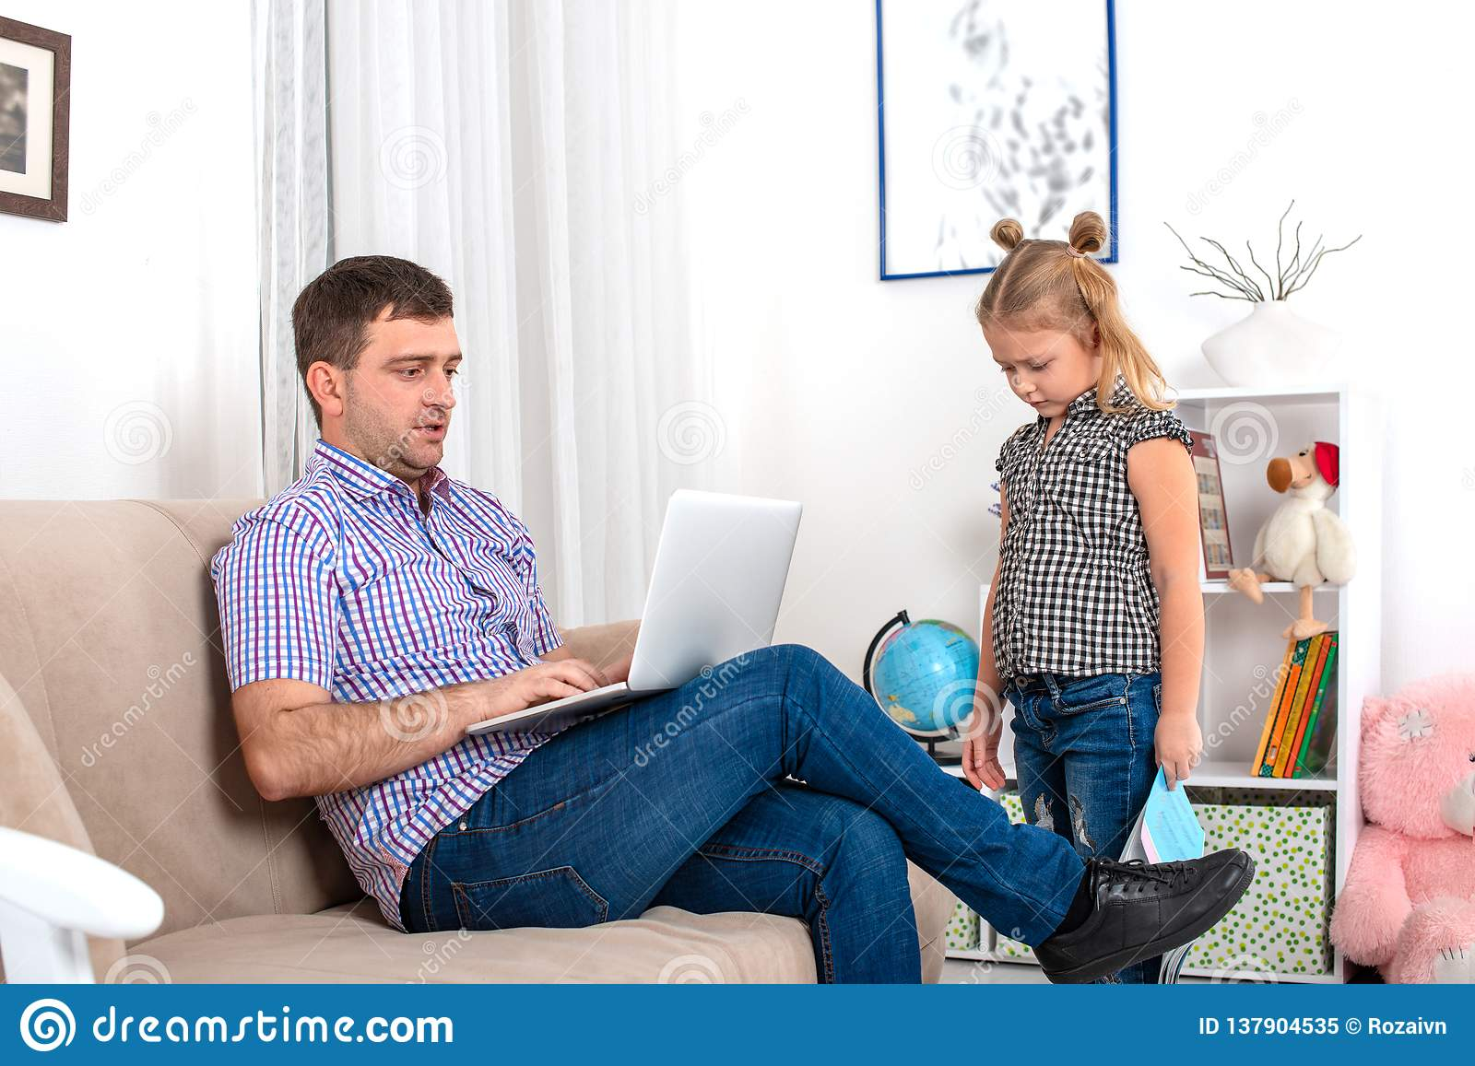
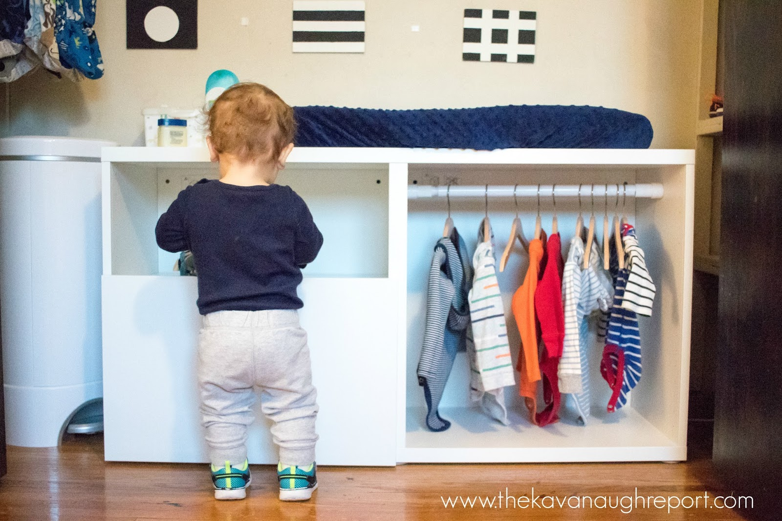
When your papa is busy in his office work but you need to ask something or take permission what should you say?
You need the help of your grandmother for arranging your cupboard what should you say?

Slide 4
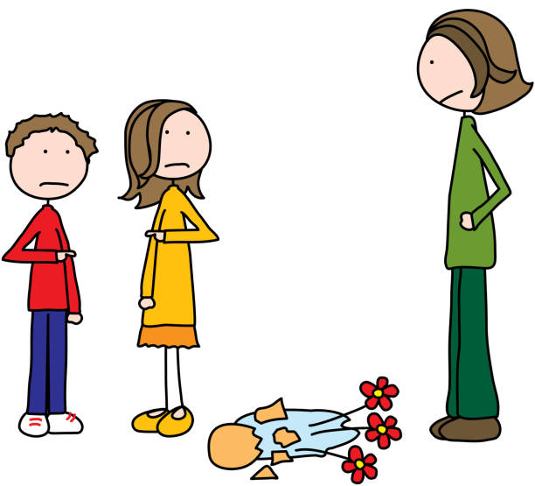
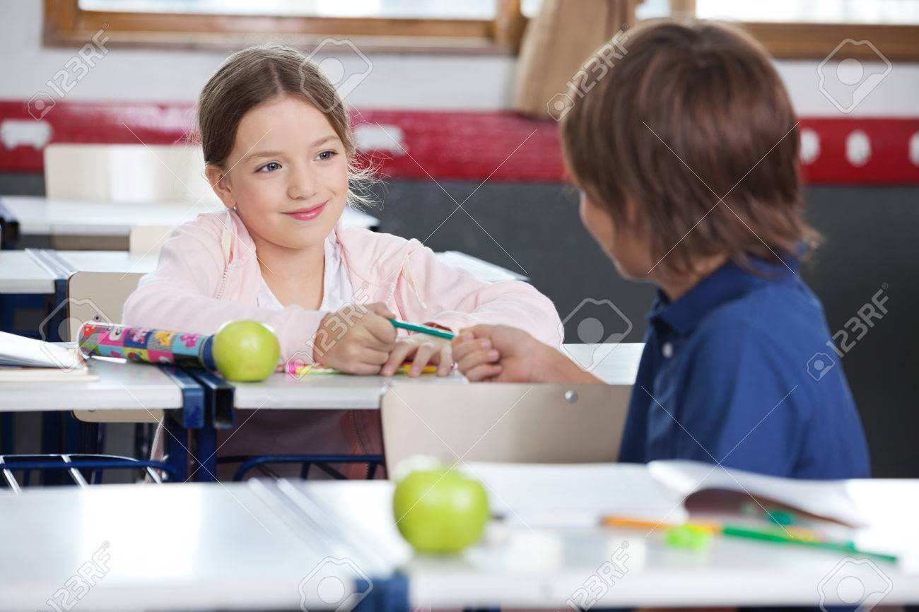
By mistake a nice flower vase fallen from your hand what should you say?
When you need a crayon/pencil from your friend what should you say?

Slide 5
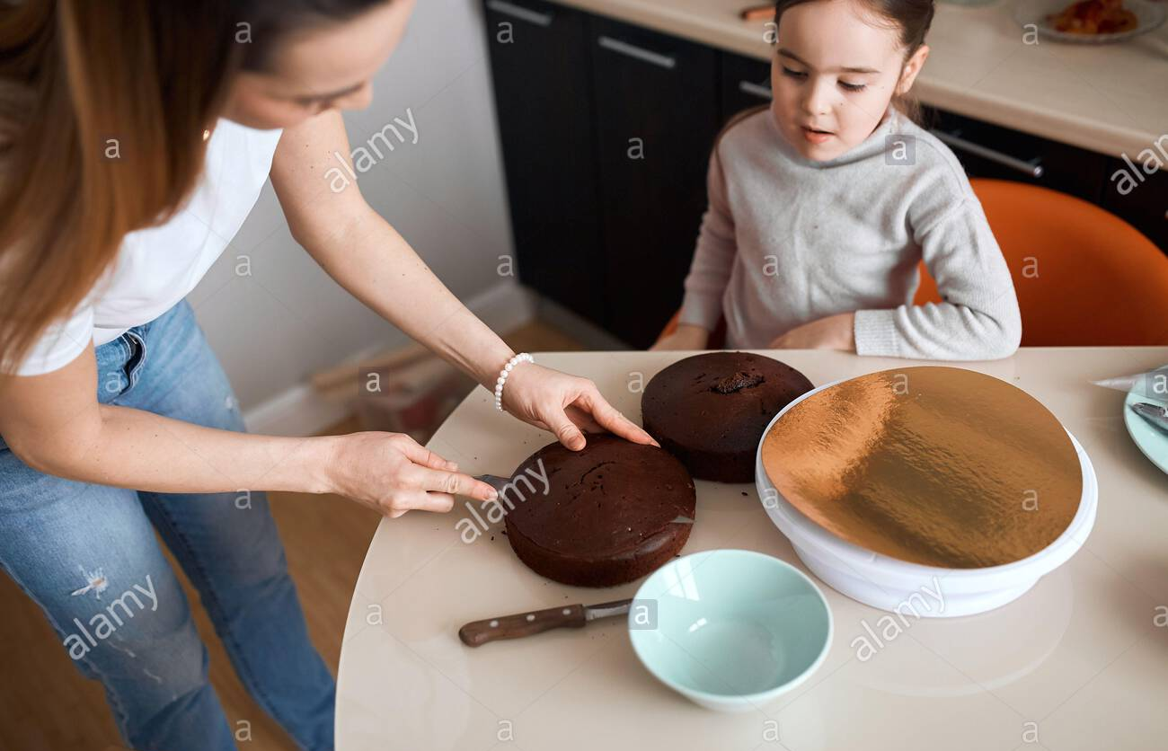
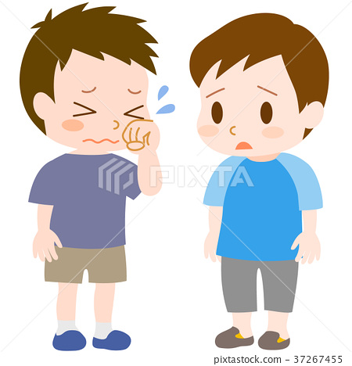
You need one more piece of cake what should you say to your mama ?
By mistake when you broke the pencil of your friend what should you say?

Slide 6

THANKING YOU
ODM EDUCATIONAL GROUP

