Slide 1



CLASS : NURSERY
DATE : 27/07/21
SUBJECT :CONVERSATION
CHAPTER NUMBER-2
SUB-TOPIC : MY SCHOOL

Slide 2
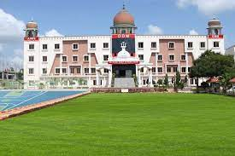
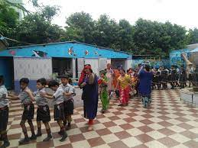
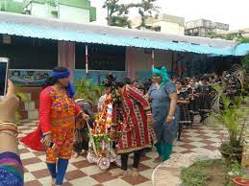
My school

Slide 3

Tell me three sentences about your school.
1.What is the name of your school?
2. Where it is?
3. In which class do you study?

Slide 4
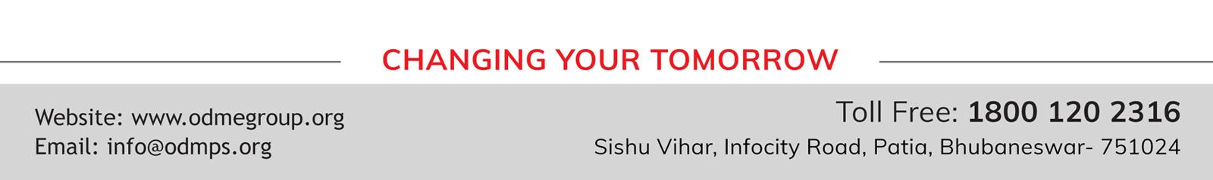
THANKING YOU
ODM EDUCATIONAL GROUP

