Slide 1



CLASS : NURSERY
DATE : 03/08/21
SUBJECT :CONVERSATION
CHAPTER NUMBER-3
SUB-TOPIC : MY MOTHER
(introduction)

Slide 2
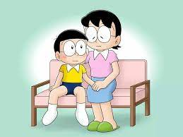
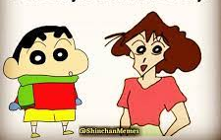
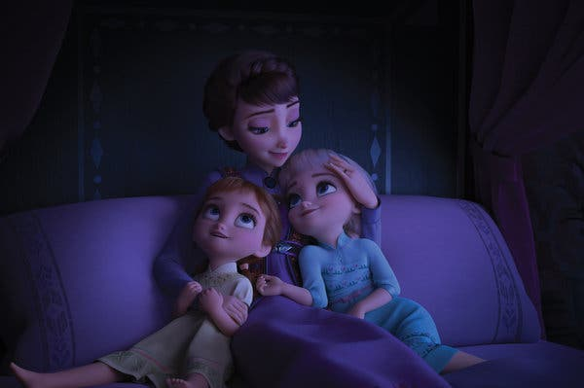
MOTHER
MOTHER
MOTHER
Notes:
RIYA

Slide 3


MOTHER
What is your mother name?
My mother’s name is…………..

Slide 4

HOME ASSIGNMENT
LEARN YOUR MOTHER’S NAME.
ANSWER THE QUESTION IN FULL SENTENCE.

Slide 5
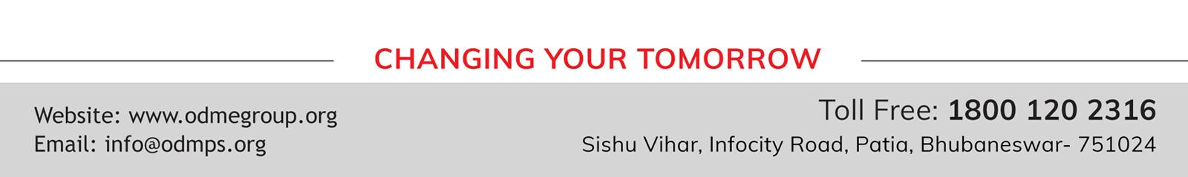
THANKING YOU
ODM EDUCATIONAL GROUP

