Slide 1

WELCOME TO ON LINE CLASS
CLASS-UKG
SUBJECT-CONVERSATION
TOPIC-PLEASE
(LESSON-9)

Slide 2

SORRY
THANK YOU
EXCUSEME
PLEASE

Slide 3
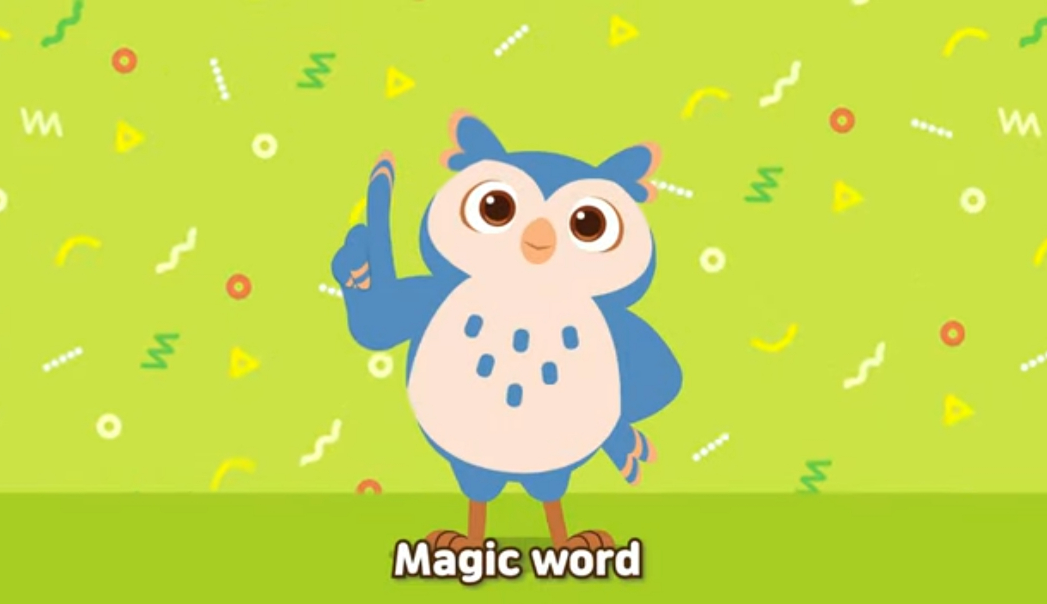
Please is a golden / magic word , a sign of proper manner to show kindness and respect to others.
PLEASE

Slide 4
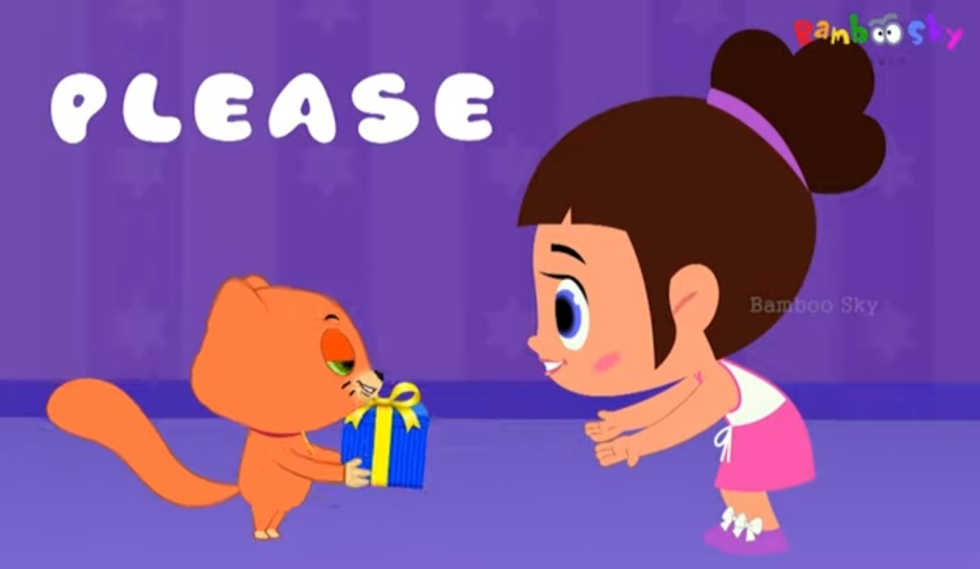
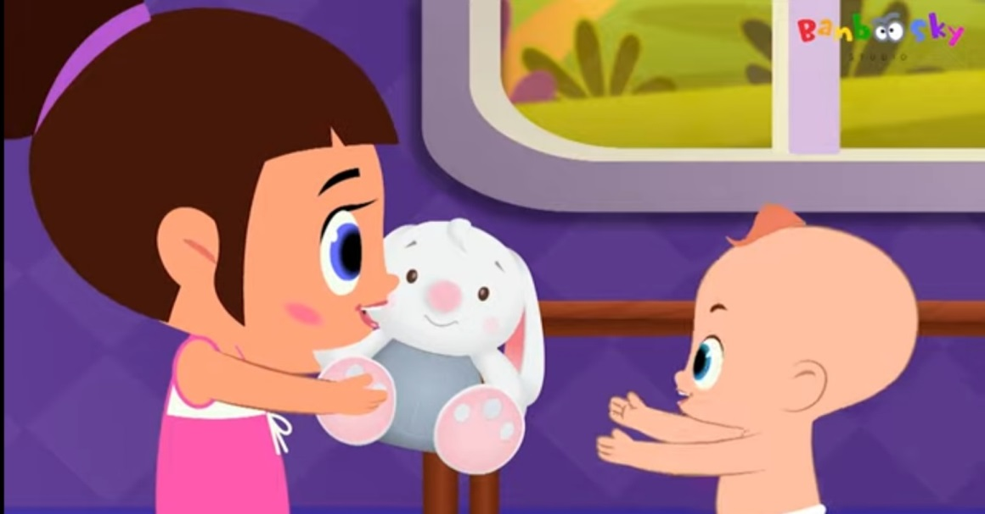
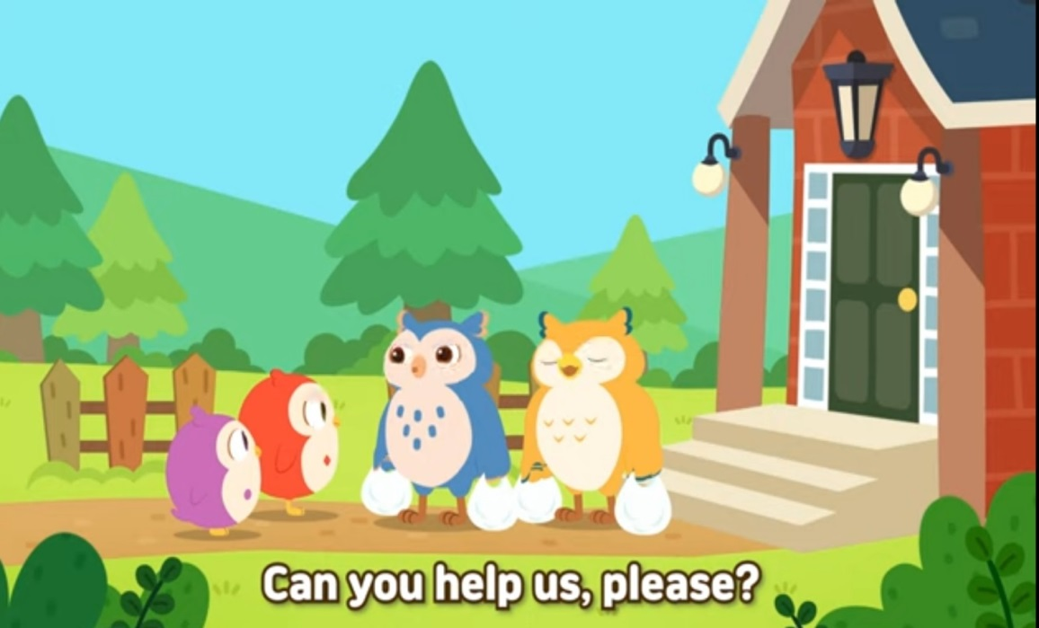
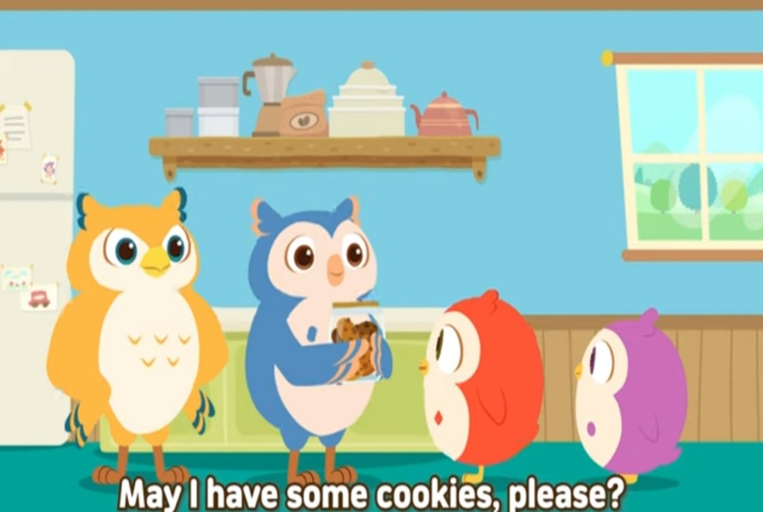

Say please when you want something
Say please when you need someone to help.

Slide 5
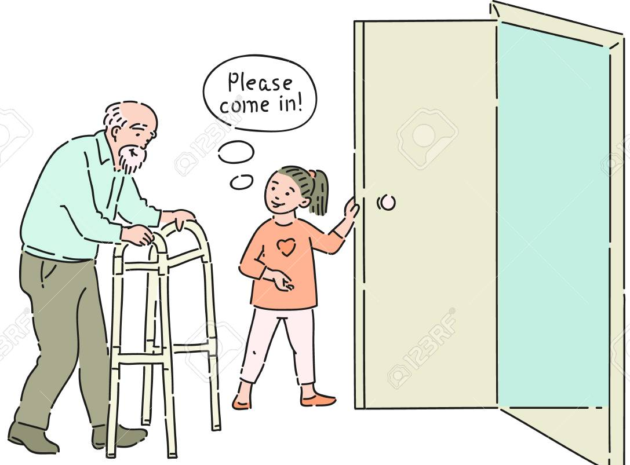
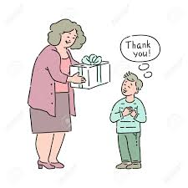
Please come inside.
Please take ,
this is for you.

Slide 6
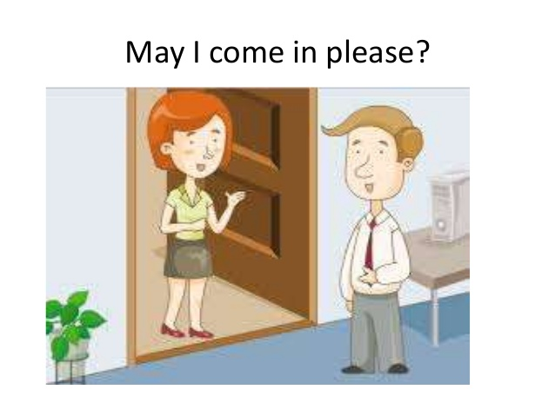
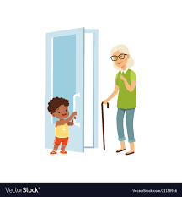
May I come in please?
Please come inside.

Slide 7
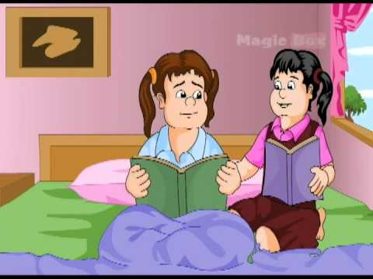
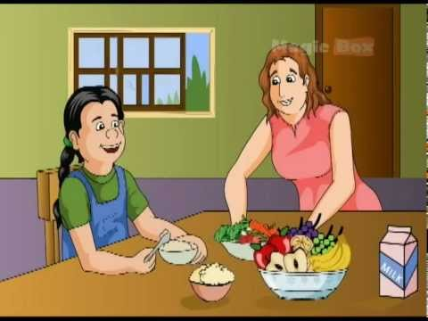
Please show your book.
Mama Please give some curry.

Slide 8
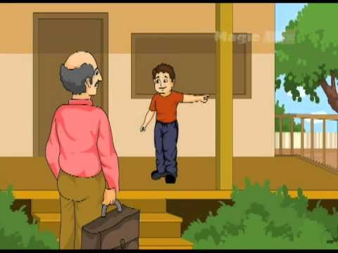
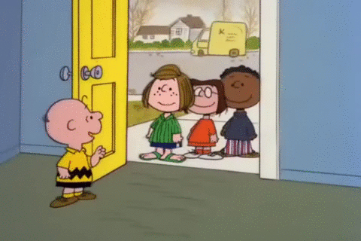
Uncle Please come,
this is my house.
Please come inside.

Slide 9
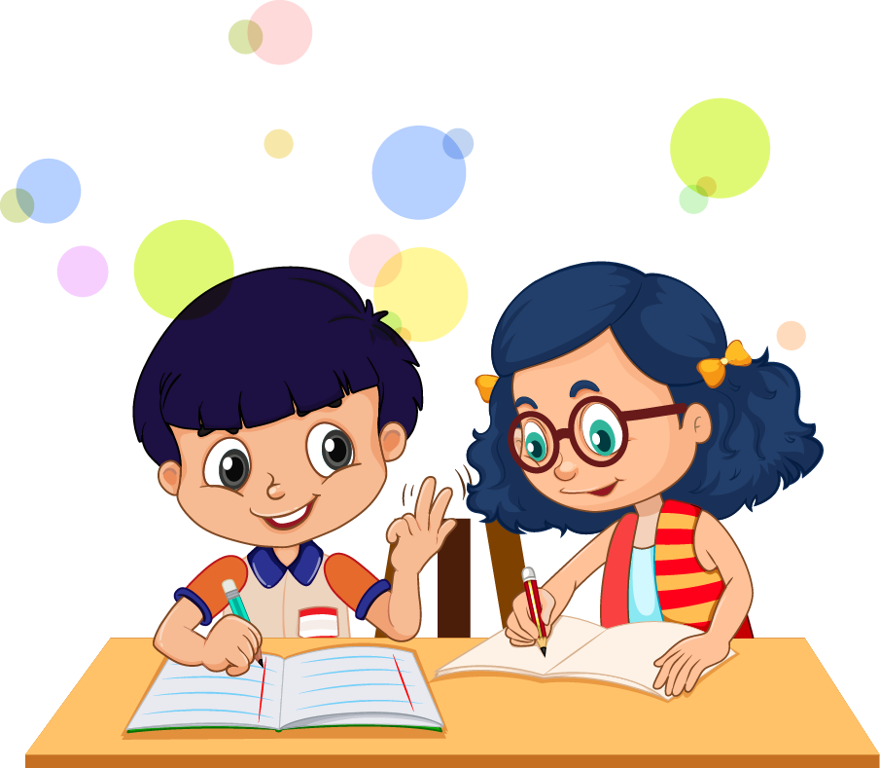
Will you give
me your
pencil
please ?

Slide 10
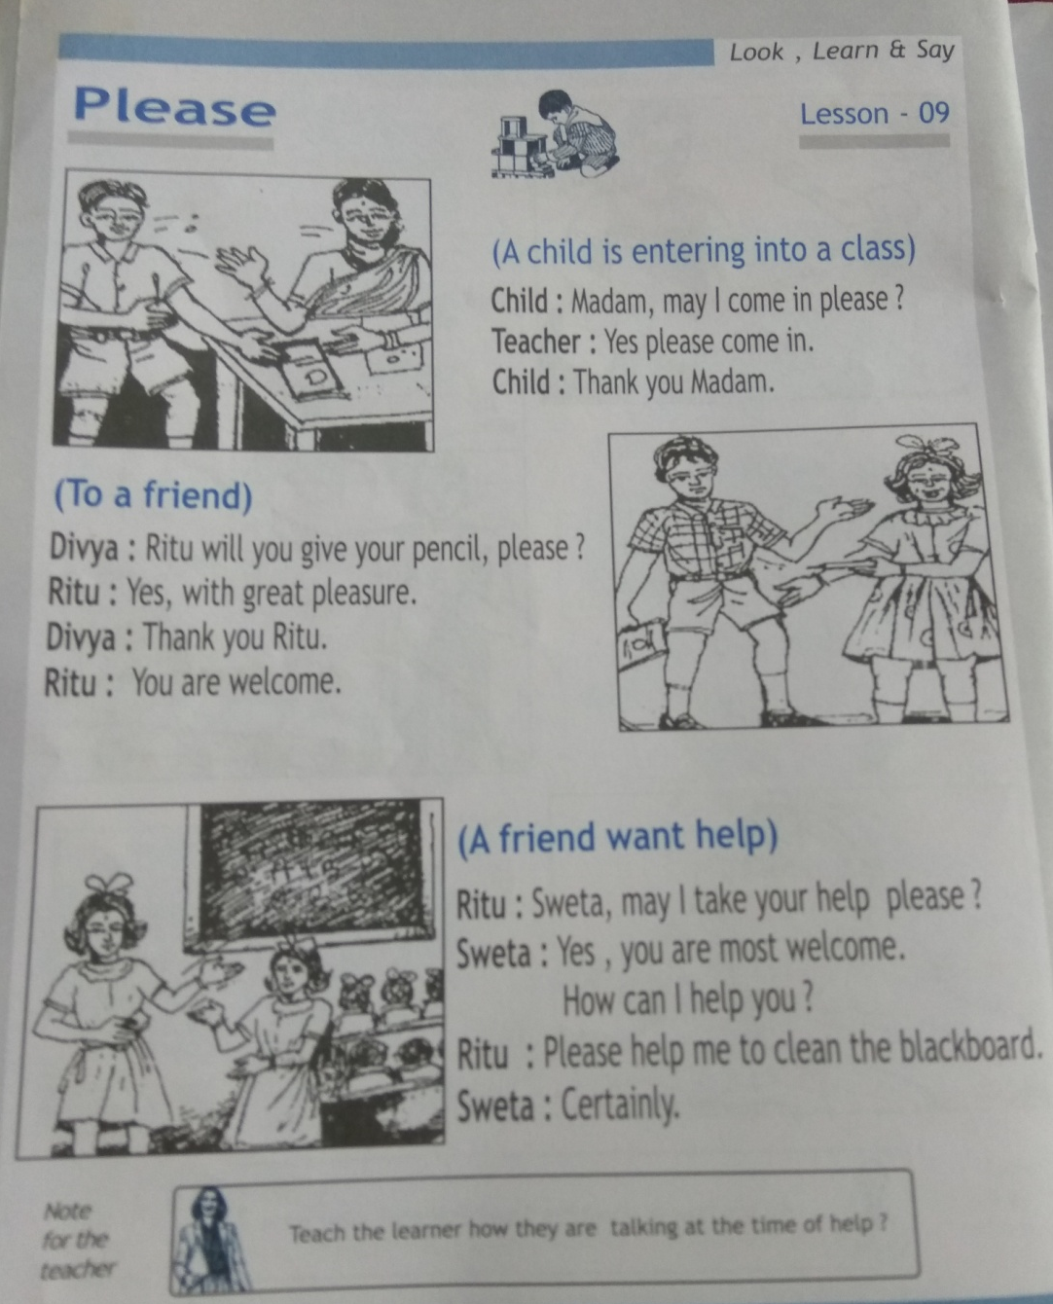
HOME ASSIGNMENT-Learn and practice the use of the golden word PLEASE in your day to day activties.

Slide 11

THANKING YOU
ODM EDUCATIONAL GROUP

