Slide 1


SESSION NO-15
CLASS:II
SUBJECT : COMPUTER
CHAPTER NUMBER:2
CHAPTER NAME : PARTS OF A COMPUTER
SUB TOPIC: REVISION ORAL

Slide 2

LEARNING OBJECTIVE:
To enable learners to revise on Input – Process – Output Cycle, Parts of a computer.

Slide 3

Tick the correct answer:-
I use light instead of a ball for the movement of mouse pointer, who I am ? (Ball mouse/Joystick/ Optical mouse)
I am used to record user’s voice and different sounds into a computer. Who I am ? (Speaker/ Microphone/ Headphones)
Choose the odd one out ( Flash drive / Hard disk/ Jump drive) .
The printed copy on a paper is called (soft copy / hard copy/ record copy)
Choose the odd one out. ( thumb drive /monitor/ CD )
√
√
√
√
√

Slide 4
Tick the correct answer:-
I am that part of computer which acts as human brain, who I am ? (Ball mouse/Joystick/ CPU)
I am the final result displayed on the monitor. Who I am ? (Process/ Output/ Input)
I look like a TV screen( Flash drive , monitor, keyboard) .
√
√
√

Slide 5
Fill in the blanks
Full form of CD is _______________.
____________ is used for transferring data from one computer to another.
The CD drive is fixed in the _________.
Working on the data is called __________
Compact Disk
Pen drive
CPU
processing

Slide 6
Fill in the blanks
Monitor and printer are most common ___________ devices.
Data can be letters, ___________ , Pictures and ___________.
_____________ allows us to listen to music and hear the sound effects stored in a computer without disturbing others.
A standard keyboard has _________ keys.
Output
numbers
instructions
Headphones
104

Slide 7
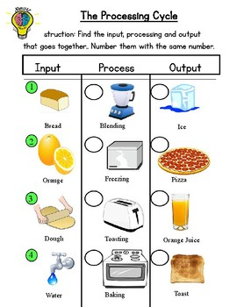
2
4
4
3
1
2
3
1

Slide 8
Choose the correct option
What are the data and instructions together known as? (Process/Input/ Output)
(CPU/ Monitor/ Printer) acts as human brain.
Choose the odd one out ( UPS , printer, monitor) .
Working on data is called (Input /Process/ Output)
Choose the odd one out. (mouse/monitor/ keyboard)
√
√
√
√
√

Slide 9
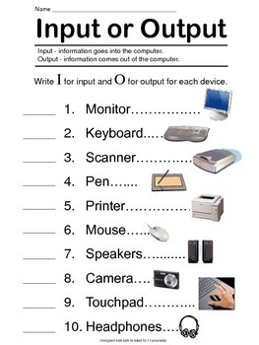

Slide 10
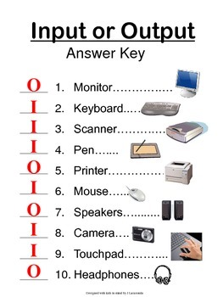

Slide 11
State true / False:-
A keyboard has many buttons called letters.
A scroll mouse is of three types.
Microphone is used to listen to music.
CD is a shiny disk that runs on a CD drive.
We input data using monitor.
A computer cannot work on its own.
The desktop holds many lines called icons.
False
False
False
True
False
True
False

Slide 12
Answer in one word or one sentence.
1. What is Title bar?
Ans) The topmost blue bar of the WordPad window.
2. What is the first screen on starting a computer called?
Ans) Desktop.
3. Which part of computer displays the output?
Ans) Monitor
4. What is the final result displayed on screen called?
Ans) Output
5. Which part of the computer acts like human brain?
Ans) Central processing unit.

Slide 13
Answer in one word or one sentence.
6. What is hard copy?
Ans) The printed copy on a paper.
7. What is the first screen on starting a computer called?
Ans) Desktop.
8. Which device helps us to listen to music without disturbing others?
Ans) Headphones
9. Which part of mouse helps to move a page up and down?
Ans) Scroll wheel
10. What is the use of keyboard?
Ans) To type letters, words, numbers and special symbols.

Slide 14
HOME WORK :
Learn Ch 2, 3 and 4

Slide 15
LEARNING OUTCOME:
Learners will able to revise on how a computer works, also the various parts of a computer through this revision.

Slide 16
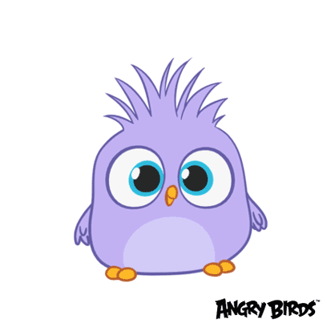
THANKING YOU
ODM EDUCATIONAL GROUP

