Slide 1


SESSION NO-13
CLASS:II
SUBJECT : COMPUTER
CHAPTER NUMBER:2
CHAPTER NAME : PARTS OF A COMPUTER
SUB TOPIC: REVISION

Slide 2

LEARNING OBJECTIVE:
To enable learners to revise on Input – Process – Output Cycle, Parts of a computer.

Slide 3

Tick the correct answer:-
I use light instead of a ball for the movement of mouse pointer, who I am ? (Ball mouse/Joystick/ Optical mouse)
I am used to record user’s voice and different sounds into a computer. Who I am ? (Speaker/ Microphone/ Headphones)
Choose the odd one out ( Flash drive / Hard disk/ Jump drive) .
The printed copy on a paper is called (soft copy / hard copy/ record copy)
Choose the odd one out. ( thumb drive /monitor/ CD )
√
√
√
√
√

Slide 4
Tick the correct answer:-
I am that part of computer which acts as human brain, who I am ? (Ball mouse/Joystick/ CPU)
I am the final result displayed on the monitor. Who I am ? (Process/ Output/ Input)
I look like a TV screen( Flash drive , monitor, keyboard) .
√
√
√

Slide 5
Fill in the blanks
Full form of CD is _______________.
____________ is used for transferring data from one computer to another.
The CD drive is fixed in the _________.
Working on the data is called __________
Compact Disk
Pen drive
CPU
processing

Slide 6
Fill in the blanks
Monitor and printer are most common ___________ devices.
Data can be letters, ___________ , Pictures and ___________.
_____________ allows us to listen to music and hear the sound effects stored in a computer without disturbing others.
A standard keyboard has _________ keys.
Output
numbers
instructions
Headphones
104

Slide 7
HOME WORK :
Learn Ch 2, 3 and 4

Slide 8
LEARNING OUTCOME:
Learners will able to revise on how a computer works, also the various parts of a computer through this revision.

Slide 9
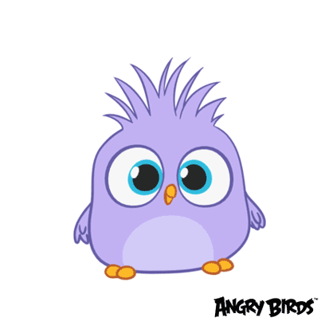
THANKING YOU
ODM EDUCATIONAL GROUP

