Slide 1


SESSION NO-12
CLASS:II
SUBJECT : COMPUTER
CHAPTER NUMBER:3
CHAPTER NAME : HOW DOES A COMPUTER WORK
SUB TOPIC: REVISION

Slide 2

LEARNING OBJECTIVE:
To enable learners to revise on Input – Process – Output Cycle.

Slide 3

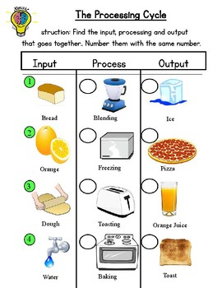
2
4
4
3
1
2
3
1

Slide 4
Choose the correct option
What are the data and instructions together known as? (Process/Input/ Output)
(CPU/ Monitor/ Printer) acts as human brain.
Choose the odd one out ( UPS , printer, monitor) .
Working on data is called (Input /Process/ Output)
Choose the odd one out. (mouse/monitor/ keyboard)
√
√
√
√
√

Slide 5
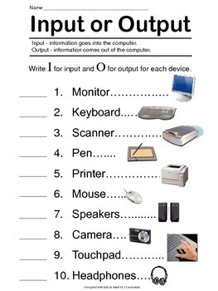

Slide 6
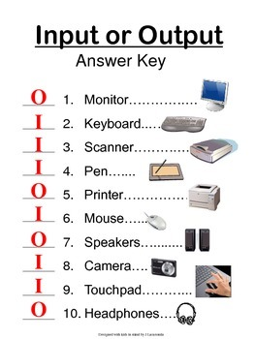

Slide 7
LEARNING OUTCOME:
Learners will able to revise on how a computer works through this revision.

Slide 8

THANKING YOU
ODM EDUCATIONAL GROUP

