Slide 1


SESSION NO-10
CLASS:II
SUBJECT : COMPUTER
CHAPTER NUMBER:5
CHAPTER NAME :OPERATING A COMPUTER
SUB TOPIC: REVISION

Slide 2

LEARNING OBJECTIVE:
To enable learners to revise on how to operate a computer.

Slide 3

Write True/ False:-
You can read the items even if the WordPad window is not active.
Windows 10 is a control button.
Desktop is the first screen that appears on starting a computer.
Title bar is present at the bottom of the desktop.
CPU makes a computer work when the electricity goes off.
Small pictures on desktop are called icons.
FALSE
FALSE
TRUE
FALSE
FALSE
TRUE

Slide 4
ANSWER IN ONE WORD :-
What is the program that makes a computer work called?
Which device supplies power to computer when electricity goes off?
After start button, which button we will select to shut down a computer?
What is the name of first screen that appears when we start a computer?
What is the name of thin bar at the bottom of desktop called?
What is the topmost blue bar of WordPad window called?
What are the small pictures on desktop called?
WINDOWS 10
UPS
POWER
DESKTOP
TASKBAR
TITLEBAR
ICONS

Slide 5
HOMEWORK
Write down the steps to switch on a computer

Slide 6
LEARNING OUTCOME:
Learners will able to revise on operating a computer through this revision.

Slide 7
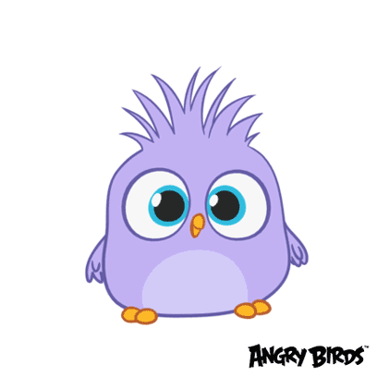
THANKING YOU
ODM EDUCATIONAL GROUP

