Slide 1


SESSION NO-9
CLASS:V
SUBJECT : COMPUTER
CHAPTER NUMBER:6
CHAPTER NAME : FORMATTING A PRESENTATION
SUB TOPIC: INSERTING SMART ART GRAPHIC, INSERTING A TABLE, INSERTING A CHART

Slide 2

LEARNING OBJECTIVE:
To enable students to know about formatting a presentation.

Slide 3
What is a SmartArt ?
SmartArt is a graphics tool that allows you to present data or information with graphics instead of just using text.
It contains a variety of graphical layouts, like pyramids, list, hierarchy, matrix etc to display data in a presentation.

Slide 4
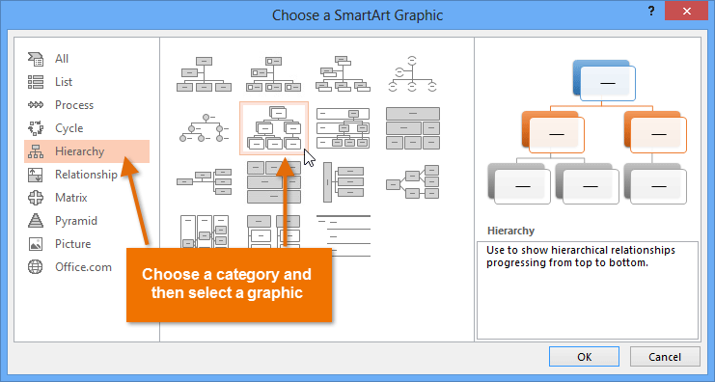

Slide 5
What is a table?
A table is a grid of cells arranged in rows and columns.
It is very useful in organising and representing the data in an effective manner.

Slide 6
When we insert a table, TABLE TOOL appears.
It has various tools and commands such as Table styles, shading, border etc

Slide 7
What is a chart?
Chart is an effective way to display data in a graphical and pictorial form.

Slide 8
Uses of charts :-
Charts make it easier to show comparisons and growth, relationship among the values and trends in data.
Charts provide an accurate analysis of the information.

Slide 9
LEARNING OUTCOME:
Students will come to know more about formatting PowerPoint 2016.

Slide 10

THANKING YOU
ODM EDUCATIONAL GROUP

